Slide 1
Using Stakeholder Power Analysis to Map Incentives
Purpose: In the context of applied political economy analysis (PEA), stakeholder power analysis (SPA) is a tool used during and beyond the baseline period to map and analyze how competing or aligned incentives of key actors influence the systems change objectives (SCOs) of ACDI/VOCA programs.
Overview: By using SPA, ACDI/VOCA can:
Identify/brainstorm key informants to interview.
Map and analyze how the behaviors and incentives of key actors influence the core questions and change over time.
Determine which key actors are champions or spoilers of the program’s intended SCOs to help ensure that the right actors are engaged at the right time and with the right messaging/strategy.
Identify where incentives of key actors align or conflict to determine the degree to which interventions and activities can succeed at influencing the behaviors of each key actor.
SPA has two components: a stakeholder power table and a stakeholder power matrix. After completing the table, the matrix helps map, with greater accuracy, the degree to which key actors are champions, spoilers, or fence-sitters in efforts to address the development problem. This can inform strategies for steering key actors toward more enabling pathways for change.
For example, a finance minister may have significant "influence" in decisions related to domestically funding a specific SCO championed by an ACDI/VOCA program (e.g., establishing a regulatory body for agricultural input markets). However, if establishing a regulatory body lacks political support (e.g., from the Prime Minister and Parliament), the finance minister's degree of "stake" in this SCO will be low. Using a stakeholder power table and matrix, staff can strategize how to influence dynamics in the operating environment that incentivize more enabling conditions for the regulatory body to move forward.
Regarding scoring, various methods can be used to weigh influence and stake in the stakeholder power table. Whether using numeric (e.g., a scale of 1 to 5) or adjectival (e.g., low, medium, high) ratings, it is important to provide guidance with a definition for each score. Staff are encouraged to work with program leadership to determine the best weighting system and definitions. Regardless of the method used, the stakeholder table is helpful for first determining the correct quadrant to position the stakeholder (high influence-high stake, high influence-low stake, low influence-low stake, low influence-high stake). The matrix is then used to pinpoint where specifically the stakeholder should be positioned in that quadrant in relation to other stakeholders based on discussions among staff.
When to Use SPA: An initial SPA is typically completed in conjunction with a baseline PEA. It should then be updated throughout the program cycle, especially as new stakeholders relevant to the program are identified and more is learned through various data points (e.g., one-on-one meetings, mentions in the media, career changes, information shared about them by other stakeholders, etc.). SPA works best when stakeholder power tables and matrices are as focused as possible. For example, program teams can develop a table and matrix for each SCO or for each issue impacting an SCO.
Users: Lead PEA expert or firm, subject matter experts/consultants involved in the analysis, Chief of Party, project staff, MEL staff
Steps for Completing SPA: The checklist on the next page includes the steps for completing a stakeholder power table and matrix.
Page 1 of 3

Slide 2
Using Stakeholder Power Analysis to Map Incentives
Stakeholder Power Table
Identify internal ACDI/VOCA staff (e.g., outcome/policy lead) or an outside firm to develop and manage updates to the SPA
In the first column (1) of the stakeholder power table, identify/update all known key actors (one per row) influencing or being influenced by the issue(s) / intended development outcome(s) that the project aims to address. A key actor can be an individual, group, ministry, department, etc. However, SPA is more nuanced and actionable when it focuses on individuals.
Rank each key actor’s level of influence (2) and degree of stake (3) in relation to the issue / development outcome on a scale of high, medium, or low.
Analyze and list the assumed incentives (4) and disincentives (5) of each key actor to support or resist efforts to address the development program.
**Note: Other versions of the stakeholder power table consolidate columns 4 and 5 into a single column with a brief blurb for each row summarizing the incentives that justify the rankings given for the key actor’s level of influence and degree of stake.
Key actor
Level of
Influence
Degree
of Stake
Incentives
Disincentives
1
2
3
4
5
Stakeholder Power Matrix
Map each key actor’s specific location in one of the four quadrant.
Identify trends (e.g., outliers and groups of actors) that help explain if one or more stakeholders share or lack incentives to spoil or champion an intended development outcome.
High
Stakeholder 1
GOAL
(high support and high influence)
Perceived Support
Stakeholder 2
Stakeholder 3
Low
Low
Perceived Influence
High
Page 2 of 3

Slide 3
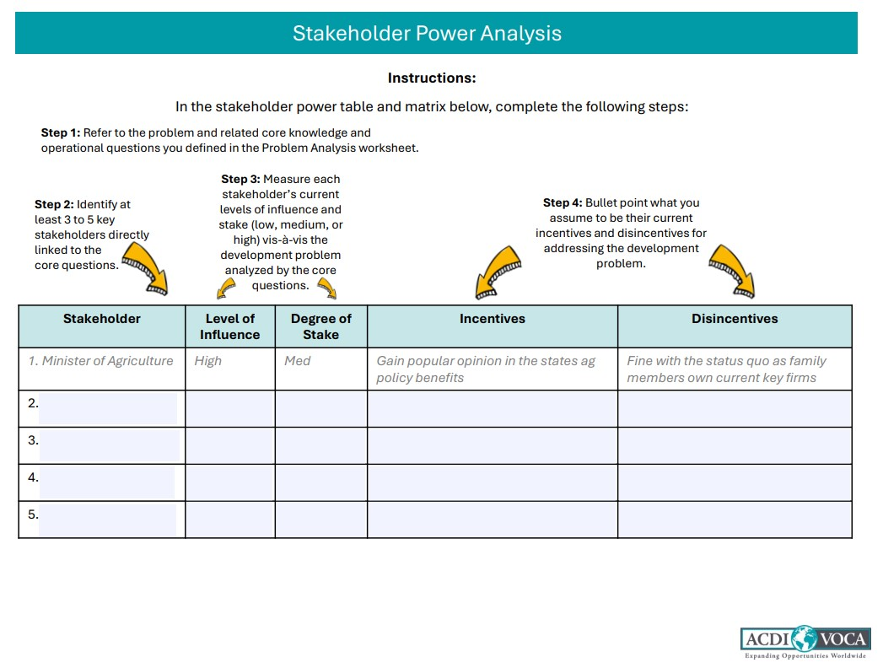
Using Stakeholder Power Analysis to Map Incentives
Stakeholder Power Table
The stakeholder power matrix is premised on the logic that an assets-based/“with the grain” approach to collective action can be sustained as momentum is generated around currently aligned incentives of key actors. For example, it can help a group of champions develop a strategy to reverse the disincentives of an influential spoiler. Alternatively, it can help champions develop a different strategy to circumvent this actor after acknowledging that these disincentives exist and may not be resolved in the near term. Ultimately, the goal is to identify pathways for shifting incentives of key actors into the “high influence” and “high support/stake” quadrant of the power matrix over time.
Worksheet: Stakeholder Power Table and Matrix
Use the online worksheet to complete the steps for the Stakeholder power table and matrix.
Note on Grants: Several key informants interviewed during a PEA and included in the SPA table and matrix may become grantees. Therefore, from a grantmaking perspective, SPA serves as a political economy tool for market research. This helps ACDI/VOCA identify the right grantees to award at the right time based on their current support for and ability to influence a program’s intended development outcome(s). When structuring grant agreements, ACDI/VOCA can use a “small bets” approach to test the political commitments made by key stakeholders identified through SPA, ensuring their commitments are backed up with action and locally leveraged resources.
Note on Format of SPA: Different software can be used to develop SPA tables and matrices, depending on the requirements for graphics and presentation. At a basic level, Microsoft Word and Excel work well for SPA tables and matrices, respectively. In Excel, borders can be used to create the matrix graph. Text boxes (one for each key actor) can then be overlaid on the graph and dragged to the appropriate position in one of the four quadrants. Regardless of the methods used, the format and software should be as simple as possible to enable program teams to update it themselves.
This guidance was developed for ACDI/VOCA’s internal use through a consultancy with Adapt Consulting. For any questions, contact Ydun Donahoe.
Page 3 of 3

