Slide 1
Adapting to crisis: ACDI/VOCA's programming experience in Burkina Faso
Presentation for the Foire aux Savoirs
December 12, 2023

Slide 2
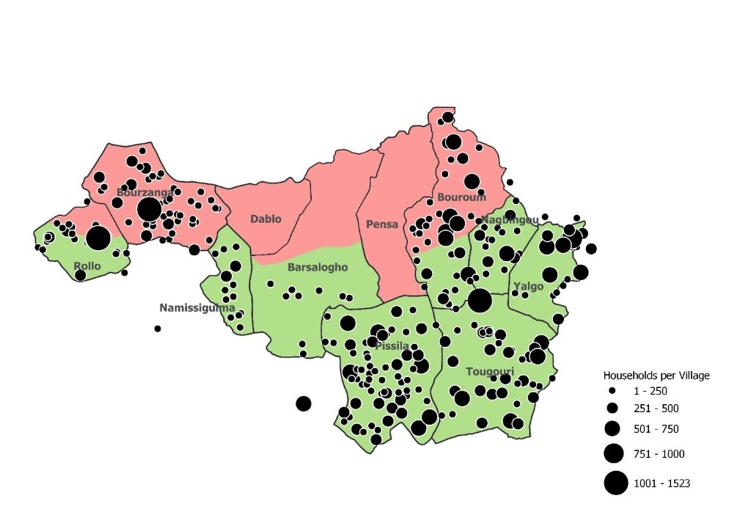
Project overview
Funded by USAID and implemented by ACDI/VOCA
Duration: October 2018 - September 2023 + sustainability period Oct 2023 - Sep 2025
Budget: 38.4 billion FCFA / $64,000,000
11 target communes: Pissila, Tougouri, Yalgo, Bouroum, Nagbingou, Barsalogho, Namissiguima, Rollo, Pensa, Dablo, Bourzanga
International partners: Save the Children and Tufts University
Local partners: APIL, OCADES, ATAD, AZND, ADSN

Slide 3
Changes in the Centre Nord Region 2018 to 2022
Closure of markets, schools and health centers
Influx of displaced persons
Lean season
Violent conflicts between communities
Ecological stress
Lowering water table and drying wells
Assassination of community leaders
Loss of grazing areas
Economic tensions
S E V E R I T Y
Loss of assets
Grain price inflation
Locust attacks
New violent religious discourse
Weak community organizations
Social/political tensions
Epidemics
Gender-based violence
Conflicts over natural resources
Fluctuating livestock prices
Regional and international conflicts
Animal diseases
F R E Q U E N C E
Notes:
Animation
Black text - Shock and stress in the proposal at USAID (2018)
Red text - Shocks and stresses present at the end of FY2022. There has been a significant increase in the number of shocks and stresses, as well as in their frequency and severity.
This changing context has necessitated collaboration, adaptation and resilience in order to reduce the loss of development gains and stabilize target populations.

Slide 4
Critical adaptation periods
Strategic
Programmatic
Technical
Security
Meeting new humanitarian needs
Developing coping skills
Building integrated assemblies (approaches and technologies)
Meeting the challenges of reduced freedom of movement
2023
2022
2021
2020

Slide 5
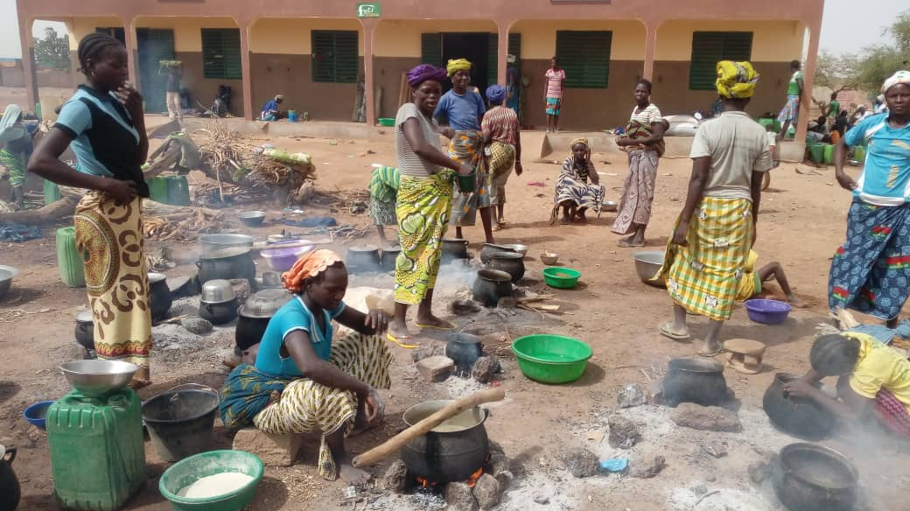
ViMPlus: Technical sequencing from 2020 to 2023

Slide 6
Sequencing in the North Central context
2020
Recovery and adaptation
Recovery
Cash transfers, vouchers, community consultations
2021
Contingency and capacity-building plan
Layer humanitarian and development programming
Capacity building, social networks, financing mechanisms, technical pilot projects, contingency plans
2022
Development of multi-sector interventions
Resilience capacities
Multi-sector packages, combination of interventions, institutional confidence-building, development of community agents, IDP targeting plan
2023
Autonomy, PAIC, WASH Markets
Community-based solutions
Local leadership, local private services, local initiatives based on local financing, micro-enterprise development, targeting IDPs.
Notes:
2020 - Initial implementation - Stabilize, adapt, thrive; also COVID. Much of the adaptation to COVID had already been necessary to adapt to the safety situation (no group gatherings, difficult to move around, mistrust).

Slide 7
Capacity building and resilience
Individuals and households
Community institutions and households
Systems
Absorptive capacities
Adaptive capacities
Transformative capacities
Voucher programs
Access to water
Sanitation
Money transfer
Malnutrition
Disaster risk management
Asset rebuilding (for IDPs)
Social cohesion
Functionality and operability
Adoption of good agricultural practices
Community planning
Local fundraising
Paid services approaches
Small businesses
Link to private model (YOLSE)
Private mechanism for input access (CIPA)
Local businesses integrating nutrition
Institutionalization of governance documents (DRM plans, land charters, PAIC)

Slide 8
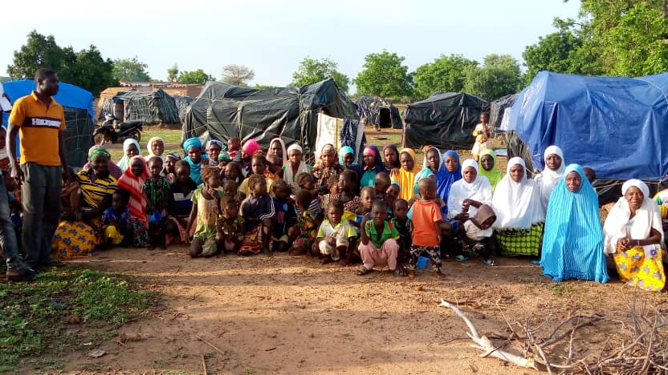
Targeting IDPs in ViMPlus HA-DA-Peace Integration

Slide 9
Adapting ViMPlus to fill the gaps in HA-DA-Peace Nexus
Adapting interventions to the needs of IDPs and host communities
Adapting the target group
Adapting to the scale of the IDP crisis
Adapting to services outside the intervention zone
Meeting new humanitarian needs
Building integrated interventions (approaches and technologies)
Meeting the challenges of remote continuous development work
Developing coping skills
2023
2022
2021
2020
Notes:
2020 - ViMPlus includes house guests in its target group
2021- Contingency planning - Strengthening transfer capacities to enable displaced people to return home
2022 - Integration of IDPs into SCOOPS, GASPAs, social cohesion
2023 - Further integration

Slide 10
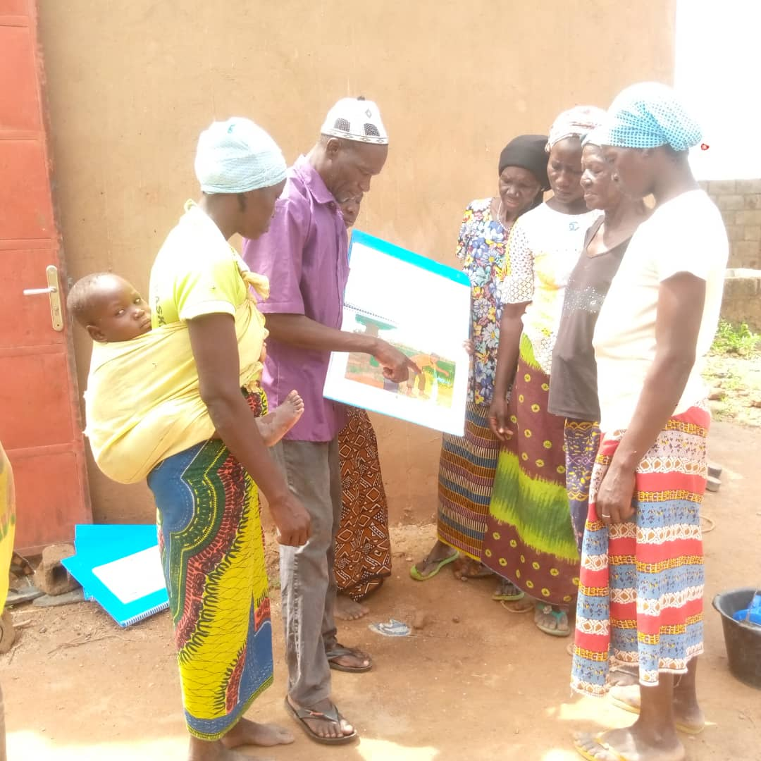
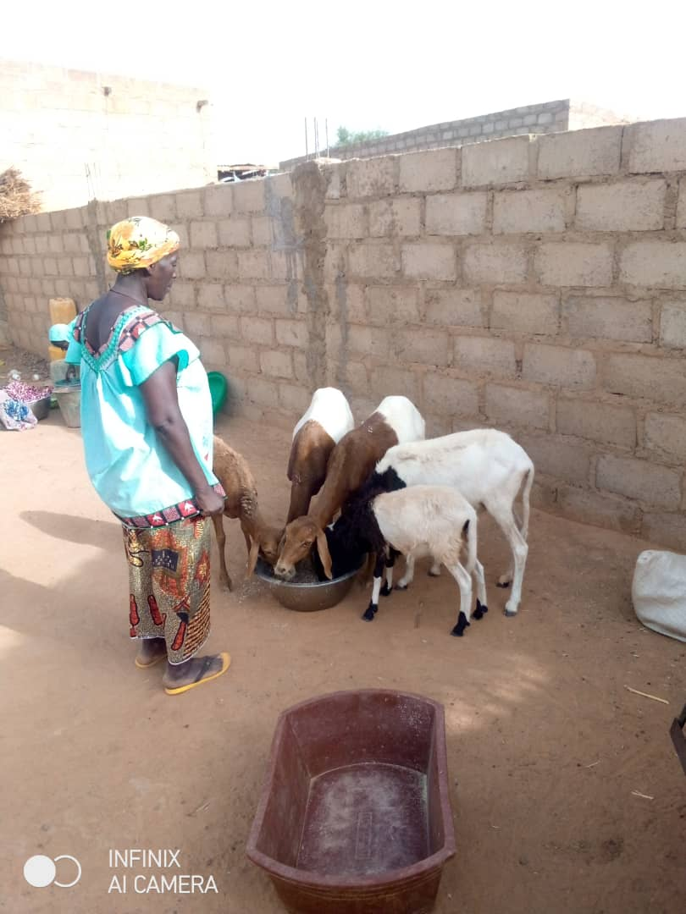
Examples of ViMPlus activities to fill the gaps in AH-AD-Paix for PDI participants
Peaceful integration into the host community
Income-generating activities, rural micro-enterprises and livestock fattening
Rebuilding the herd with breeding units
Access to agricultural inputs through group purchasing and manure production
Screening for child malnutrition (GASPA)
Construction of hand-washing facilities
Notes:
Nexus interventions developed/insured :
Peaceful integration into the host community, including social cohesion and access to resources.
Income generation through income-generating activities and rural microenterprises,
Rebuilding livestock herds through livestock units
Generate income with feeder units
Access to agricultural inputs through group purchasing and mass production of organic manure
Screening displaced children for malnutrition with the support of mother leaders
Construction of hand-washing facilities
Adopting positive health behaviours

Slide 11
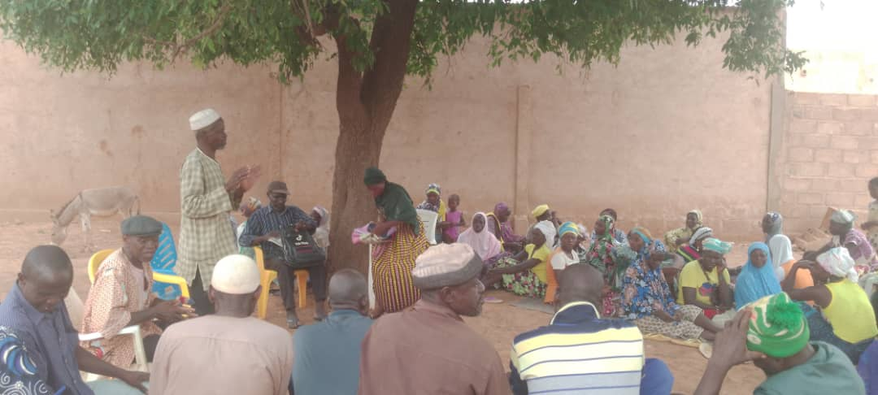
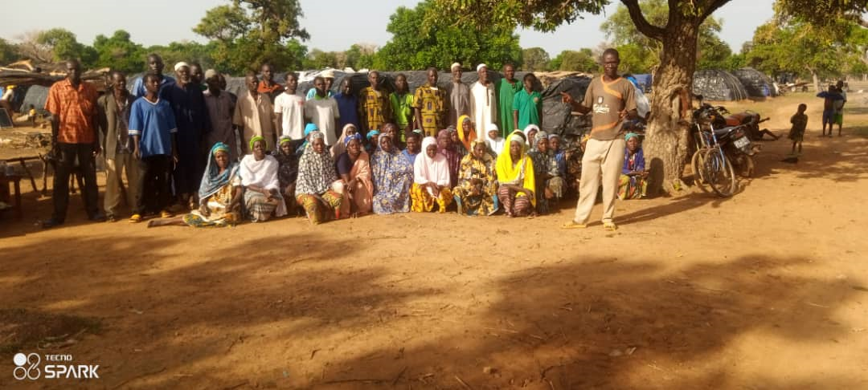
Achievements of PDI participants in 2023
ViMPlus supports displaced organizations: 98 SCOOPS, 33 GPCS and 290 GASPA
Eleven social cohesion committees conducted community dialogues to strengthen cohabitation.
2,184 displaced people benefited from GASPA sessions at their reception sites in the commune of Kaya.
36 SCOOPS have made group purchases of inputs
131 small ruminant units created
10 onion SCOOPS in Kaya produced 600 tons of onions.

Slide 12
Looking to the future
2024: Food safety risks and crises
Decrease in cultivated areas (0.85 ha/household in 2022 vs. 0.40 ha/household in 2023).
Around 85% of project participants are located outside their original census zone.
The season was marked by more than 23 days of drought between mid-August and the end of September.
The duration of the IDPs' move and their living habits suggest that they will remain in the host villages for the long term.
Access to fertilizers, whose prices remain high, and insecurity were the main constraints during the campaign.

Slide 13
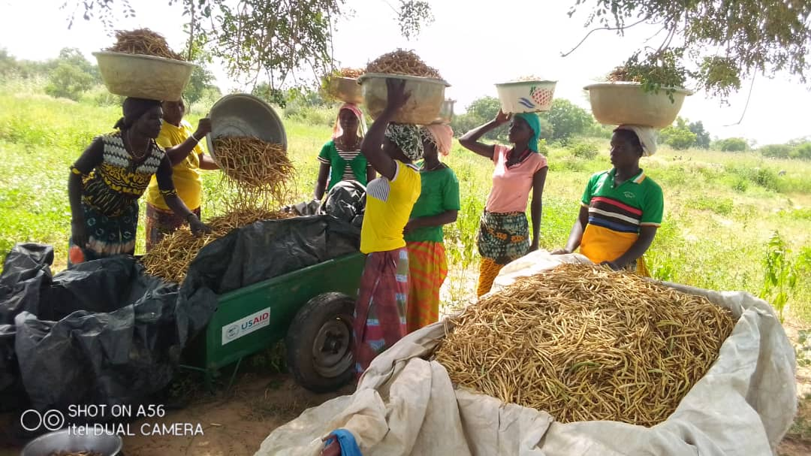
Discussion and Q&A

Slide 14
We envision a world in which people are
empowered to succeed in the global economy.
www.acdivoca.org
50 F Street Northwest, Washington, D.C. 20001
+1 202 469 6000 | acdivoca.org | Follow us @acdivoca

