Slide 1

Victory over Malnutrition Plus Project
(ViMPlus)
Livelihoods

Slide 2
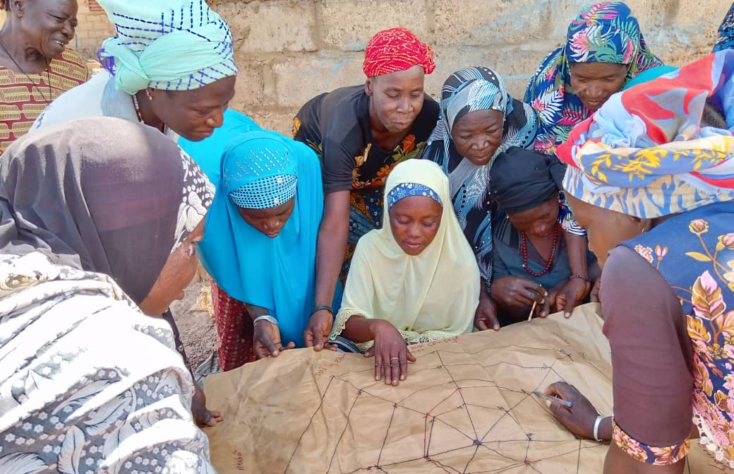
Innovation for Resilience
Farmers' Auxiliary Model for Extension and Advisory Support (PAVAC): a local support system for agricultural producers

Slide 3
Context
Objective: Diversify and increase agricultural production
Strong demand for training and farm advisory support throughout the region
Successful experience of the ViM Project (local trainers)
Research into the sustainability of training/extension and advisory services
Target population: 205,200 producers from 36,000 households
Shrinking state support network
Producers' limited access to local training/extension and advisory services

Slide 4
Objectives
Diversifying and increasing agricultural production
Increase the number of GAP/GLP users
Increase household income
Ensure the sustainability of training/extension and advisory support activities
Increase the adoption rate of GAP/GEP
Increase yields and agricultural production
Improve knowledge of farmers and local agro-ecological systems

Slide 5
System based on the Paysan auxiliare de vulgarisation et d'appui conseil (PAVAC) :
Description of approach
Fundamental principles
Behavior Change Communication
Strategy and implementation tools
2 PAVACs per SCOOP
1,096 PAVACs including 73% women
15% young people

Slide 6
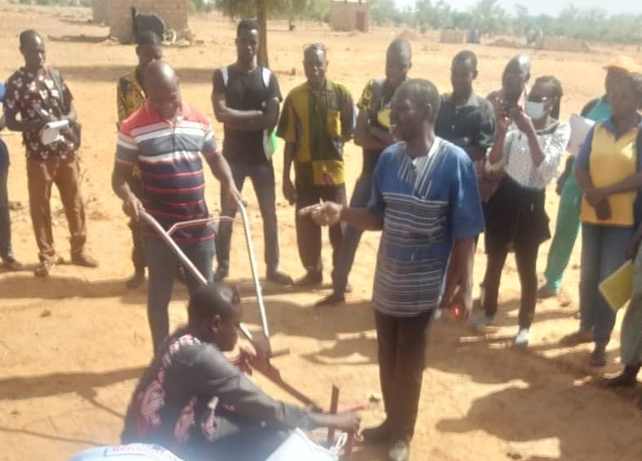
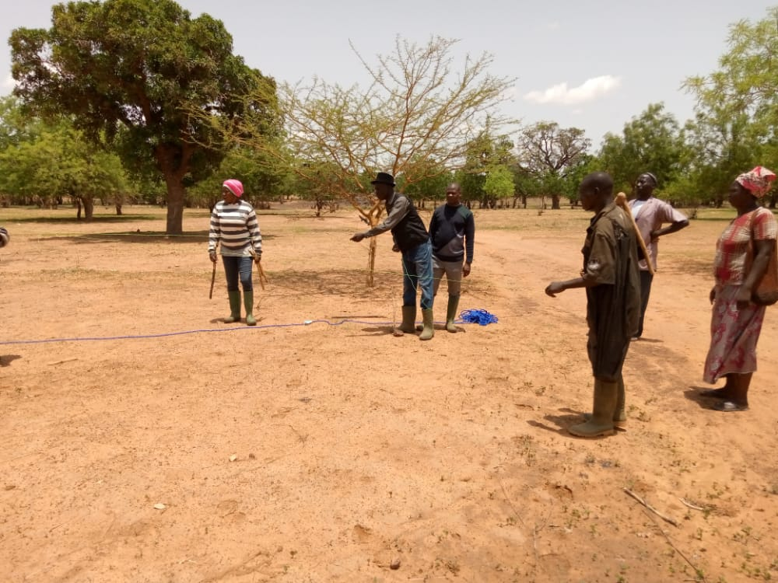
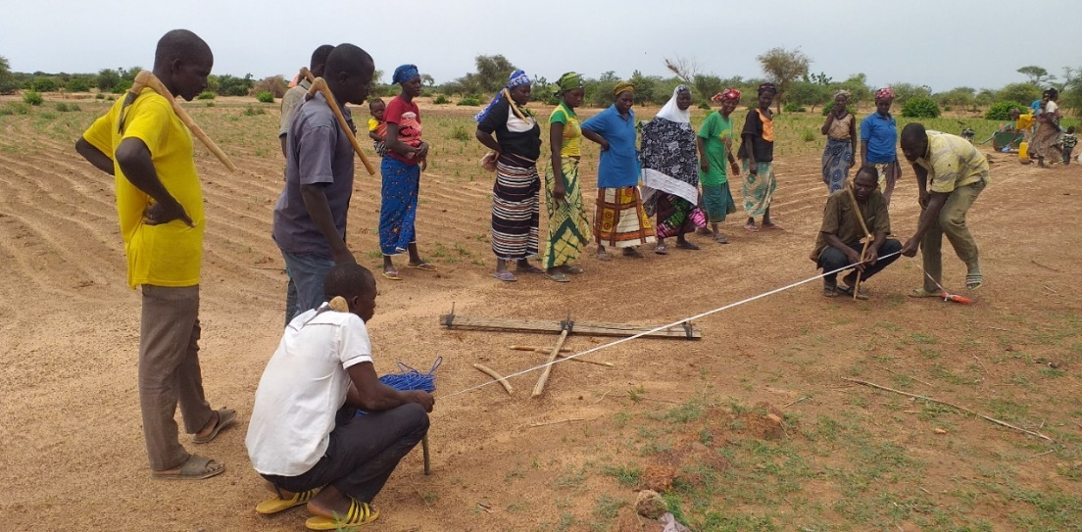
Implementation process (1/2)
PLEP agents train PAVACs
ACDI/VOCA technical staff
trains PLEP agents
Cooperative Societies (SCOOPS)
Paysans de Contact (PC)
PAVAC trains producers

Slide 7
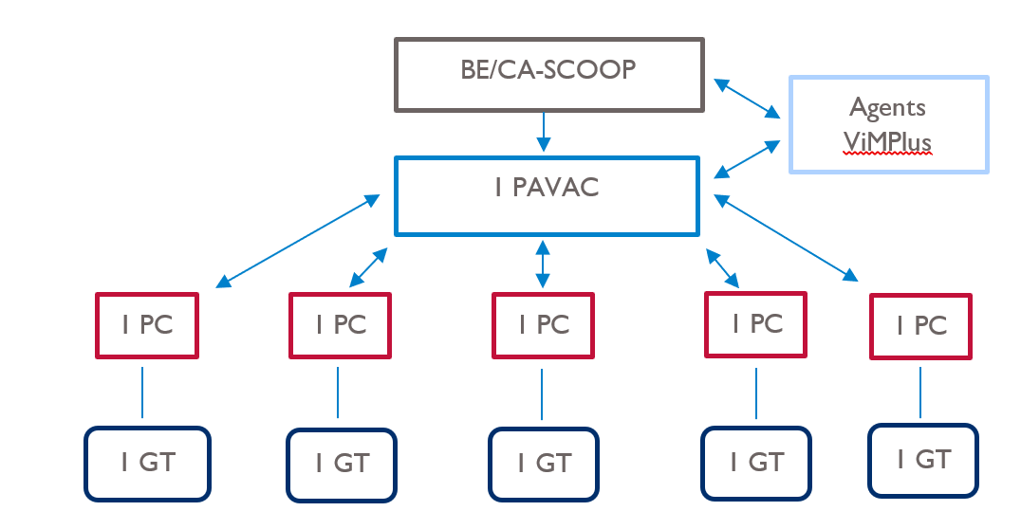
Implementation process (2/2)
BE/CA-SCOOP: Cooperative societies PC: Contact farmers GT: Working group
PAVAC trains producers

Slide 8
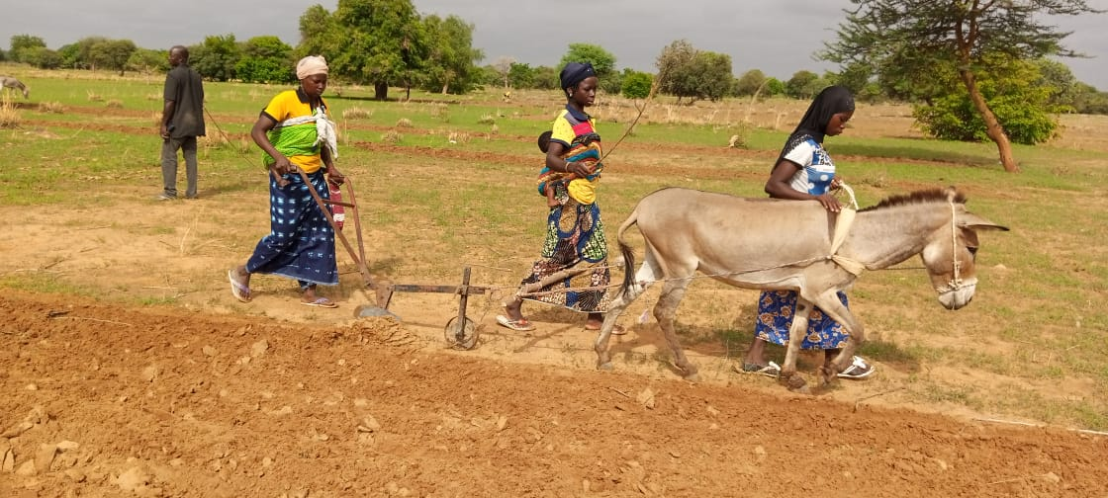
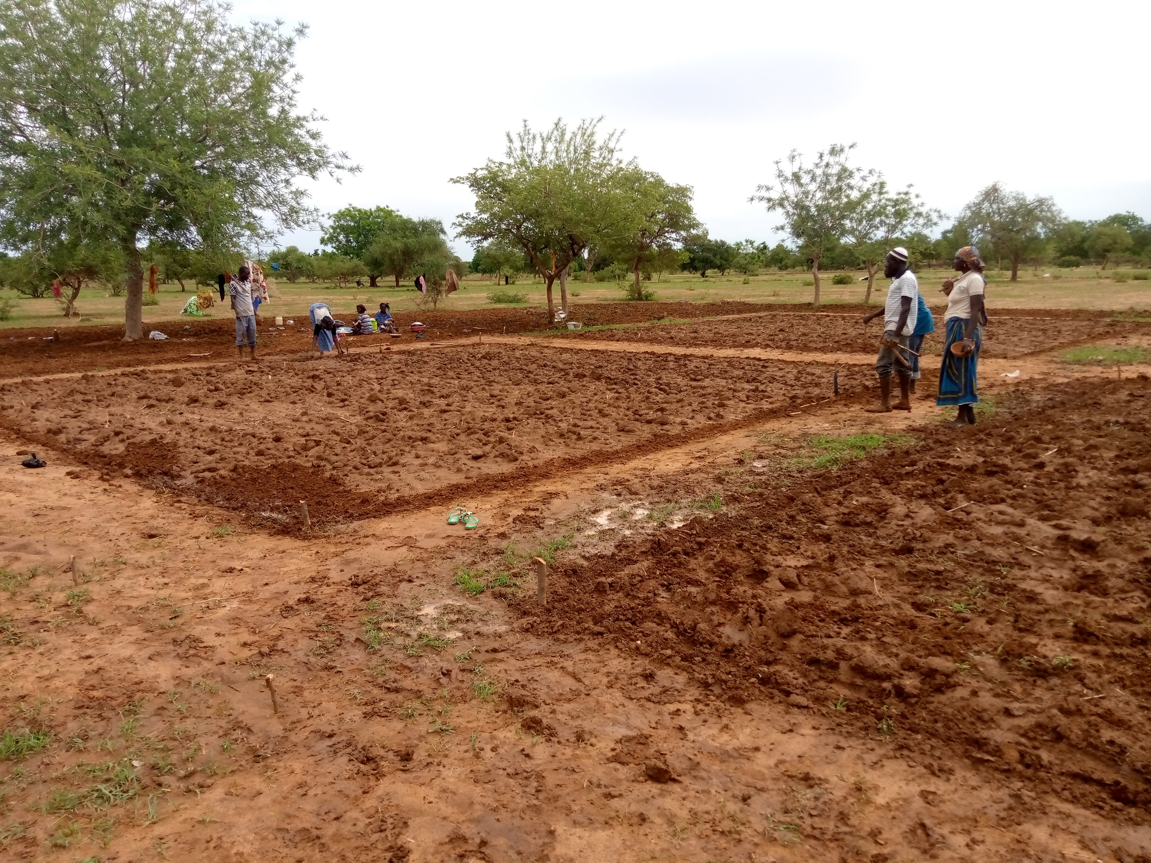
Results (1/3)
Improving SCOOPS governance
Effective appropriation of the training/extension system by PAVACs
87% of producers are satisfied with PAVAC services
Use of ICTs for training, information gathering and sharing has become systematic among stakeholders (PAVAC, PLEP and ACDI/VOCA).
Ploughing a demonstration plot
Sowing a demonstration plot
Notes:
With the support of PAVACs, SCOOPS governance has improved (automation of self-assessments and seasonal programming).
Effective appropriation of the training/extension system by PAVACs. Setting up and running demonstration plots without the physical presence of project staff.
A positive assessment of the quality of services provided by PAVACs. 87% of producers are satisfied with the services provided by PAVAC.
In the security context, the use of ICTs in training, information gathering and sharing between players has become systematic (PAVAC, PLEP and ACDI/VOCA).

Slide 9
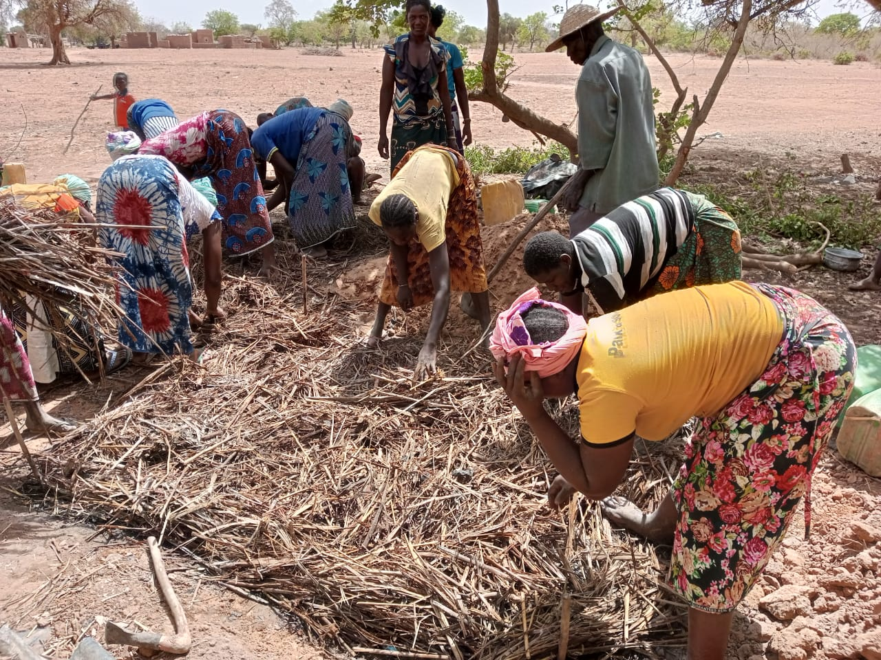
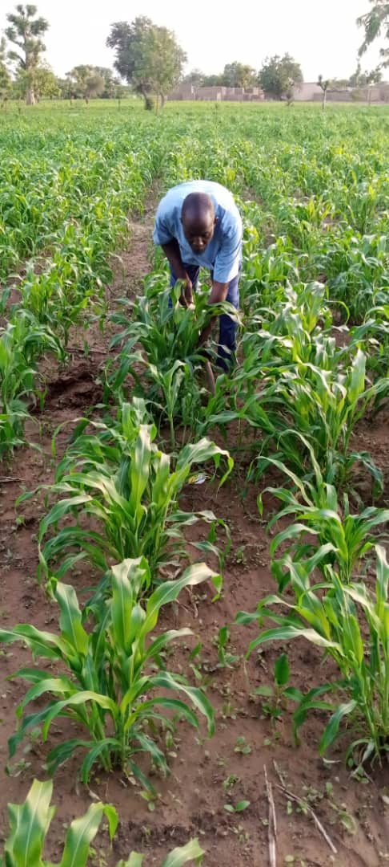
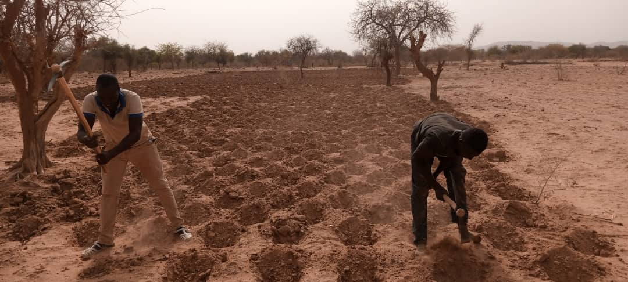
Results (2/3)
93% of growers used at least one improved management technique on their plots during FY23
Implementing good farming practices

Slide 10
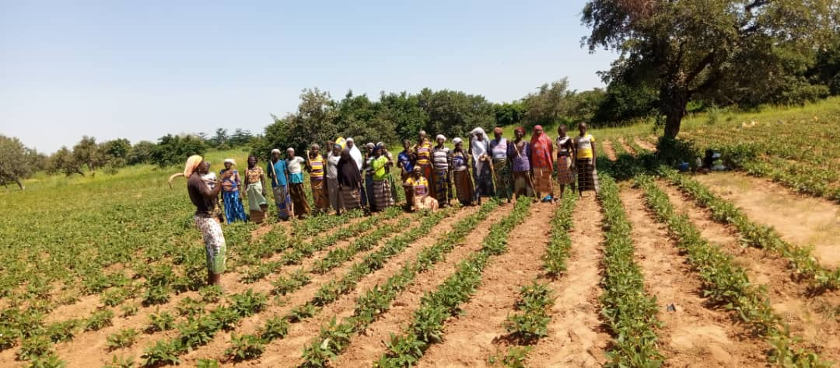
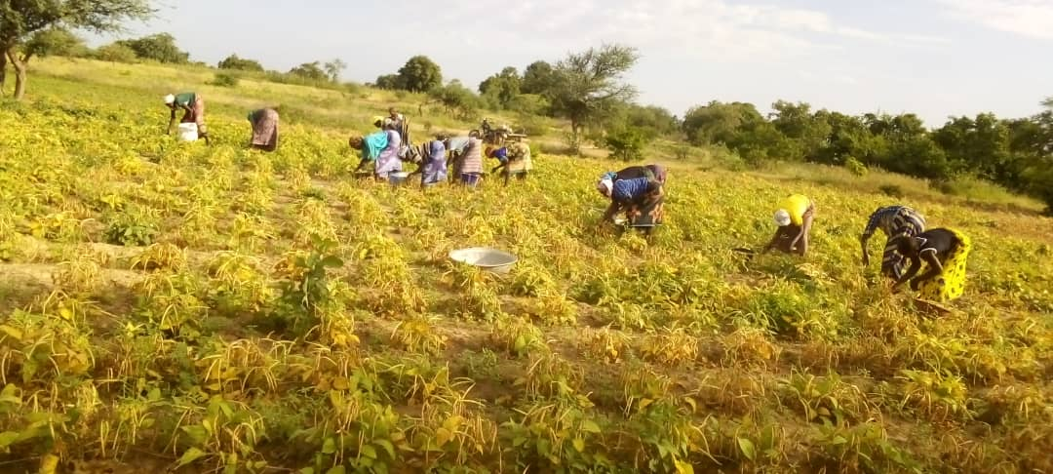
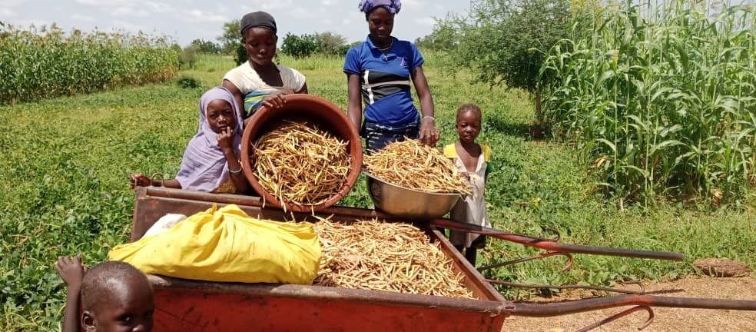
Results (3/3)
Increased agricultural yields.
Guided Tour
Cowpea harvest

Slide 11
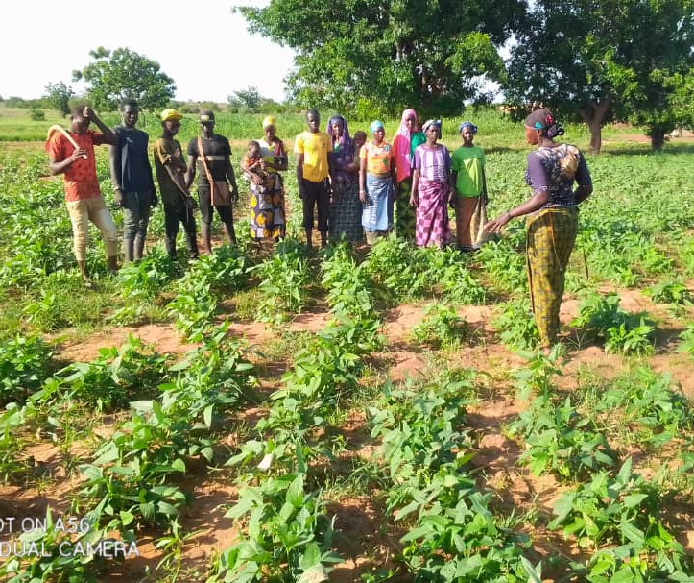
Lessons learned
The quality of PAVAC selection is the key to the success of the experiment
SCOOPS member and PAVAC permanent resident status makes expertise available
Demonstration by evidence and collaborative learning facilitate the adoption of practices
Adapting tools reinforces mastery of techniques and technologies
Combination of hands-on learning and media campaign enhances participant learning
Guided Tour
Notes:
The quality of PAVAC selection is the key to the success of the experiment
SCOOPS member and PAVAC permanent resident status makes expertise available
Demonstration through evidence (Model Farm, Showcase Plot) and collaborative learning (guided tour) facilitate the adoption of practices.
Adapting tools to the language and technical level of farmers, and using voice tutorials via WhatsApp, reinforces the mastery of techniques and technologies.
The combination of hands-on learning and a media campaign with the ULIZA 321 interactive platform, enhances participants' learning.

Slide 12
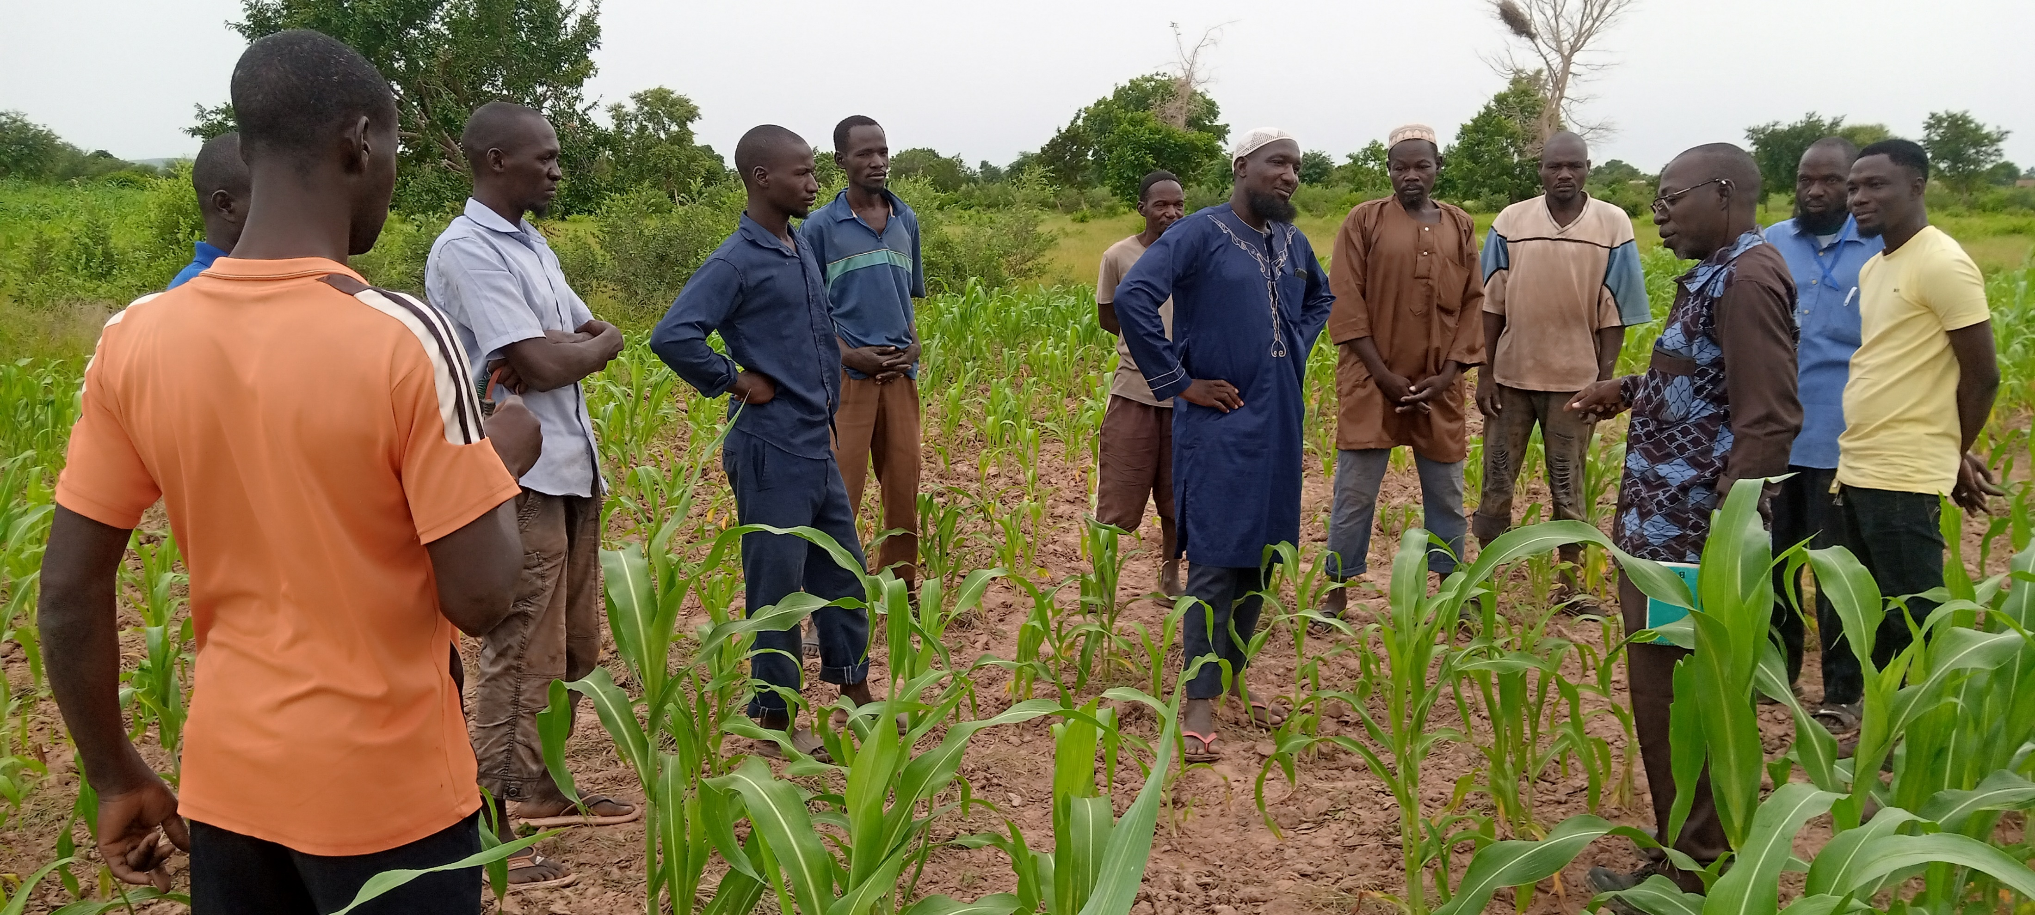
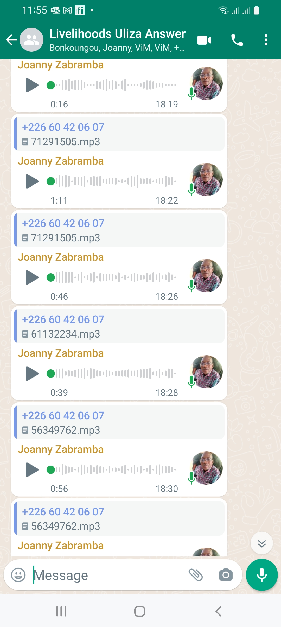
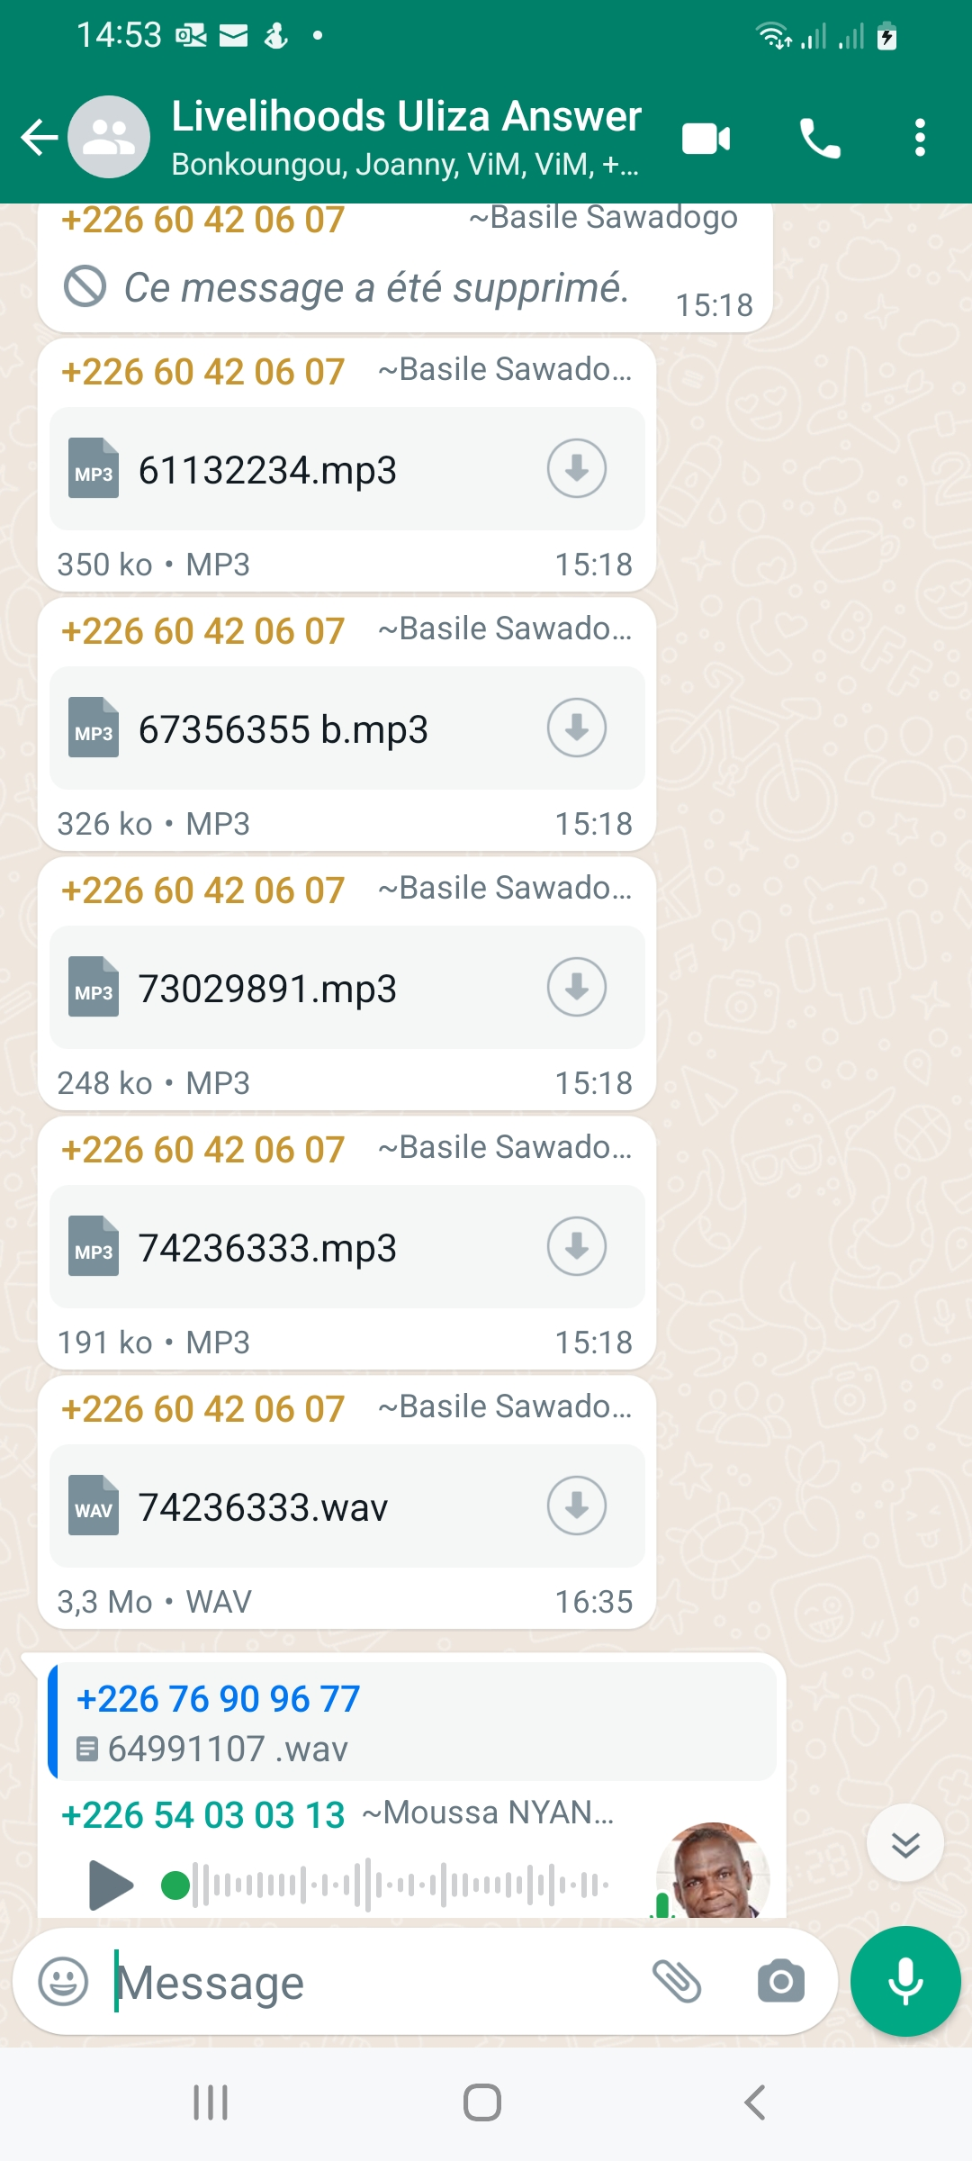
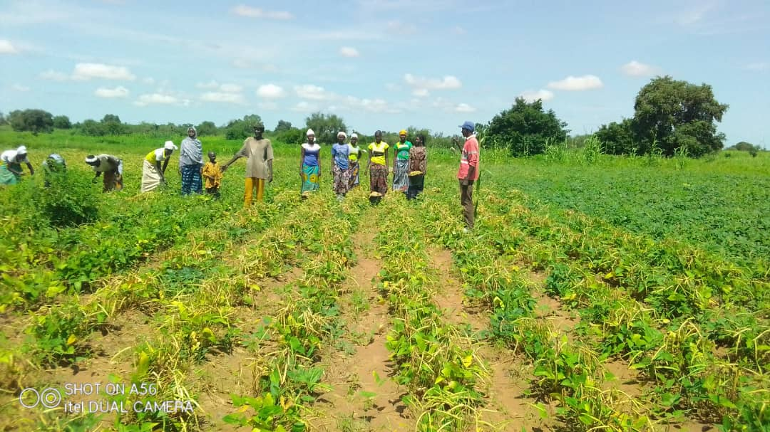
Communication tools
Interactive Radio: Questions & Answers
Supervision trip for senior agricultural production specialist
Guided tour

Slide 13

Sustainability factors (1/2)
Mastery of training/extension and advisory support tools
Good command of adult training/facilitation techniques, proven organizational and leadership skills
Activities piloted for two (2) years by PAVACs, with no direct presence of ViMPlus technicians in the field
Provision of didactic tools for training and advisory support for producers
Producer training
Notes:
PAVACs have mastered the techniques of setting up and running training/extension and advisory support tools;
PAVACs and SCOOPS managers have a good command of adult training/animation techniques, proven skills in organizing and planning activities (action plans) and in leadership;
For two (2) years, PAVACs have successfully piloted training, extension of agricultural techniques and technologies and advisory support for producers, without the direct presence of ViMPlus technicians in the field;
PAVACs have didactic tools for training and advising producers

Slide 14
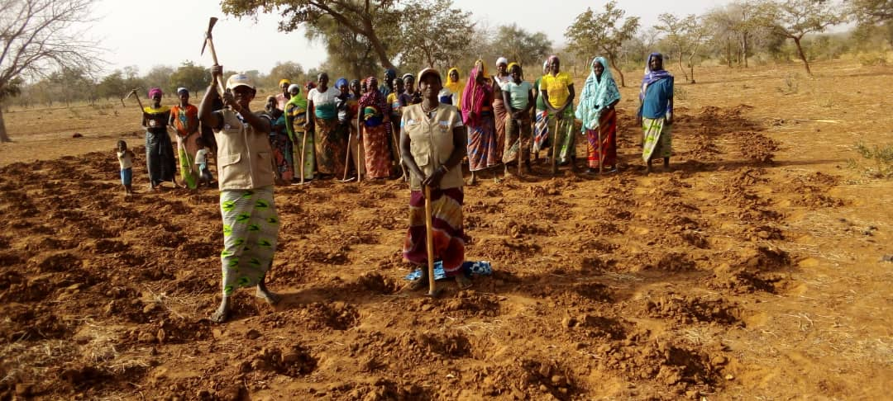
Sustainability factors (2/2)
Provision of production equipment to SCOOPS to put training into practice
Respect and recognition for PAVAC's technical advisory role
Ongoing remuneration through the Unités de Prestations de Services Agricoles (UPSA - agricultural service units)
Facilitating the establishment of relationships between the various players in the value chains promoted
UPSA activities
Notes:
The SCOOPS have been provided with equipment to put the training received into practice;
PAVACs feel useful within their cooperatives/communities, through the respect and recognition linked to their technical support role;
Ongoing remuneration for the provision of agricultural services through the Unités de Prestations de Services Agricoles (UPSA);
The ViMPlus project has facilitated the establishment of relationships between the various players in the value chains promoted.

Slide 15
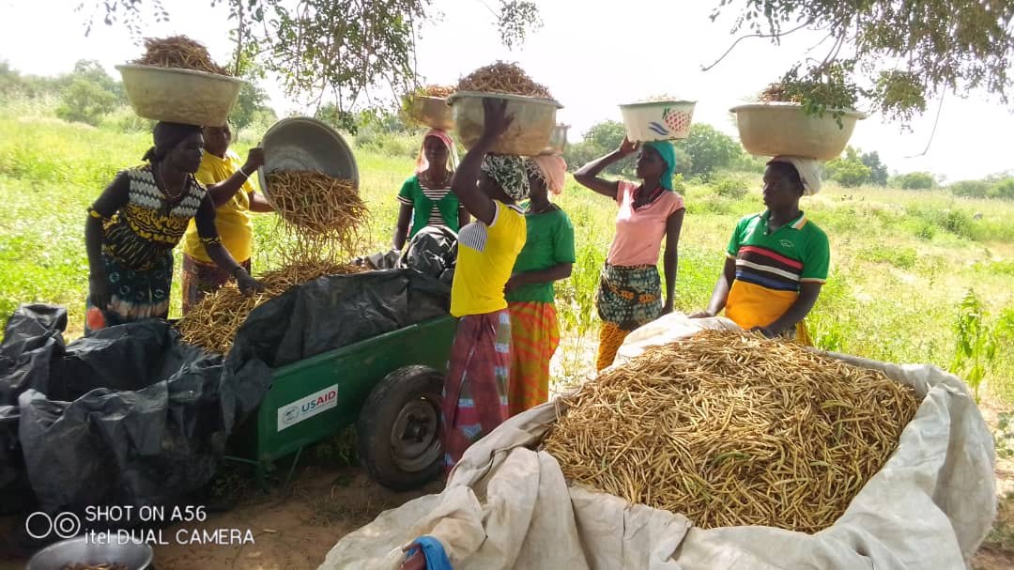
THANK YOU FOR YOUR KIND ATTENTION

