Slide 1
Victory over Malnutrition Plus Project (ViMPlus)
Component 1: Governance and disaster risk management

Slide 2
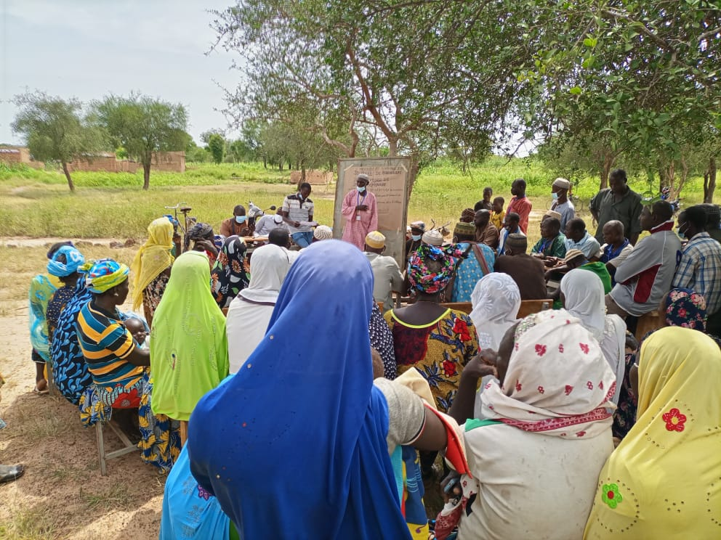
Annual Community Investment Plan (ACIP): a community-driven development tool
Innovation for Resilience

Slide 3
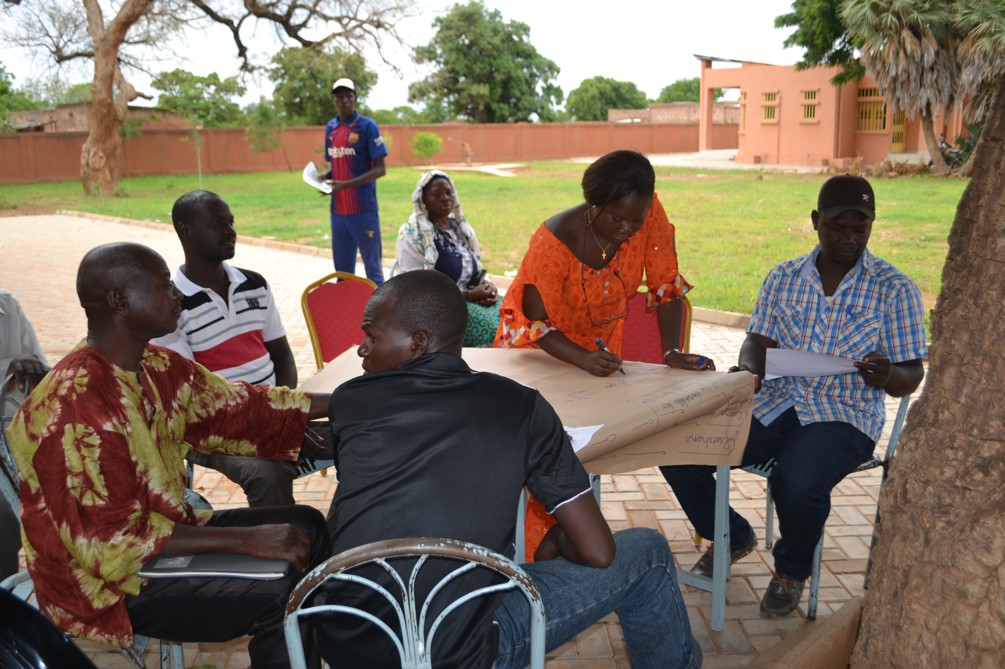
Context: Targeted problems
Low participation in the local development plan (PCD) process
Limited funding (PCD)
Weak organizational and operational capacity
Inability to defend the interests of their constituents
Lack of planning tools for community initiatives
Notes:
Insufficient consideration of village priorities in local development plans (PCD) due to low village participation in the process.
Low level of funding for SCI actions
Weak organizational and operational capacity of the CVDs
The inability of CVDs to defend the interests of their constituents
Lack of planning tools at village level, hindering local leadership and initiatives in community development.

Slide 4
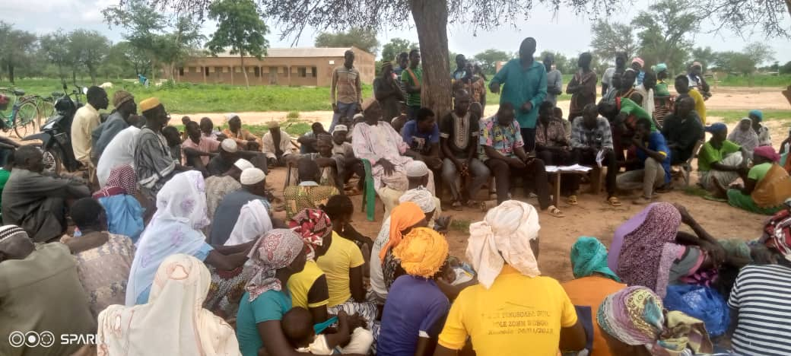
Solution: Annual Community Investment Plan (ACIP)
Objectives
Support the CVDs in assuming responsibility for the development of their villages;
Facilitate community involvement in mobilizing resources and implementing community actions;
Encourage people to take ownership of the planning and execution of community actions
Village assembly
Notes:
Solution: Annual Community Investment Plans (ACIP)
Create a participatory and inclusive approach to local planning to help communities develop local solutions to their priority problems.
Initiation of the participatory and inclusive local planning approach as a community-driven development model through the elaboration of Annual Community Investment Plans (ACIPs) in the villages, with a view to providing communities with adaptation and resilience responses to the factors limiting their development.
Objectives
Empower local structures, in particular the CVDs, and the local population to take charge of the development of their respective villages;
Facilitate community involvement in mobilizing resources and implementing community actions;
Enable local structures and the population to take ownership of the participative and inclusive local planning approach to community action and integrate it into their daily lives.

Slide 5
Implementers
Structures involved in developing and implementing the practice
The ViMPlus /ACDI-VOCA technical team
ViMPlus/PLEP agents
Members of the CVD office (approach sponsor)
Local communities...
State actors and external partners
Notes:
Implementers
Structures involved in developing and implementing the practice
The ViMPlus /ACDI-VOCA technical team
ViMPlus/PLEP agents
Members of the CVD office (approach sponsor)
Customary authorities and religious leaders
Other local organizations
Village councillors
Local communities
State actors and external partners
Municipal councils (supervisory authority for CVDs)
Decentralized government technical services
Development projects and programs.
NGOs/Development associations
IMPLEMENTATION PROCESS
Community consultations
Training technical field agents
Training and provision of operating and management tools for DVCs
Community membership information meetings
Practice implementation (diagnostic assemblies, PAIC planning and implementation)
Development of a financial mobilization strategy

Slide 6
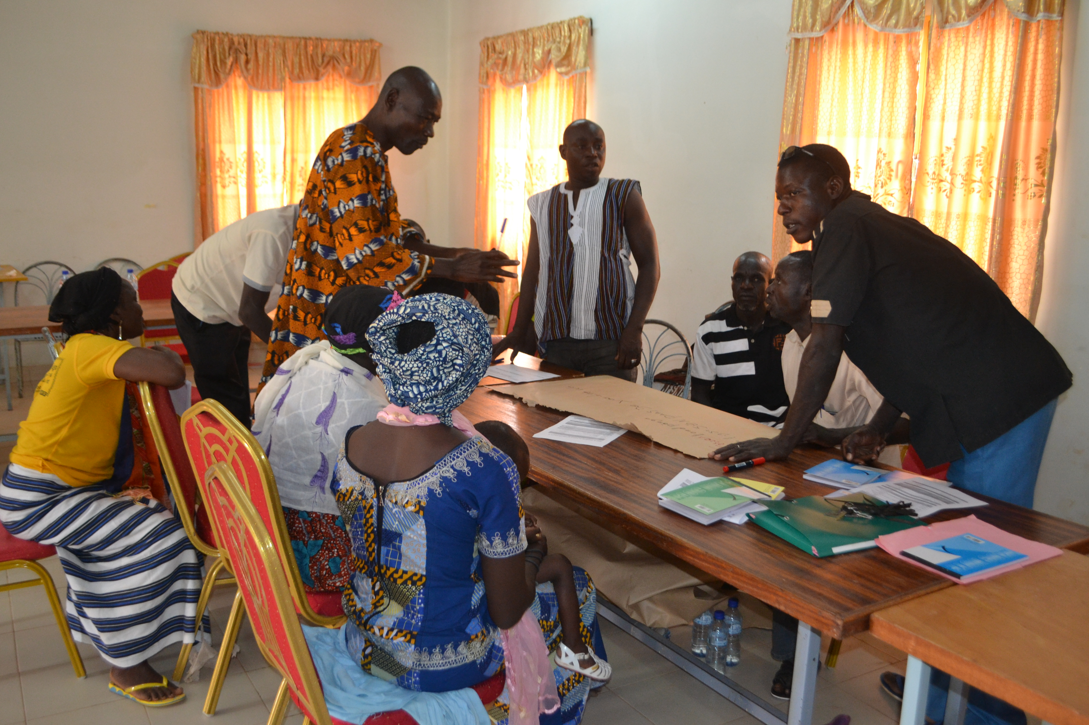
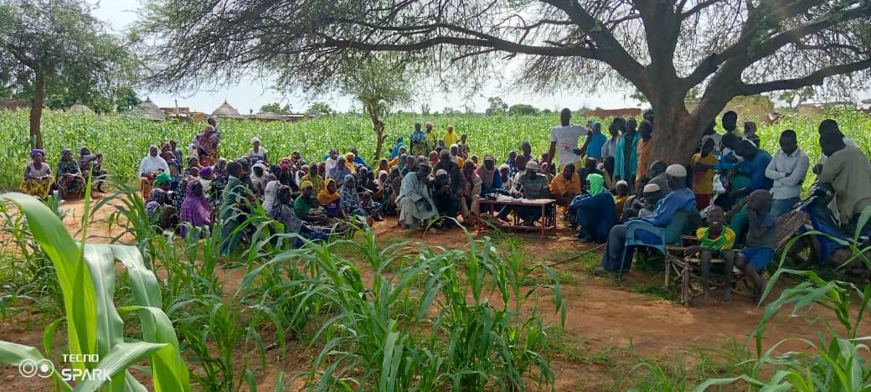
Implementation processes
Community consultations
Development of a financial mobilization strategy
Agent training
Group work/community consultation workshops
Implementation
Training and equipment for CVDs
Village Assemblies
Village-level community consultation
Notes:
Community consultations
Training technical field agents
Training and provision of operating and management tools for DVCs
Community membership information meetings
Practice implementation (diagnostic assemblies, PAIC planning and implementation)
Development of a financial mobilization strategy

Slide 7
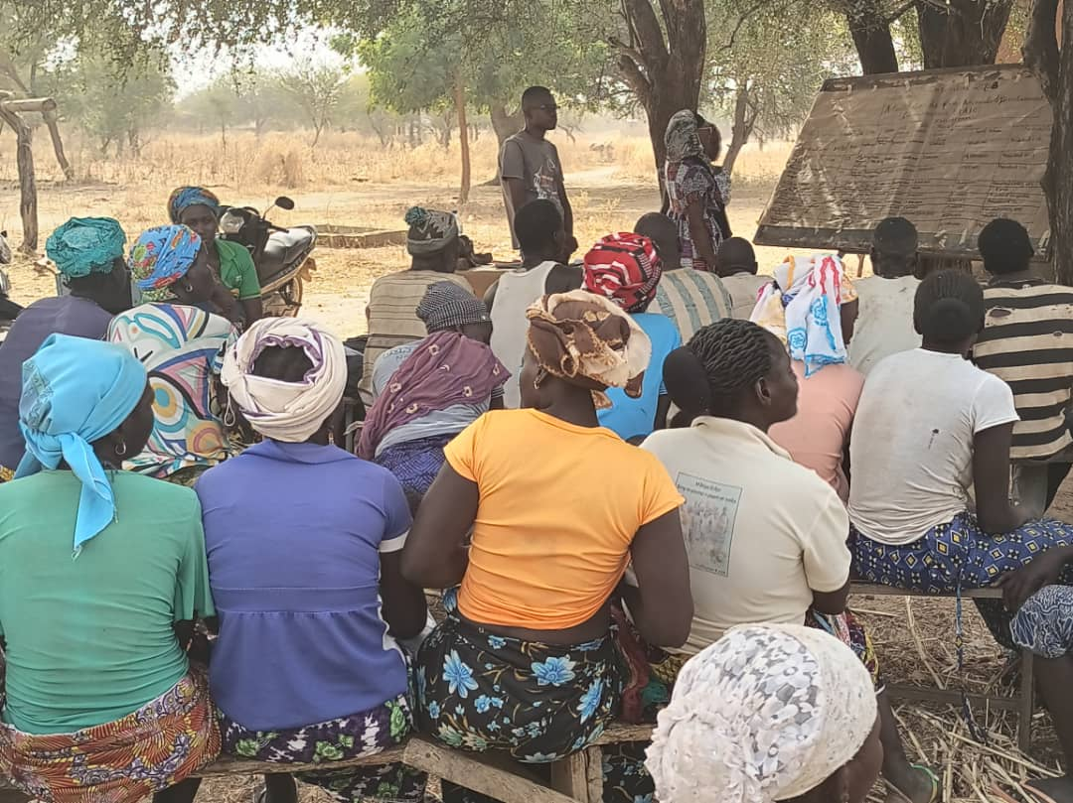
Implementation results (1/3)
84/126 CVDs (66.67%), on their own initiative, have animated and mobilized communities to analyze the factors limiting their development and plan actions.
The importance of participatory and inclusive local planning, which enables the different social strata to get involved, express themselves and have the real needs of the community taken into account.
Village planning meeting
Notes:
84/126 CVDs, on their own initiative, have animated and mobilized communities to analyze the factors limiting their development and plan adaptation and resilience actions.
CVDs and other community leaders manage community assets properly and effectively, are accountable to communities and make inclusive decisions:
18464 out of 18484 households are satisfied with the implementation of community actions by the CVDs, i.e. 99.9% of households taking action.
63 CVDs held accountability days on the management of community assets and the implementation of PAICs

Slide 8
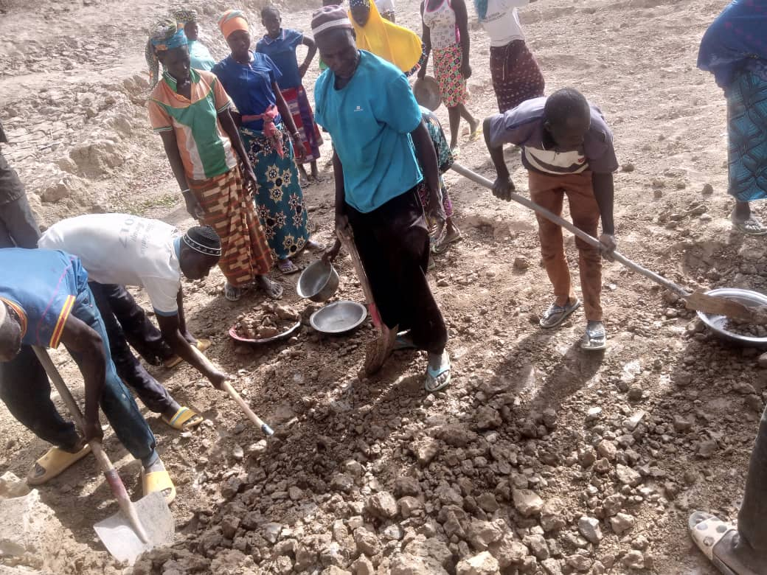
Implementation results (2/3)
Figure 1: Level of community satisfaction with services provided by CVDs, according to the ViMPlus FY23 annual survey
Bouli digging
Notes:
Participatory and inclusive local planning has enabled different social strata to get involved, express themselves and have their real needs taken into account.
Community involvement in the mobilization of internal resources and physical participation in community actions
55,462,980 FCFA were raised internally by 54 villages over the last two years FY22, and FY23
29,831 out of 98,268 people, including 1,513 women, mobilized around collective activities at village level

Slide 9
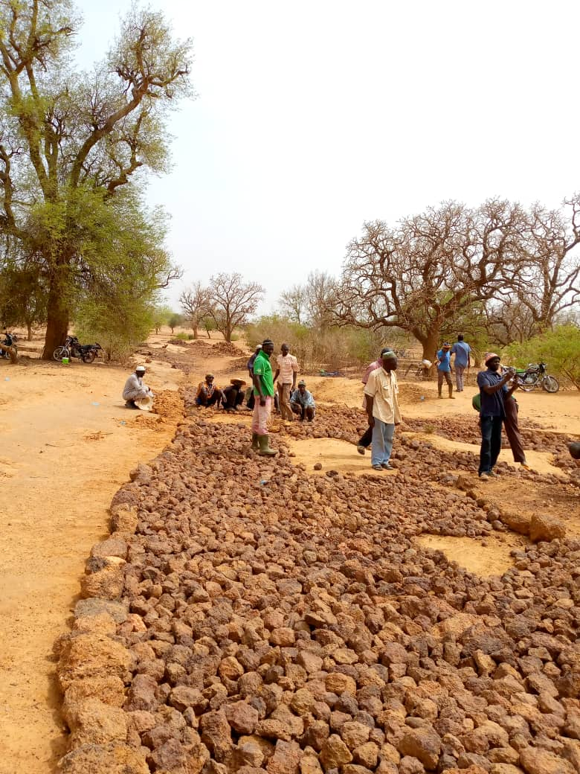
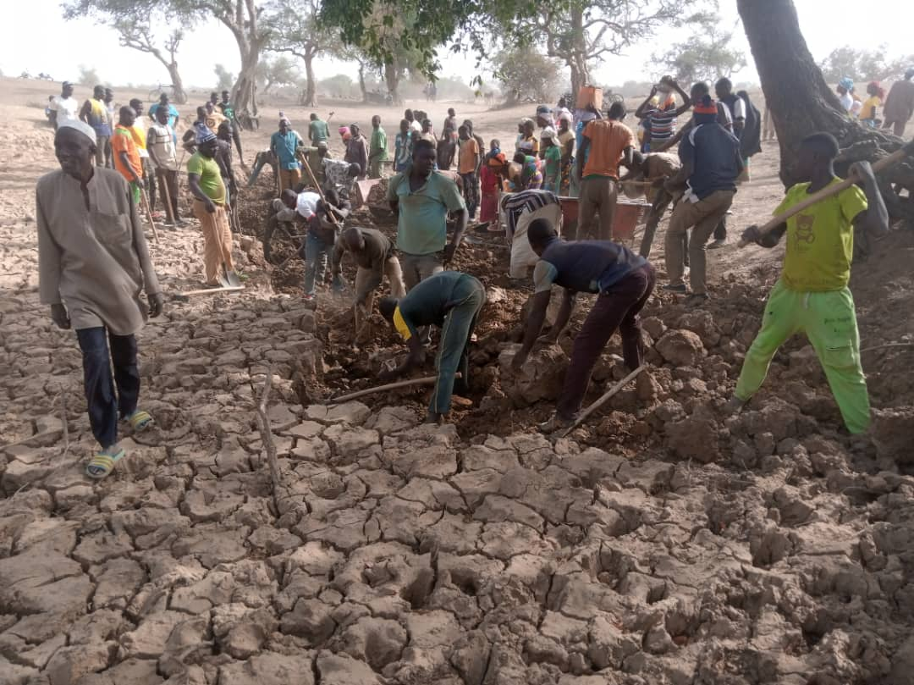
Implementation results (3/3)
55,462,980 FCFA raised by 64% CVD in FY22 and FY23
29,831 out of 98,268 participants (30%), including 15,513 women
Rural track rehabilitation
Bouli rehabilitation
Notes:
Participatory and inclusive local planning has enabled different social strata to get involved, express themselves and have their real needs taken into account.
Community involvement in the mobilization of internal resources and physical participation in community actions
55,462,980 FCFA were raised internally by 54 villages over the last two years FY22, and FY23
29,831 out of 98,268 people, including 1,513 women, mobilized around collective activities at village level

Slide 10
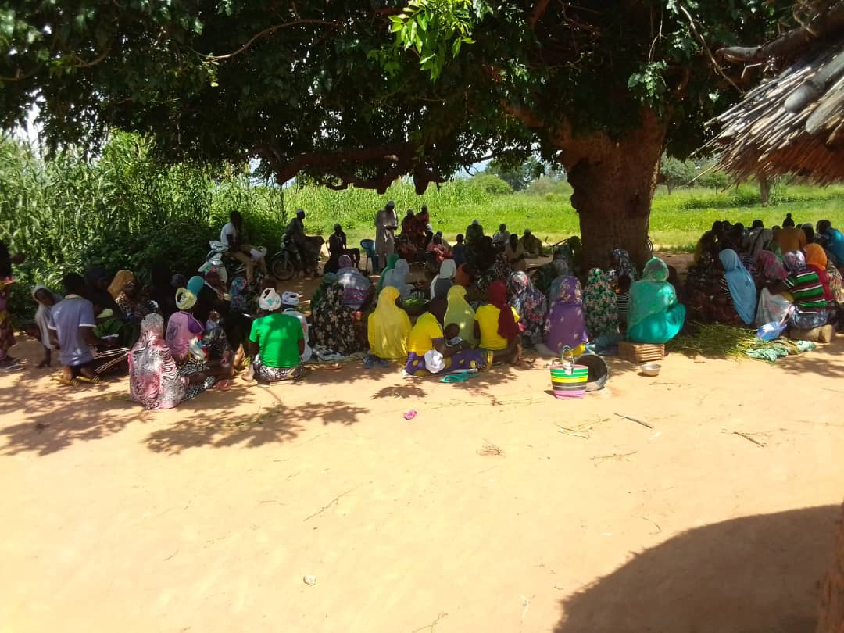
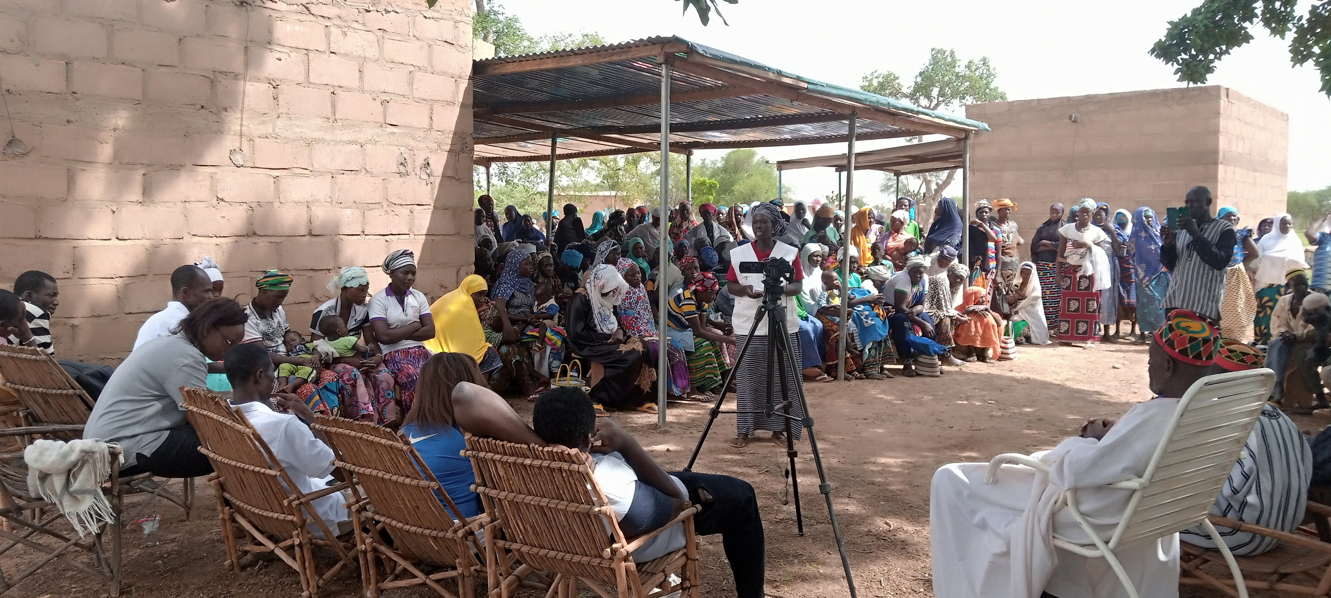
Conditions for success
Capacity-building for CVDs
Commitment and effective operation of the CVDs
29,414 out of 32,582 households surveyed (90%) in FY23 acknowledged having benefited from services provided by the CVDs
Transparent management of village funds
Involvement and participation of all social strata in the process, with a focus on gender
Participatory and inclusive village assemblies
Accountability Day
Notes:
Conditions for success
The long-term, legal nature of CVDs
Capacity-building for CVDs
379/ 651 heads of 126 DVC offices out of 217 planned DVCs, including 70 women, have strengthened planning and monitoring-evaluation skills
The commitment and effective operation of the CVDs
29,414 out of 32,582 households surveyed (90.3% in FY23) acknowledged having benefited from services provided by the CVDs
Transparent management of village funds: accountability and reporting days at microfinance institutions (MFIs) ;
The involvement and participation of all social strata in the process, with a focus on gender;
The provision of tools adapted by the project for the benefit of players (translated templates)
The inclusion of community initiatives in response to the difficulties/problems experienced in the proposed solutions is essential to ensure ownership of the actions by the communities and therefore sustainability.

Slide 11
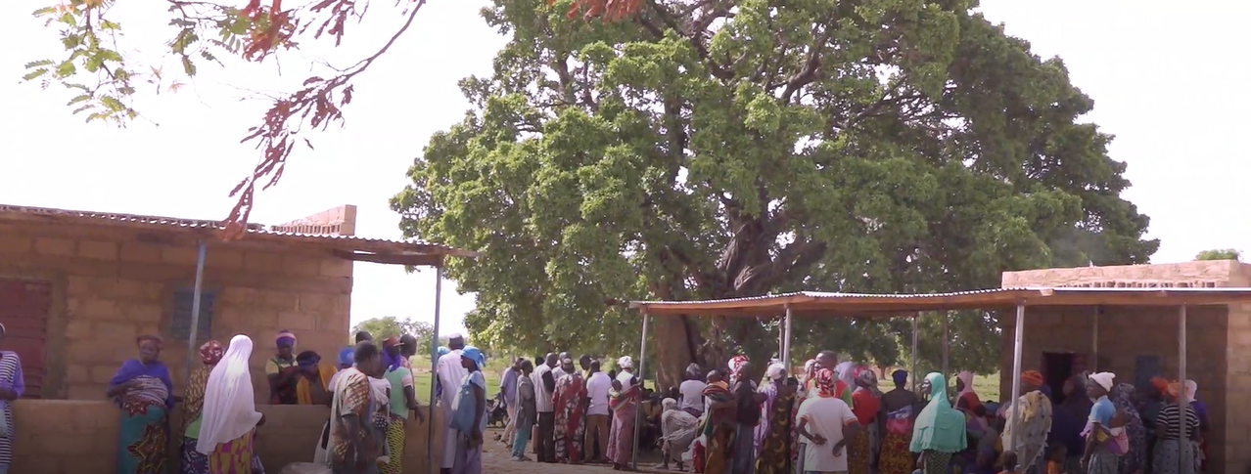
Lessons learned
PAIC: a means of strengthening leadership, prestige and local expertise
ICAPs as a means by which communities themselves develop actions to address their vulnerability
Involvement of customary authorities and religious leaders, a guarantee of community mobilization and the granting of land to CVDs.
CVD headquarters and women's meeting center
Notes:
the involvement of customary authorities and religious leaders has helped to mobilize communities to participate in the process, and to grant land for the construction of CVD headquarters.
The inclusion of community initiatives in response to the difficulties/problems experienced in the proposed solutions is essential to ensure ownership of the actions by the communities and therefore sustainability.
Participatory and inclusive planning is a guarantee of community mobilization and commitment around development players and the CVD, and of the establishment of village funds and the assumption of responsibility for local development.
The elaboration of a PAIC is a means by which communities themselves develop actions to address their vulnerability.
The empowerment of DVCs in the development and implementation of PAICs is a means of strengthening DVC leadership, prestige and local expertise.

Slide 12
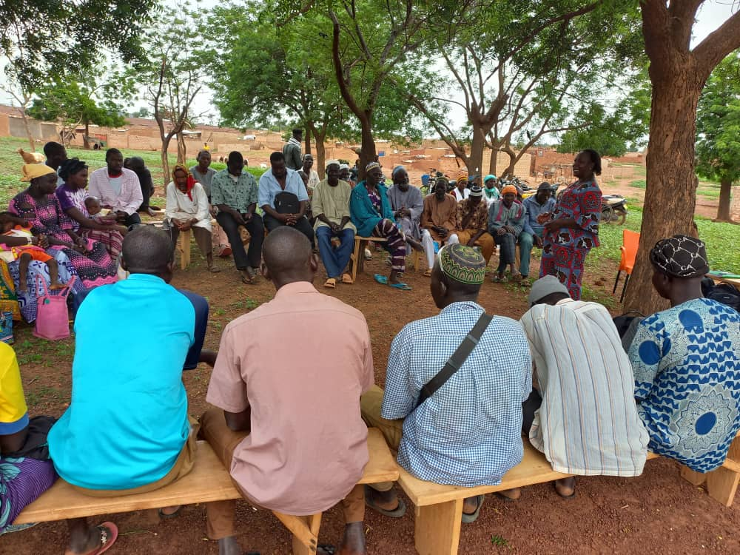
Sustainability and scalability factors
The long-term, legal nature of CVDs
PAIC: a community initiative
Participatory and inclusive planning
Accountability days
Creation of a CVD network
The adapted development framework
CVD networking session
Notes:
The long-term, legal nature of CVDs
PAICs are drawn up on the initiative of local authorities and run by CVDs. The cycle is annual;
The community's ownership of the actions, thanks to their participation in the various phases of the process, is a guarantee that certain actions will be carried out using funds mobilized internally;
accountability days, which are largely based on the results of ICAP implementation. They are a tool that creates and reinforces: (i) trust between the BE/CVD and their base, (ii) community commitment;
The development framework is translated into the local Mooré language. This facilitates understanding and appropriation of the development process.

Slide 13
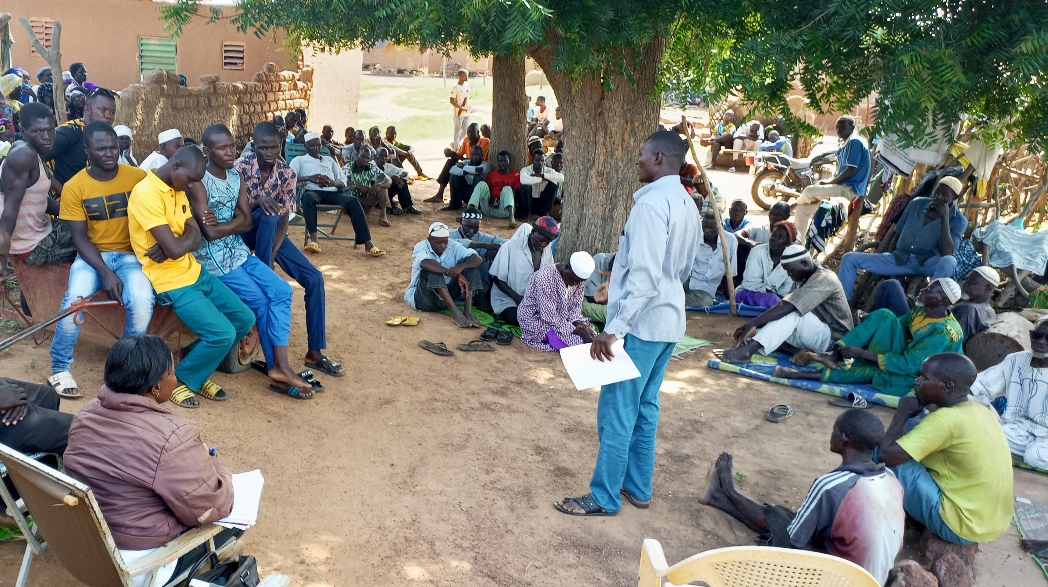
THANK YOU

