Slide 1
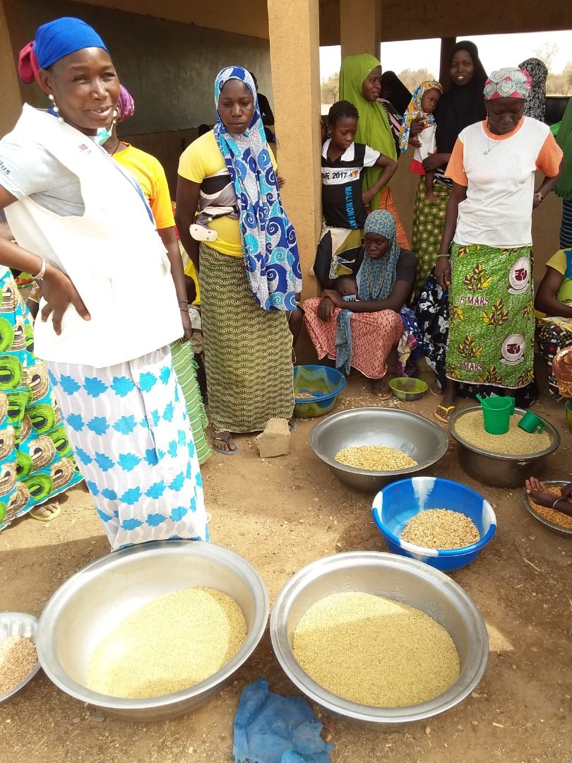
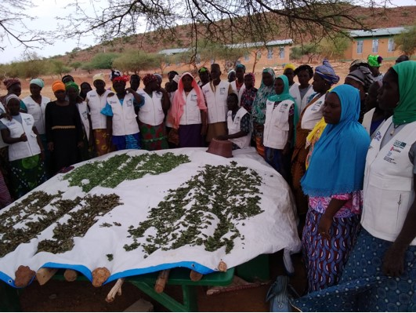
Integrated package for community management of malnutrition
Drying dark-green leafy vegetables
Thematic activities to promote maternal and child health and nutrition
Improved group production of infant flour

Slide 2
Presentation plan
Malnutrition in the project area
Package components
Community screening for malnutrition by Mothers Leaders
Infant flour production
Food diversification: the drying approach for dark-green leafy vegetables
Lessons learned from implementation
Sustainability and scalability challenges

Slide 3
1. Background to malnutrition in the project area
Global acute malnutrition (6-59)
8,4%
Underweight 19
Chronic malnutrition
25,5%
Beginning of health center closures
SMART 2019

Slide 4
2. Package components
Community screening for malnutrition by MLs and referral of cases
Pregnant women,
Nursing mother
Children 6-59 months
Drying dark-green leafy vegetables to diversify your diet
The production of improved infant flours from local foods

Slide 5
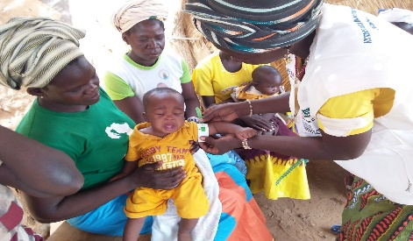
3. Community screening for malnutrition by MLs and referral of cases
Capacity-building for MLs and GASPA members on community screening techniques for child malnutrition
Capacity-building for MLs in handling screening tools (MUAC)
Strengthening capacity to assess the severity of cases and the measures to be taken
Players: Health services, GASPA, ViMPlus, Resource persons, Husband's school supervisors
Mama leader from the village of Tempelga( Bouroum) village at a screening session.

Slide 6
3.1 Implementation strategy
I. Capacity-building
Consultation with the Regional Health Department
ViMPLus staff training
ML&ASBC Training
II. Operational plan
Measuring brachial perimeter with MUAC
By ML
Referring children to ASBC
Referring children to the health center
Support
Support and advice for mothers
Home visits
Supervision/ coordination /ViMPlus/DRS

Slide 7
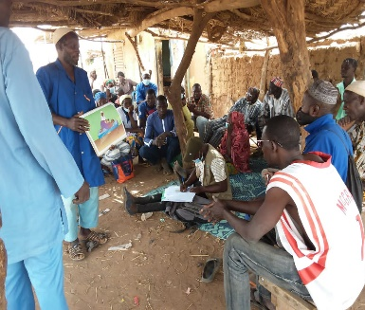
3.2. Implementation results (1/2)
A fully grassroots-driven approach (GASPA) - Proximity
Supervision system led by: ASBC: 352; Mères Leaders: 2,221; PRV: 325; Encadreurs Ecoles des Maris: 207
GASPA members: 25,060 adhere to the local advisory support mechanism
In 2022, ML conducted screening without the assistance of project staff
11,222 children aged 6 to 23 months monitored by MUAC in GASPAs
Screening training for mothers of malnourished children
A framer from a Yalgo EdM animates with the husbands
Notes:
Mothers of malnourished children have been equipped with MUACs to enable them to monitor their children's nutritional status.

Slide 8
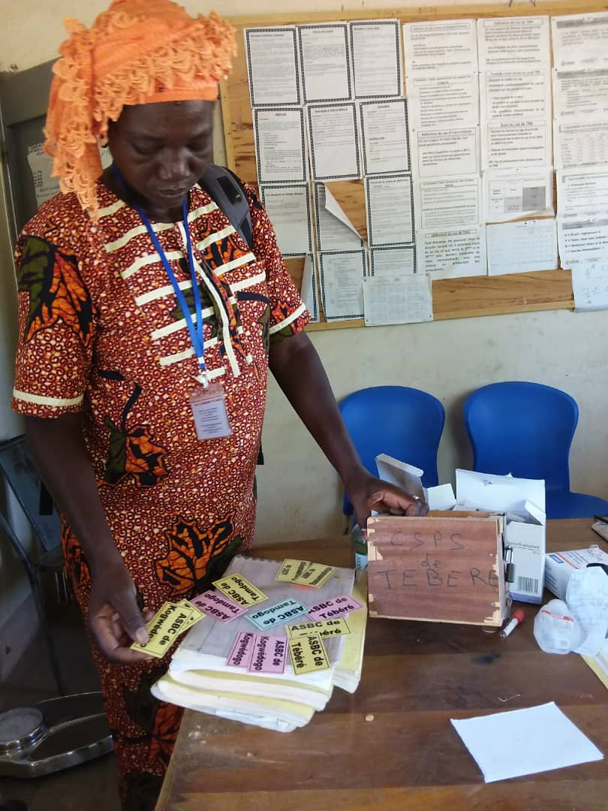
3.2. Implementation results (2/2)
11,222 children aged 6 to 23 months monitored by MUAC in GASPAs
1,226 MAM/MAS detected and referred for treatment (FY22 =909 cases and FY23 =317 cases )
Growing confidence in ML's action
More malnourished children screened and referred
Early detection for early management
Photo 4: A promoter visits the Tébéré CSPS in the commune of Pissila to take stock of the children referred.

Slide 9
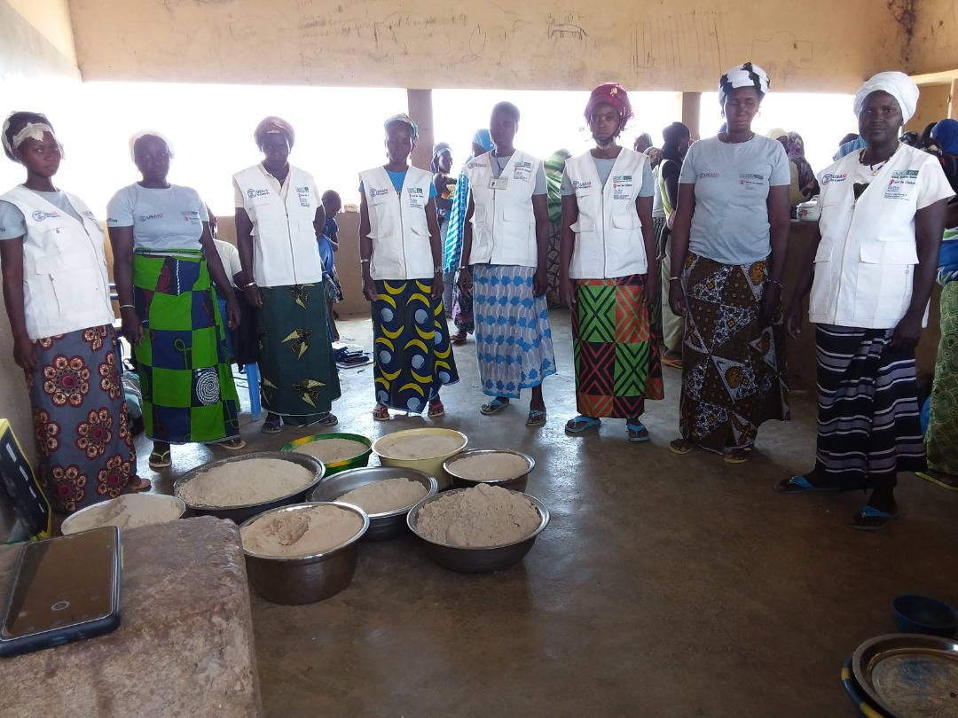
4. Production of infant flour

Slide 10
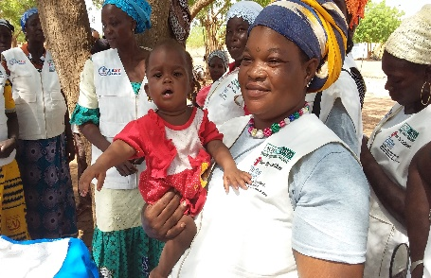
4.1. Logic of the approach
Strengthen the skills of key players in the production processes for improved infant flours based on local products.
Mitigating dependence on imported and industrial supplementary feeds
Promote grouped flour production in GASPAs to address the cost factor
Promote individual production of this flour at household level.
Increasing the use of local produce to prevent malnutrition

Slide 11
4.2. Implementation strategy
Collecting local produce
Group transformation session
Flour production
Monitoring the adoption of best practices
Capacity building
Health Department
Health agents,
ASBC, MLA
GASPA members
Culinary demonstrations
Replication monitoring at household level

Slide 12
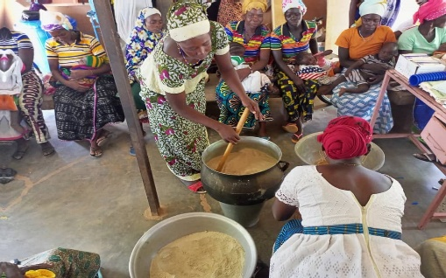
4.3. Implementation results in terms of changes in behavior, quality of life for households or organizations (1/2)
Children in GASPAs have regular access to improved infant formula over a long period of the year.
Quantity of flour produced: 12,532 kg in FY22 and 21,668 kg in FY23 (grouped production).
home visits in FY23: 3,870 follow-up visits to 10,005 mothers to replicate cooking demonstrations;
average number of children who consumed the bouille in FY23: 11,222 children aged 6 to 23 months;
Grouped flour production session for young children aged 6 to 23 months in the Timnaoré CSPS, Rollo commune.

Slide 13
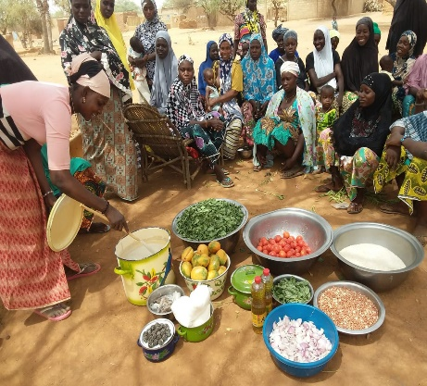
4.3. Implementation results in terms of changes in behavior, quality of life for households or organizations (2/2)
Adoption of best practices for ANJE (resulting from ML action)
Practices | FY 22 | FY23
1. Household consumption of iron-rich foods | 66,8% | 95%
2. Minimum dietary diversity for women of childbearing age | 44,8% | 61,5%
3. Exclusive breastfeeding | 82,9% | 78,2%
4. timely introduction of complementary food for children aged 6 to 23 months | 47,4% | 68,8%
5. Minimum acceptable diet for children aged 6 to 23 months | 19,2% | 23,1%
Cooking demonstration at a GASPA in the Yalgo area
Source: ViMPlus annual surveys

Slide 14
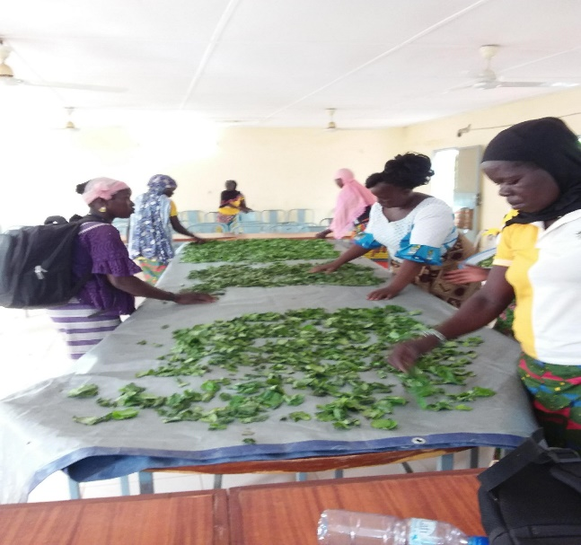
5. Dietary diversification: the drying approach for dark-green leafy vegetables

Slide 15
5.1. Logic of the approach
Introduce the notion of dietary diversification and balanced meals within communities.
On average, only 23.3% of children aged 6 to 23 months consumed 4 distinct food groups
Encourage the availability and consumption of quality dark-green leafy vegetables at all times of the year.
Provide the community with qualified personnel to guide households in leaf picking and drying techniques.

Slide 16
5.2. Implementation results in terms of changes in behaviour, quality of life of households or organizations
Households have regular/permanent access to dried dark-green vegetables and leaves over a long period of the year
26,893 households consumed dried dark-green leafy vegetables according to the ViMPlus 2023 annual survey.
63,674 kg of dark-green leafy vegetables dried in FY22
An evolution in the quality of conservation practices Vs traditional practices
Proven expertise in drying and preserving dark-green leafy vegetables
A contribution of the approach to food diversification for children and their mothers
For some women, the business generates income

Slide 17
6. Lessons learned from implementation (conditions for success, technical difficulties 1/2)
Conditions for success
The collection of ingredients during the harvest period provides a large stock of foodstuffs for the production of infant formula throughout the year.
Implementing the husbands' approach in the villages enabled the men to get involved in production by providing the ingredients and facilitating their wives' participation in flour production.
The grouped production of flour enables all GASPA members to benefit from the flour (even those who were unable to contribute ingredients such as IDPs), thus reinforcing solidarity and social cohesion in the GASPAs.
Promotion of the collection and spreading of wild seeds of certain types of plants (Bulvaka, Sogoda...).
Promotion of the collection and spreading of wild seeds of certain types of plants (Bulvaka, Sogoda...).

Slide 18
6. Lessons learned from implementation (conditions for success, technical difficulties 2/2)
Technical challenges
The absence of grain mills in some villages is a limiting factor for individual production.
The milling of improved infant flour in collective grain mills is a factor in cross-contamination of the flour produced.
Bleaching certain leaves before drying is an additional burden for the women and requires firewood.
Picking dark-green leafy vegetables at inappropriate times of the day by women because of their domestic duties.
The closure of the majority of health centers limits the adequate management of malnutrition cases detected at the community level and the supervision of community actors.

Slide 19
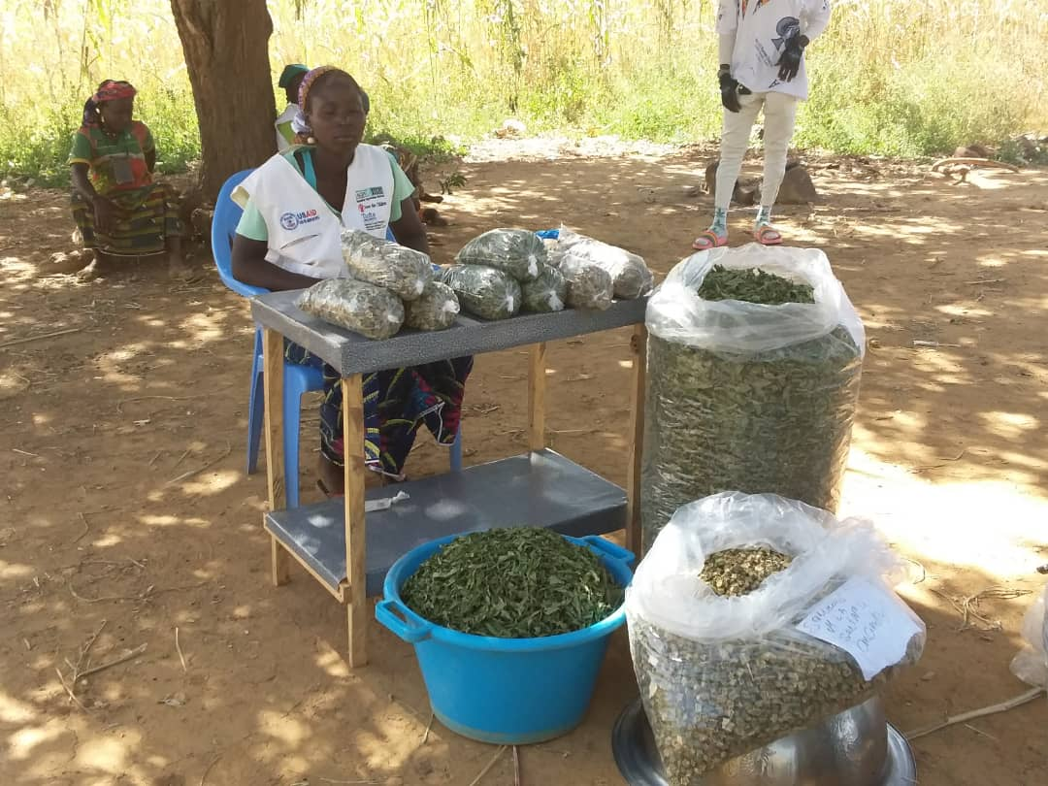
7. Sustainability and scaling challenges
(opportunities, threats, potential short- or long-term blockages 1/3 )
Opportunities
GASPAs meet the needs of the Ministry of Health
The existence at community level of a large number of women trained by ViMPlus who know how to produce infant flour from local foods.
The existence of a social environment conducive to the production of improved infant flour, thanks to husband schools and community dialogue sessions.
The existence at community level of a large number of women trained by ViMPlus who know how to pick and dry dark-green leafy vegetables.
The existence of a social environment conducive to the drying of dark-green vegetables and leaves, thanks to Husband's Schools and community dialogue sessions.
Demand for dark-green vegetables and leaves on the market square is strong

Slide 20
7. Sustainability and scaling challenges
(opportunities, threats, potential short- or long-term blockages 2/3)
Challenges
Sustainable production of improved infant flour in households in the project area;
improving the availability and use of improved infant flour through the implementation of the granary approach
the creation of improved infant flour production units in the ViMPlus project area.
extension of the dark-green leafy vegetable drying technique to households in the project area;
production and consumption of dark-green leafy vegetables by households throughout the year.

Slide 21
7. Sustainability and scaling-up challenges
(opportunities, threats, potential short- or long-term blockages 3/3)
Threats, potential blockages
Weather-related drop in agricultural production
Insecurity leading to loss/abandonment of production assets
Poor access to foodstuffs (soaring cereal prices, market closures)
Weather-related drop in dark-green leafy vegetables
Insecurity leading to the loss/abandonment of production assets and the closure of several health centers.
Herbicide use in agricultural production threatens the natural availability of dark green vegetables and leaves

