Slide 1
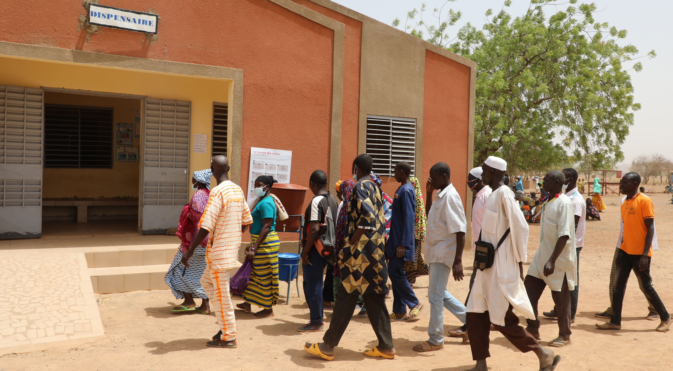


USAID-PREPARE-BURKINA
REALIGNING VILLAGE MIDWIVES: A RESILIENT RESPONSE TO IMPROVING MATERNAL AND NEONATAL HEALTH IN HIGH-INSECURITY ZONES IN BURKINA FASO
Learning event on resilience practices in Burkina Faso, December 12 and 13, 2023

Slide 2

PRESENTATION OUTLINE
BACKGROUND AND RATIONALE
IMPLEMENTATION STRATEGY
METHODOLOGY
AREA OF INTERVENTION
OPERATIONS CARRIED OUT BY VILLAGE MIDWIVES
RESULTS
LESSONS LEARNED
SUSTAINABILITY FACTORS

Slide 3
BACKGROUND AND RATIONALE
Security crisis: massive displacement of populations, including health workers.
Disorganization of the healthcare system.
  Nationwide: 398 SF closed and 381 operating at minimum capacity by August 31, 2023 (health cluster report data).
  PREPARE-BURKINA zones: 59 FS closed and 52 operating at minimum capacity by Sept 30, 2023, i.e. 69% FS affected (Project data).
  Unavailability of health services: PMA not provided or incomplete.

Slide 4
BACKGROUND AND RATIONALE
Negative impact on population health, including maternal and neonatal health.
Community-based care approach: Strengthening the resilience of the local health system and Alternative for the continuity of health service provision.
  Repositioning Village Midwives (Accoucheuses Villageoises or AV) to improve maternal and neonatal health by performing hygienic deliveries in high security challenge areas.

Slide 5
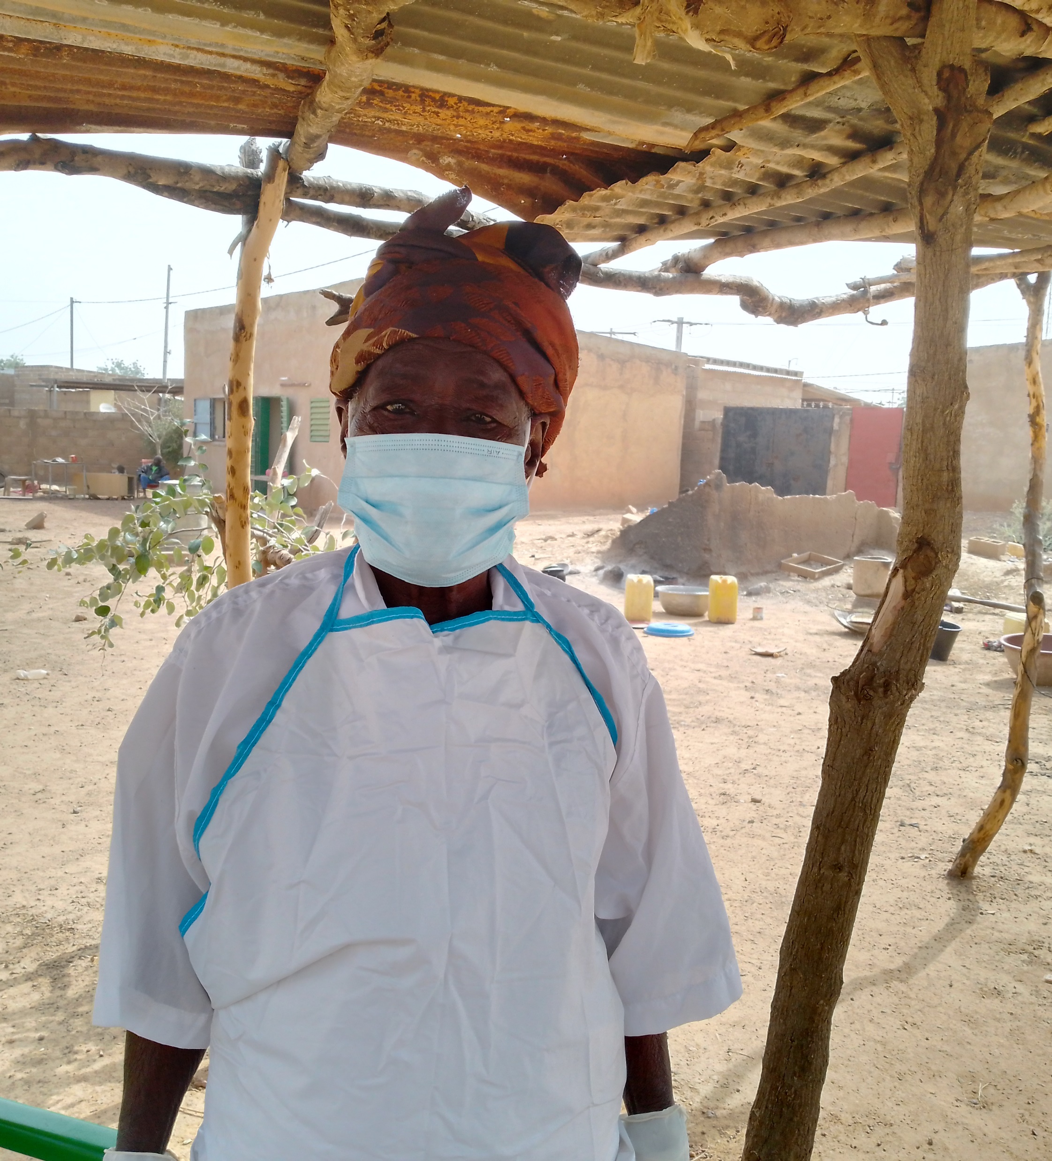
IMPLEMENTATION STRATEGY
Training for village birth attendants: Exercise on mannequin, Sebba. Photo credit: DS Sebba
Close collaboration with DRS and MCD.
Targeting high security challenge health districts (Districts sanitaires or DS) with DRSs and MCDs.
Targeting Health and Social Promotion Centers (Ciblage des Centre de Santé et de Promotion Sociale or CSPS) that are closed or operating at minimum capacity.
Zongo Cathérine, Accoucheuse villageoise de Tougouri,Credit photo: Kargougou Salamata CMCO PREPARE-BURKINA, 2023

Slide 6
IMPLEMENTATION STRATEGY
AV selection criteria :
  Be already involved in accompanying parturients to CSPS.
  Being a former AV reconverted to accompanying parturients.
  Reside in the village or neighborhood.
  Be accepted by your community.
  Be involved in FS activities.

Slide 7
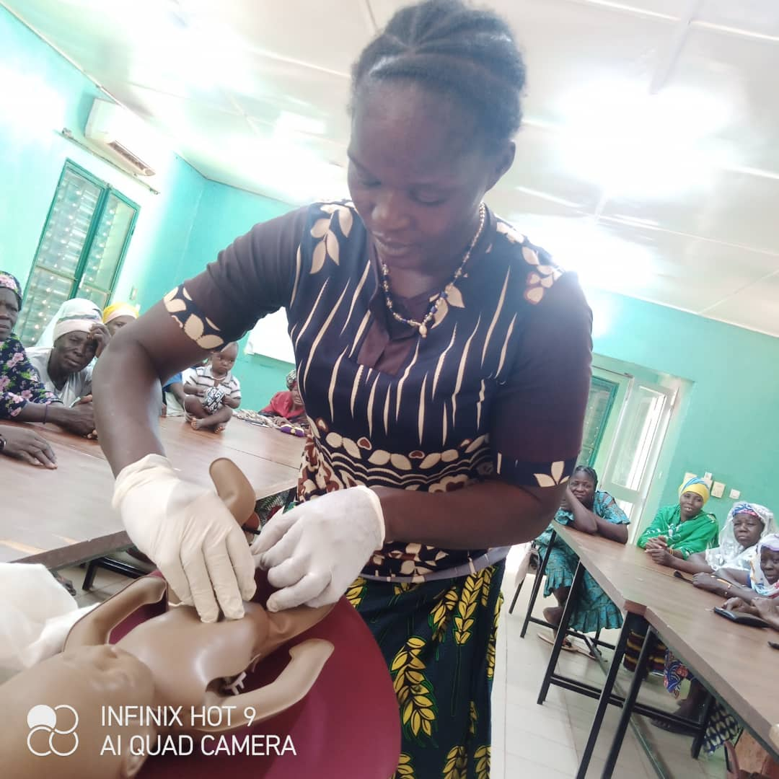
METHODOLOGY
Technical capacity building for selected AVs
Training in maternal and neonatal care using adapted modules,
- Recognition of danger signs in pregnant women and newborns at community level.
-Eutocic deliveries at community level.
-Promotion of essential family practices at community level.
-Referring complicated cases.
Training for village midwives: Exercise on mannequin, Kongoussi. Photo credit: DS Kongoussi

Slide 8
METHODOLOGY
Technical capacity building for selected AVs
Data management
  Simplified community data collection tool.
  Monthly collection and transmission of data to the Head Nurse (Infirmier Chef de poste or ICP).
  Monthly data transmission to the district (RMA).
USAID - PREPARE - BURKINA

Slide 9
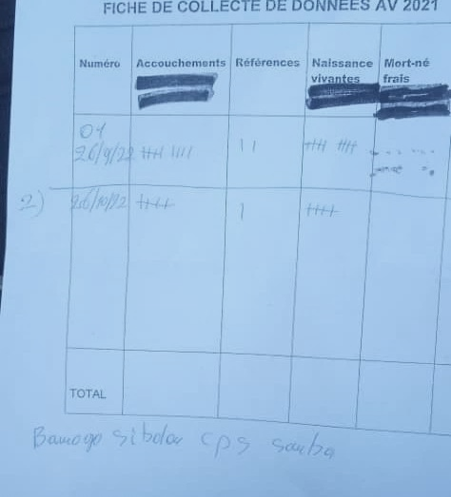
METHODOLOGY
N° | Births | References | Live births | Fresh stillbirths | Macerated stillbirths
TOTAL
Blank VA data collection form
Completed VA data collection form

Slide 10
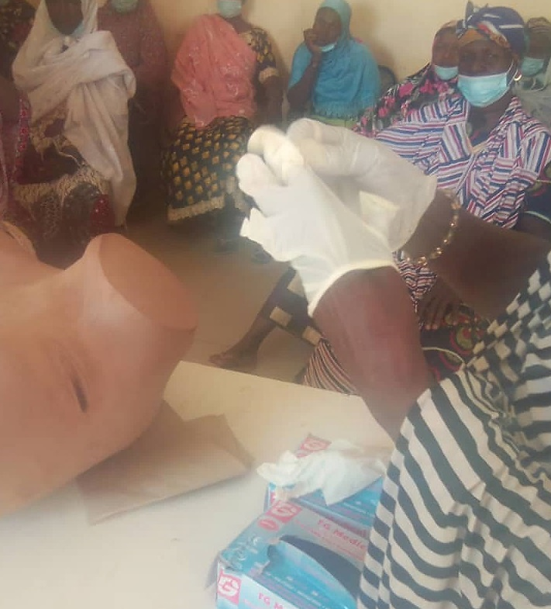
METHODOLOGY
Trainer profile: ECD members
  Head of SR.
  Health promotion manager (SPS).
Training location: DS headquarters
Training duration: 6 days.
  Theoretical phase: 3 days, classroom practice on mannequin.
  Practical phase: 3 days at CM/CMA level.
Training for village birth attendants: Exercise on mannequin, Sebba. Photo credit: DS Sebba

Slide 11
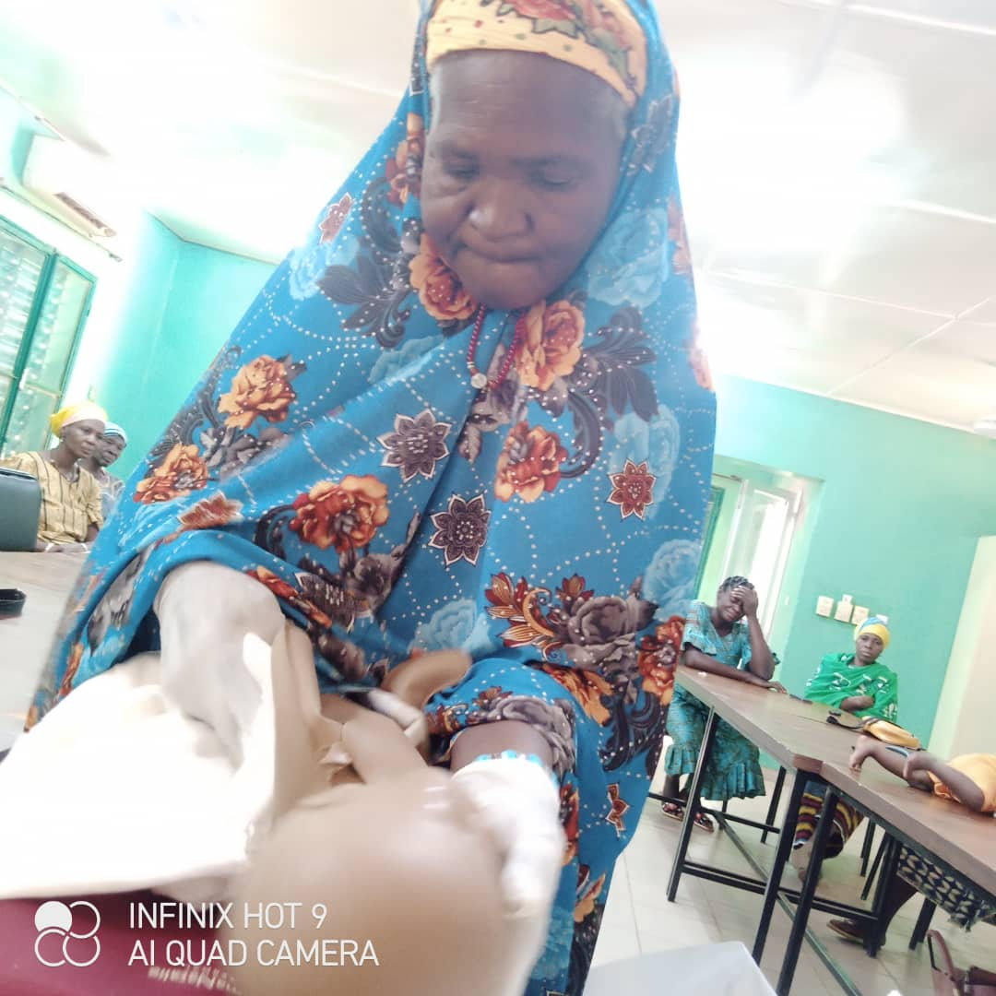
METHODOLOGY
Provision of equipment
-Personal protection kit: goggles, apron, boots, smocks, household gloves, loose gloves.
-Hygienic delivery kit: Cotton cloth / Towels, Scalpel blade, Loose gloves, Soap ball, Umbilical cord ligation wire or Bar clamp, Plastic mattress cover, Alcohol swab, Plastic bag for placenta.
Training for village birth attendants: Exercise on mannequin, Kongoussi Credit photo: DS Kongoussi

Slide 12
METHODOLOGY
Coaching
Remote monitoring.
Maternity ward managers, ICP.
Regular telephone contact with maternity managers and ICPs for guidance on managing complicated situations: monitoring pregnancy, during childbirth, monitoring the woman in labor, monitoring the newborn.
USAID - PREPARE - BURKINA

Slide 13
AREA OF INTERVENTION
Health district | # FS covered by AV | # villages | # trained AVs
Barsalogho, Centre Nord | 6/7 | 88 | 95
Tougouri, Centre Nord | 10/22 | 25 | 25
Kaya, Centre Nord | 17/33 | 41 | 45
Kongoussi, Centre Nord | 11/24 | 40 | 43
Bogandé, Est | 7/8 | 25 | 25
Manni, Est | 6/7 | 20 | 20
Sebba, Sahel | 2/5 | 7 | 25
Dori, Sahel | 6/6 | 31 | 90
TOTAL | 65/112 | 277 | 368
USAID - PREPARE - BURKINA

Slide 14
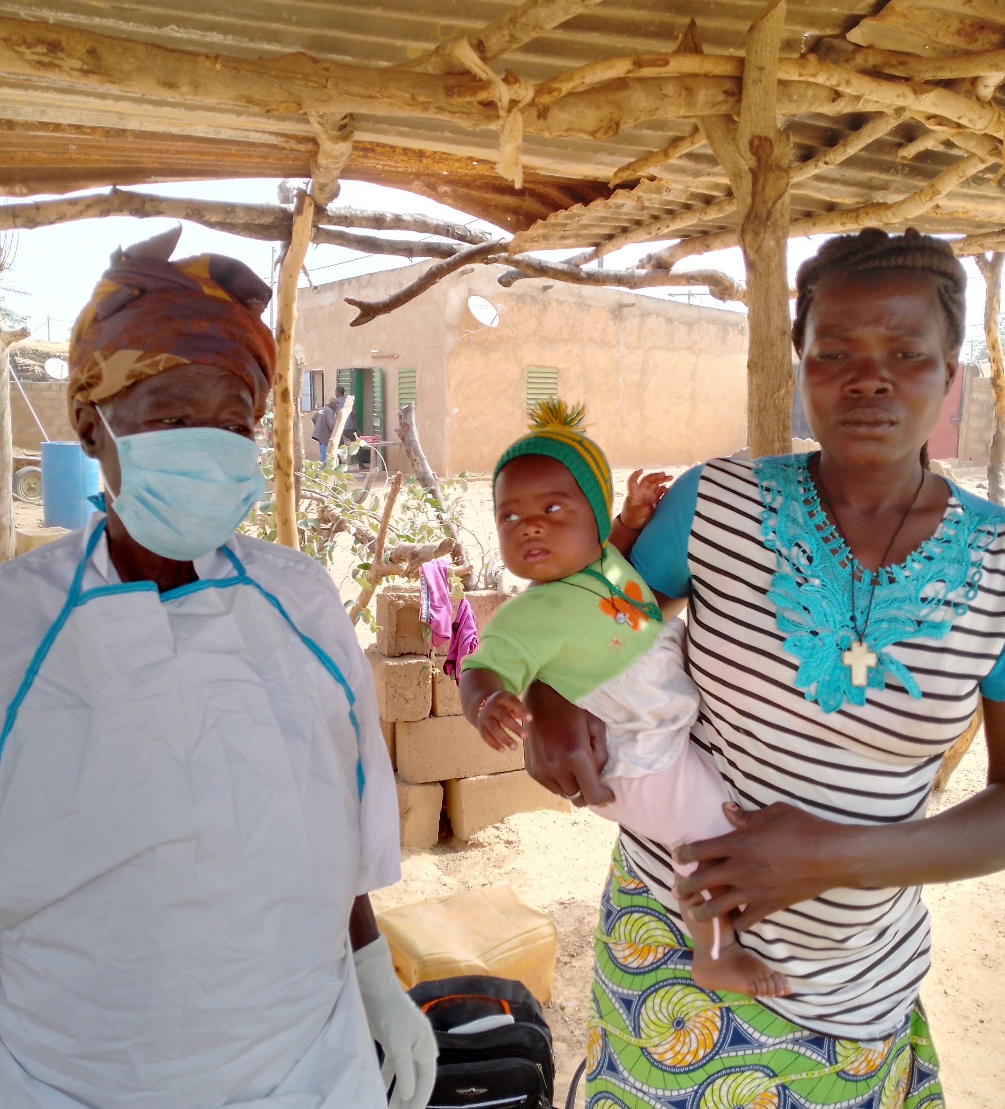
ACTIVITIES OF VILLAGE MIDWIVES
Eutocic deliveries.
Identify and refer high-risk pregnancies (scarred uterus, vulvar stricture, abortions, bleeding, precious pregnancies, very young parturients, etc.).
Tougouri village midwife with one of her clients Credit photo: Kargougou Salamata CMCO PREPARE-BURKINA, 2023

Slide 15
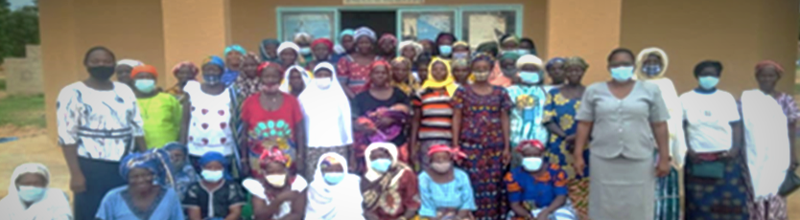
ACTIVITIES OF VILLAGE MIDWIVES
Post-natal follow-up: monitoring the health of the woman and her newborn.
Provide essential care for newborn babies.
Report and transmit data to ICP on a monthly basis.
Training village birth attendants in Barsalogho. Photo credit: DS Barsalogho, PREPARE-BURKINA, 2021

Slide 16
Overall AV performance from 2021 to 30 September 2023
USAID - PREPARE - BURKINA

Slide 17
RESULTS
Table 1: Vitality of newborns assisted by AV from 2021 to 30 Sept 2023
Health district | # Births attended | # Live births |  | # Stillbirths
 |  | # | % | # | %
DS Barsalogho | 3071 | 3061 | 99,7% | 9 | 0,3%
DS Bogandé | 161 | 164 | 101,9% | 0 | 0,0%
DS Dori | 54 | 54 | 100,0% | 0 | 0,0%
DS Kongoussi | 376 | 375 | 99,7% | 1 | 0,3%
DS Sebba | 1211 | 1174 | 96,9% | 49 | 4,0%
DS Tougouri | 1763 | 1785 | 101,2% | 37 | 2,1%
Total | 6963 | 6917 | 99,3% | 96 | 1,4%
USAID - PREPARE - BURKINA

Slide 18
RESULTS
Table II: Types of stillbirths recorded by the VA from 2021 to 30 Sept 2023
Health district | Number of stillbirths | Fresh stillbirths | Macerated stillbirths
DS Barsalogho | 9 | 0 | 9
DS Bogandé | 0 | 0 | 0
DS Dori | 0 | 0
DS Kongoussi | 1 | 0 | 1
DS Sebba | 49 | 21 | 28
DS Tougouri | 37 | 32 | 5
Total | 96 | 53 | 43
USAID - PREPARE - BURKINA

Slide 19
AV performance from January 2023 to September 30, 2023
USAID - PREPARE - BURKINA

Slide 20
Contribution of AVs to deliveries by health district (Jan 2023-Sept 2023)
USAID - PREPARE - BURKINA

Slide 21
Contribution of AVs to deliveries carried out by project intervention FSs in health districts (Jan 2023-Sept 2023)
USAID - PREPARE - BURKINA

Slide 22
RESULTS
Table 1: Vitality of newborns assisted by AV from January to September 2023
Health district | # Births attended | # Live births |  | # Stillbirths
 |  | # | % | # | %
DS Barsalogho | 619 | 617 | 99,7% | 2 | 0,3%
DS Bogandé | 161 | 164 | 102% | 0 | 0,0%
DS Dori | 54 | 54 | 100% | 0 | 0,0%
DS Kongoussi | 376 | 375 | 99,7% | 1 | 0,3%
DS Sebba | 510 | 483 | 95% | 27 | 5,3%
DS Tougouri | 750 | 744 | 99% | 6 | 0,8%
Total | 2470 | 2437 | 99% | 36 | 1%
USAID - PREPARE - BURKINA

Slide 23
RESULTS
Table II: Types of stillbirths recorded by the AVs from January to September 2023
Health district | Number of stillbirths | Fresh stillbirths | Macerated stillbirths
DS Barsalogho | 2 | 0 | 2
DS Bogandé | 0 | 0 | 0
DS Dori | 0 | 0
DS Kongoussi | 1 | 0 | 1
DS Sebba | 27 | 11 | 16
DS Tougouri | 6 | 1 | 5
Total | 36 | 12 | 24
USAID - PREPARE - BURKINA

Slide 24
LESSONS LEARNED
Conditions for success
Good support and involvement of all the different players in the process: DRS, ECD, ICP/Maternity manager
Continued availability of personal protection kits and delivery kits
AV follow-up.
Technical challenges
Gathering AVs for training
Inadequate monitoring - supervision of AVs and data collection (inaccessibility of areas and interruption of cell phone networks)
Shortages of delivery kits (inaccessibility of areas to supply kits to AVs)
Referral of difficult cases to open CSPS
USAID - PREPARE - BURKINA

Slide 25
SUSTAINABILITY FACTORS
Opportunity
Alignment with the "Politique nationale de résilience du système de santé dans un contexte à défi sécuritaire au Burkina Faso" (National policy on the resilience of the healthcare system in the context of a security challenge in Burkina Faso)
Support from donor USAID.
Threats, or potential short- or long-term blockages
Persistence and worsening of the security situation which could lead to the displacement of AVs
Inability to supply AVs with protection and hygienic delivery kits
End of financing
USAID - PREPARE - BURKINA

Slide 26
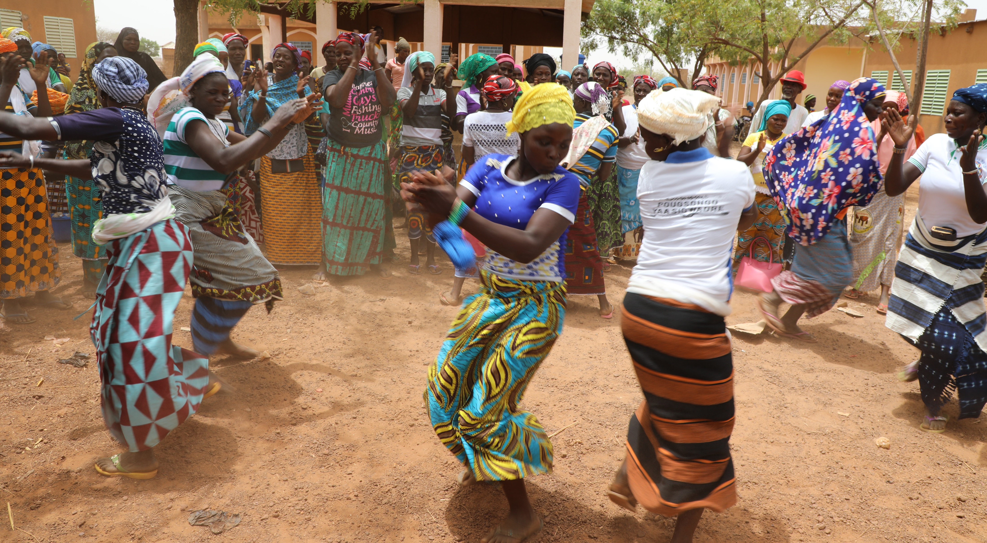
Club de santé communautaire PREPARE-BURKINA Mars 2022, Credit Abdoulaye Maïga
For further information, please contact
DR GINETTE HOUNKANRIN
ghounkanrin@pathfinder.org
USAID - PREPARE - BURKINA

