Slide 1




Learning event
PRESENTATION OF THE PROJECTED MARKET ACCESS APPROACH (Spam)

Slide 2
PRESENTATION PLAN
PAPFA/PAFA-4R overview
Introduction to the approach
Definition of SPAM
Principles and conditions of access
Implementation process
Results
Lessons learned
Sustainability challenges

Slide 3

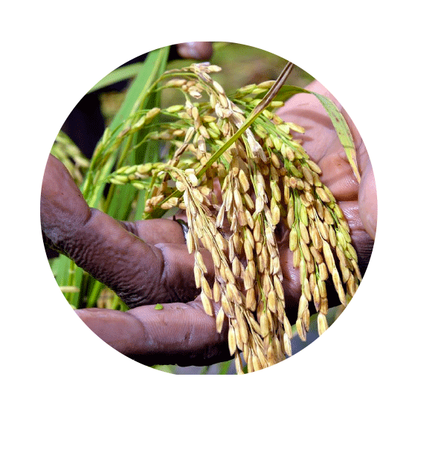
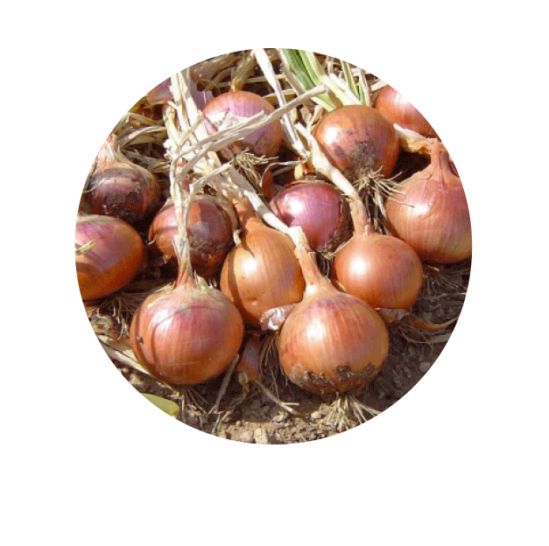
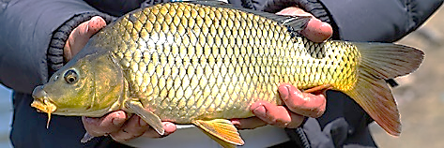
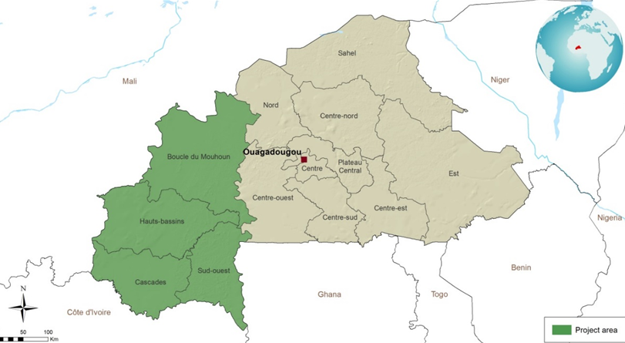
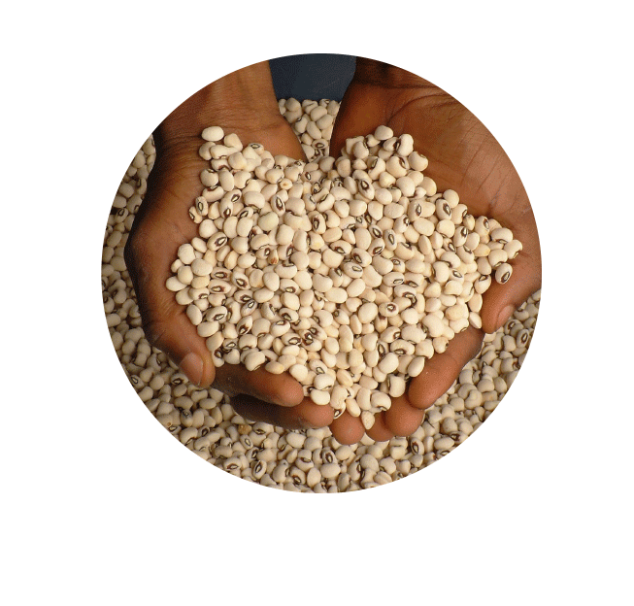
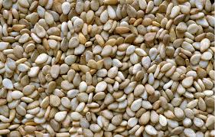
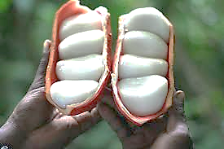

PAPFA/PAFA-4R OVERVIEW
General objective
Development objective
Contribute to poverty reduction and stimulate economic growth in the 4 intervention regions
To sustainably improve food security and incomes for farms involved in producing and adding value to products in the rice, market gardening, sesame and cowpea, fish farming and NTFP sectors.
Sud-Ouest;
Hauts-Bassins;
Cascades;
Boucle du Mouhoun
For actors in 6 sectors
Duration:
PAPFA (2018-2024)
PAFA-4R (2020-2026)
Rice
Market gardening
Fish
Financing:
PAPFA (FCFA 40.1 billion)
PAFA-4R (FCFA 73.5 billion)
Cowpea
Sesame
NTFPs

Slide 4
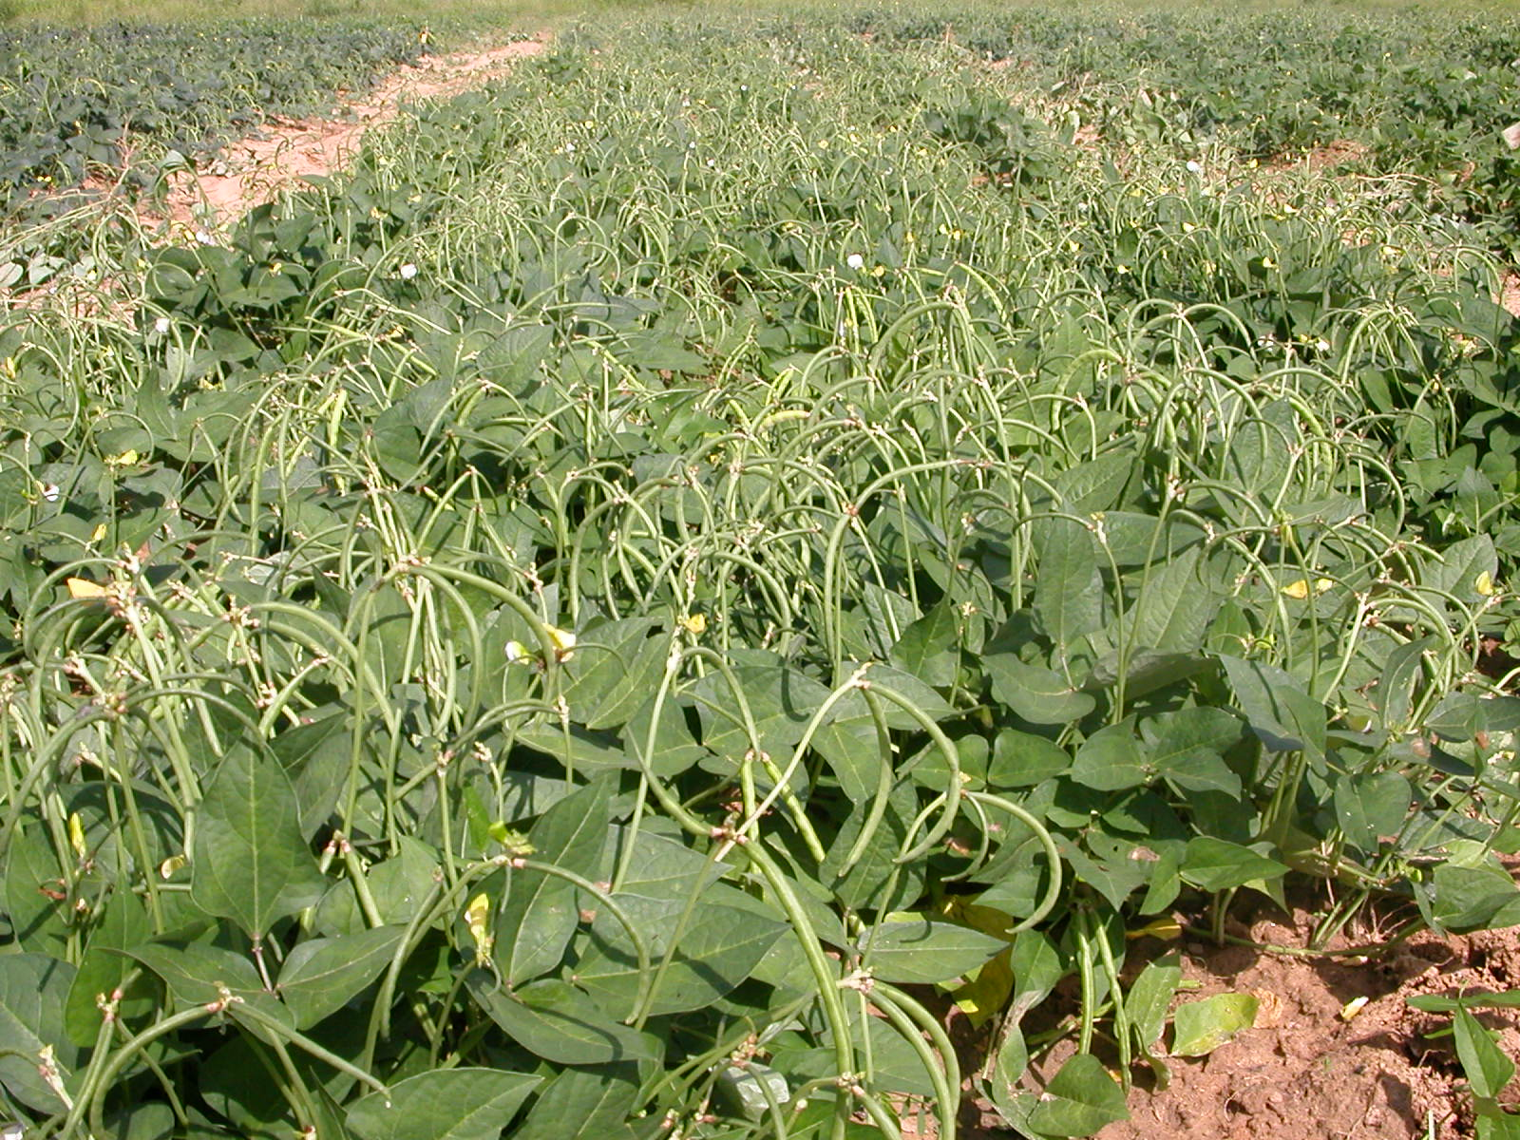
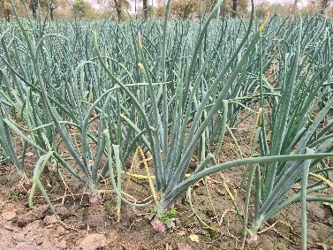
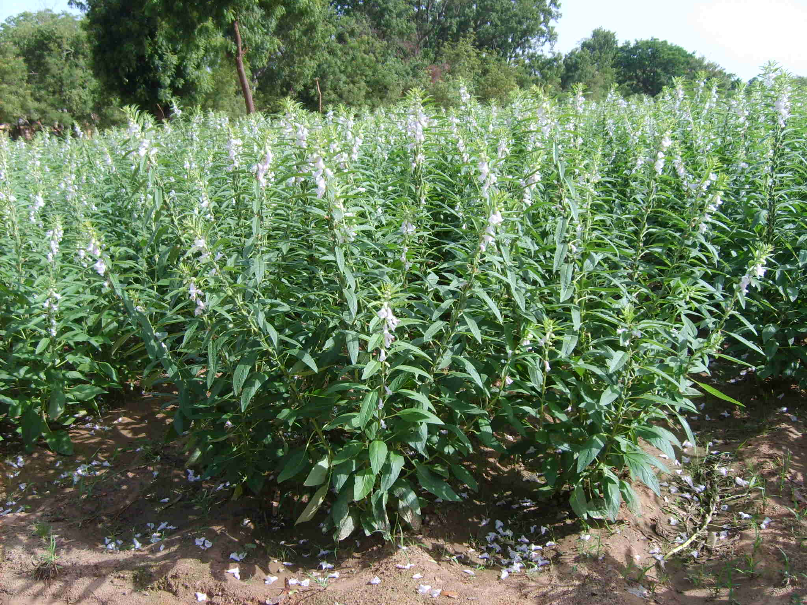
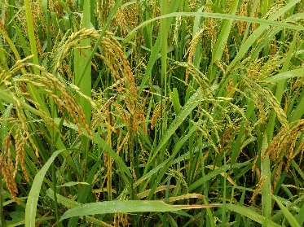
INTRODUCTION
The intensification approach adopted by PAPFA/PAFA-4R is based on the implementation of cost-sharing SPAMs by the DPOs for the target commodities (rice, sesame, cowpeas, onions, fish farming).
SPAM aims to promote access :
(i) agricultural inputs (selected seeds, fertilizers, plant protection products) and equipment according to reasoned technical itineraries;
(ii) training and high-quality technical and economic advice.
Expected effects:
Empowering market actors;
Empowering beneficiaries;
Networking with market operators (input suppliers, traders, processors, etc.).

Slide 5

1.DEFINITION OF SPAM
Cowpea SCOOPS: 24 members, 12 ha
SPAM
Support package
Sesame SCOOPS: 20 members, 10 ha
3 years
Market gardening SCOOPS: 40 members, 4 ha
Lowland rice SCOOPS: 40 members, 10 ha

Slide 6
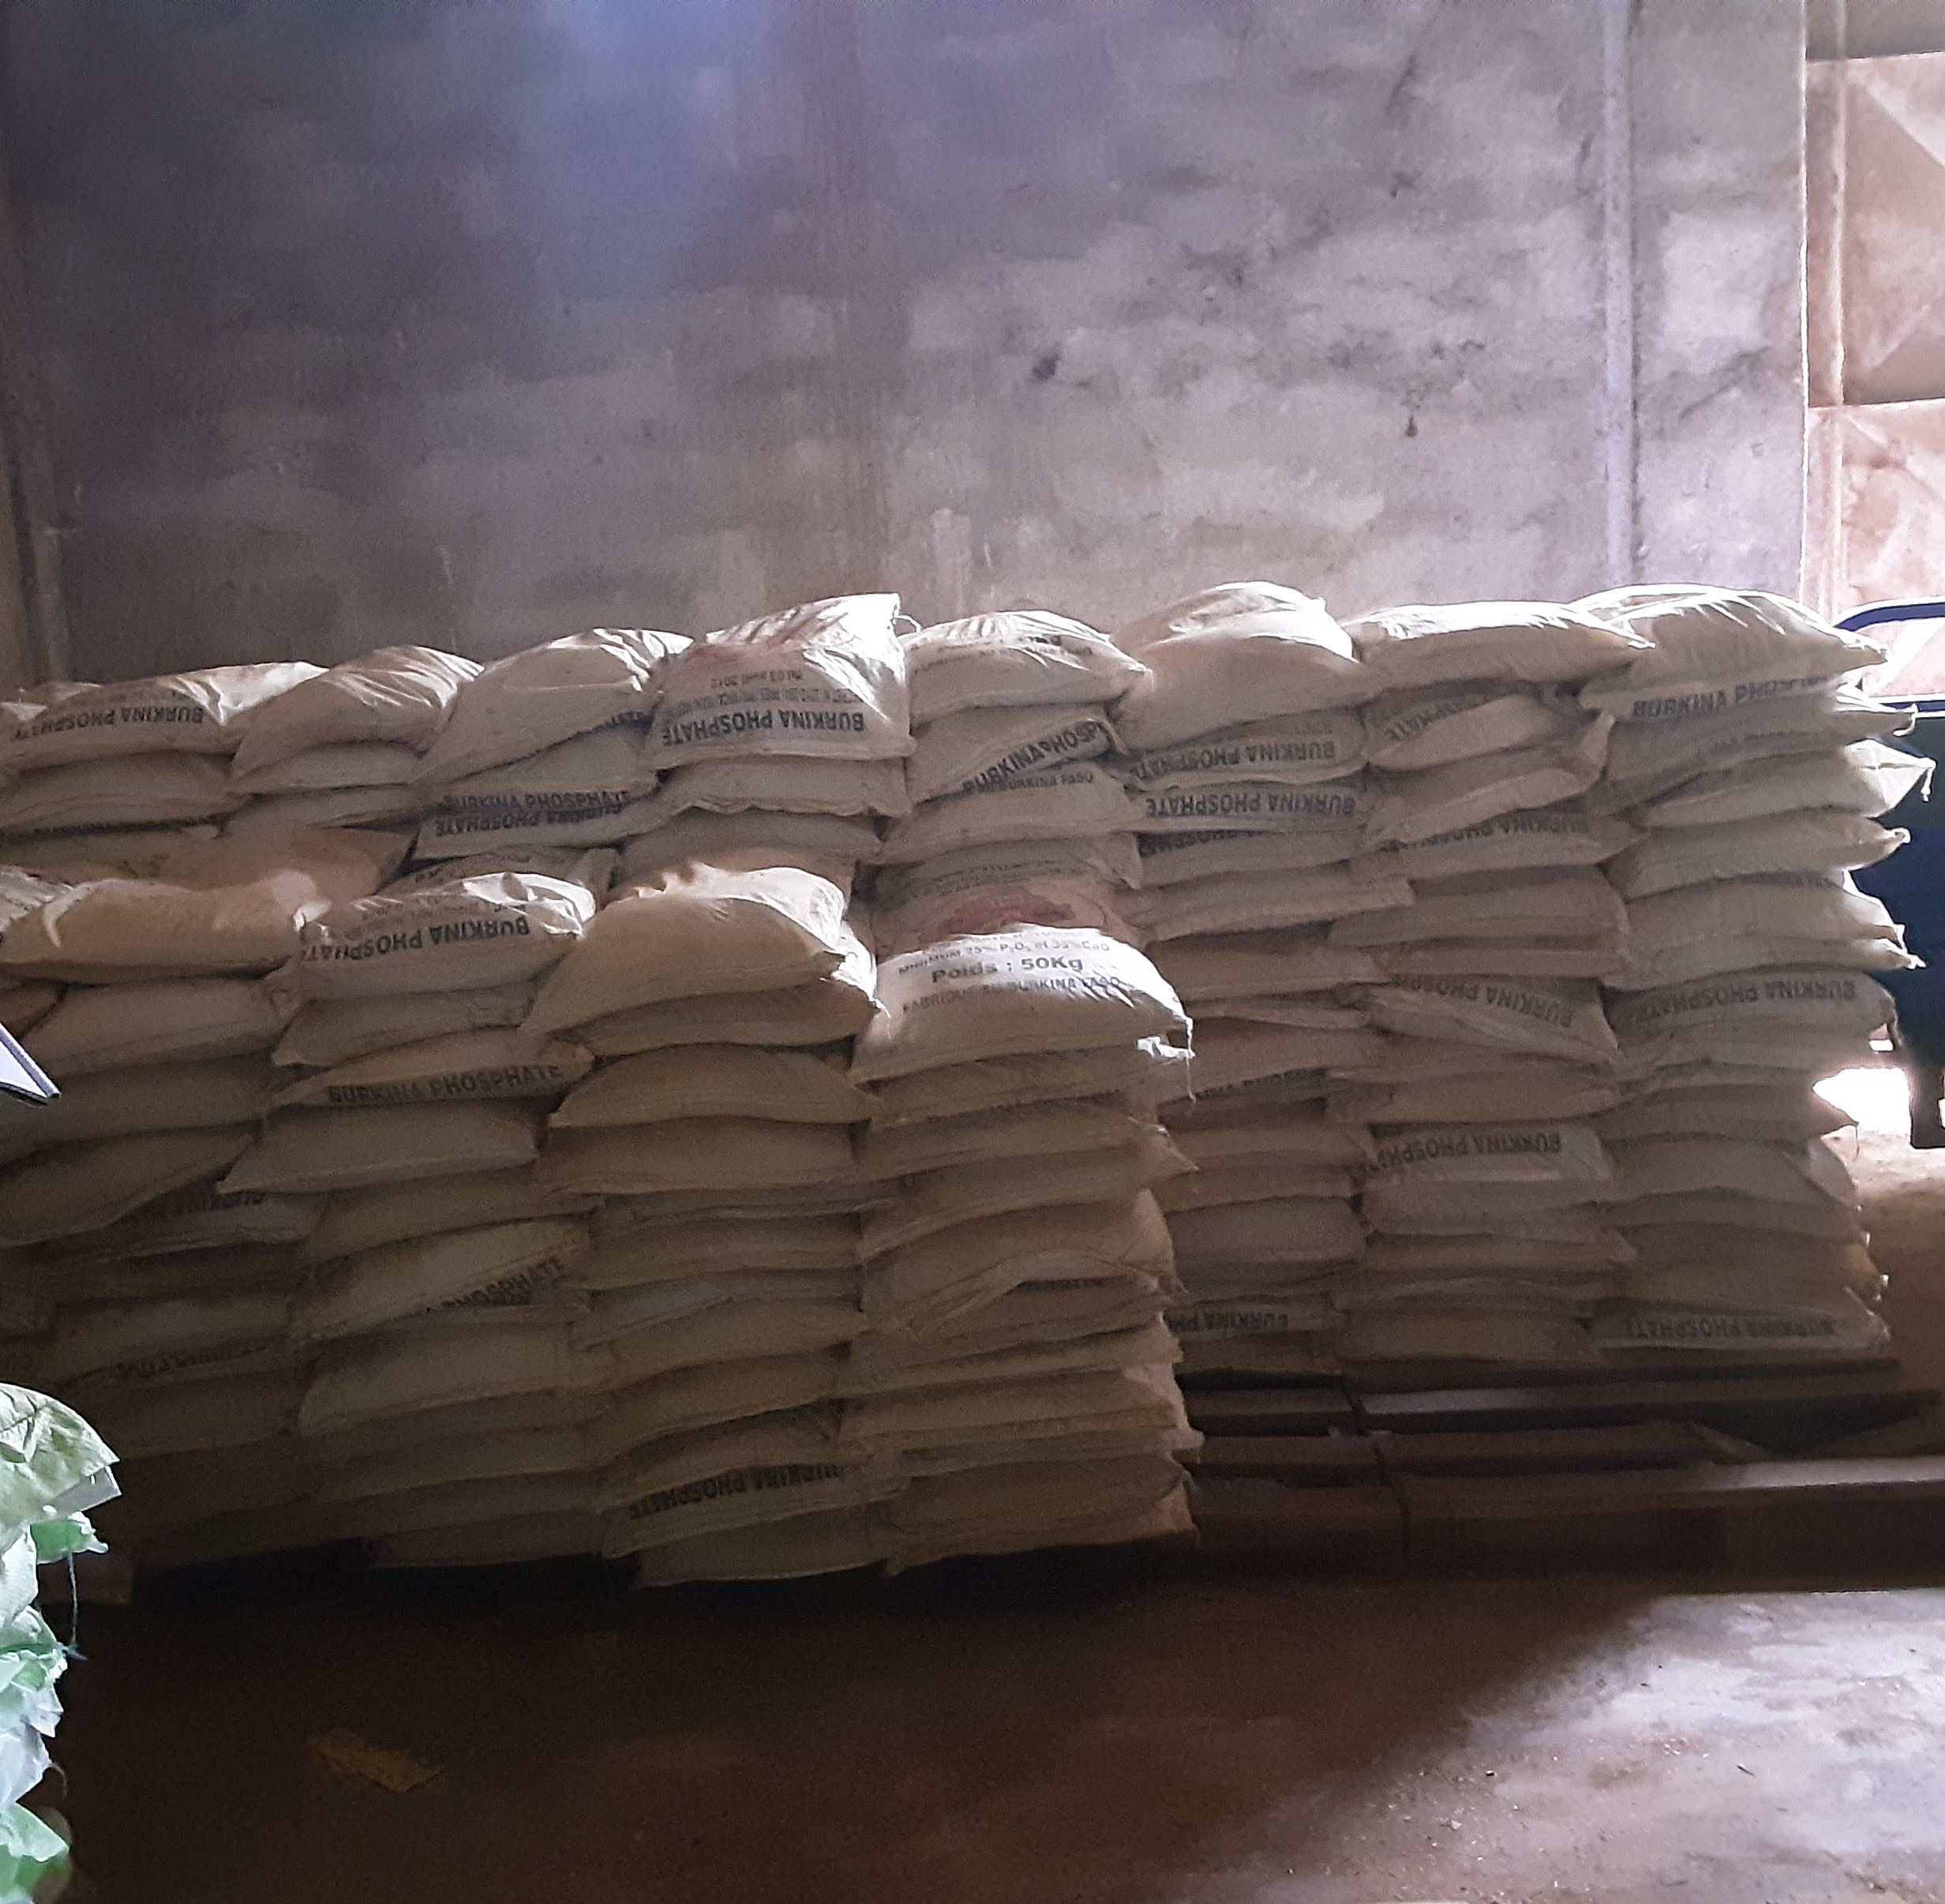
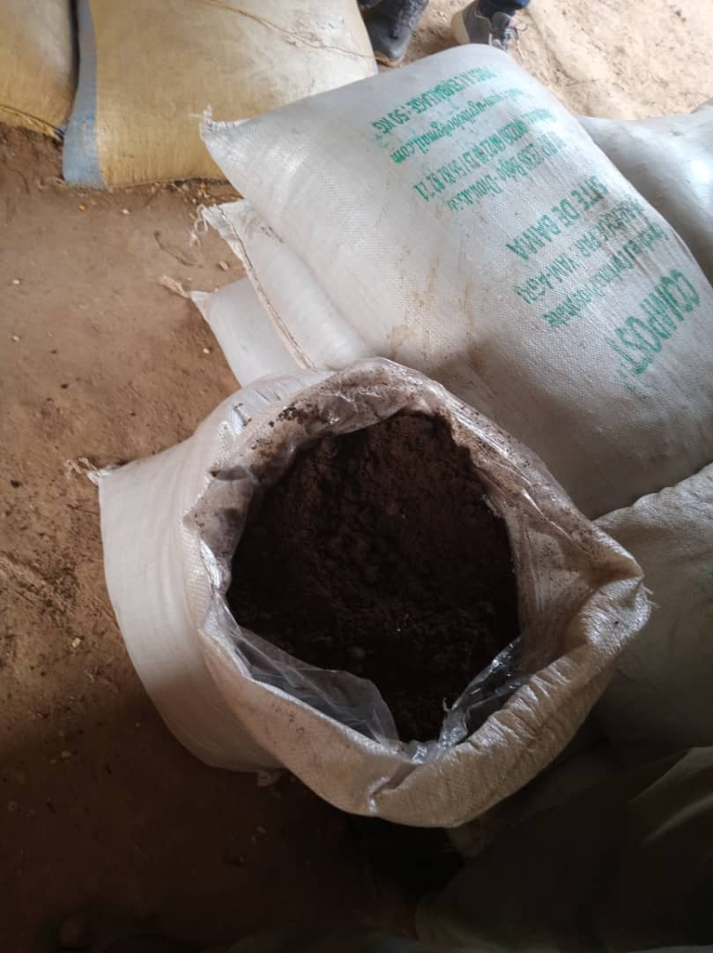
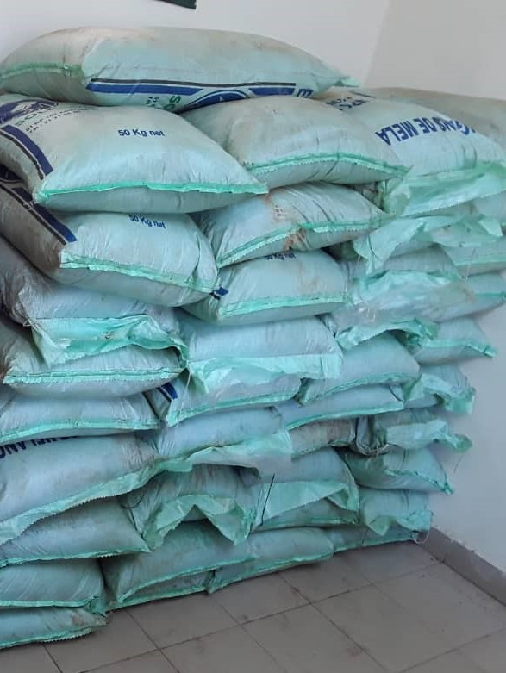
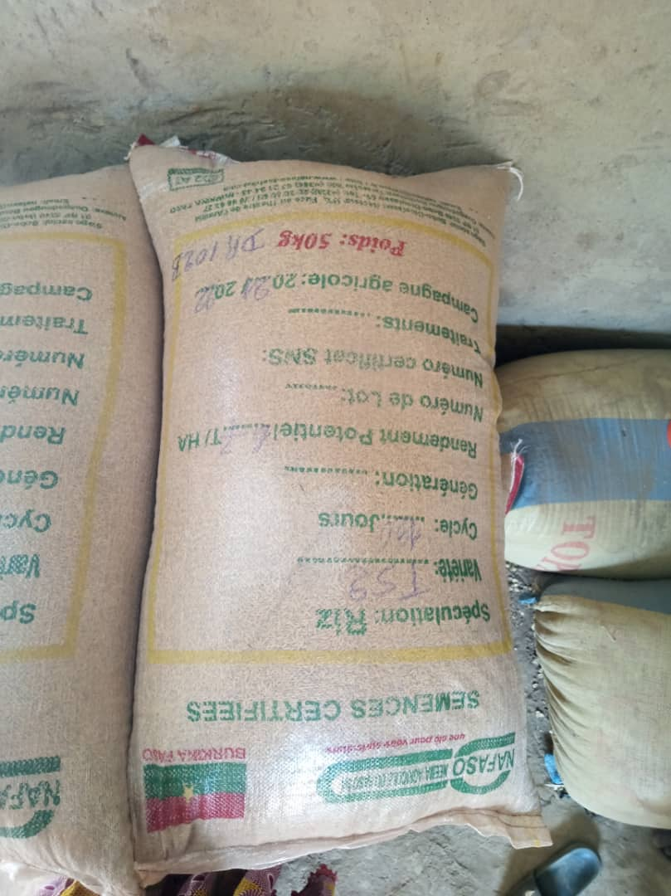
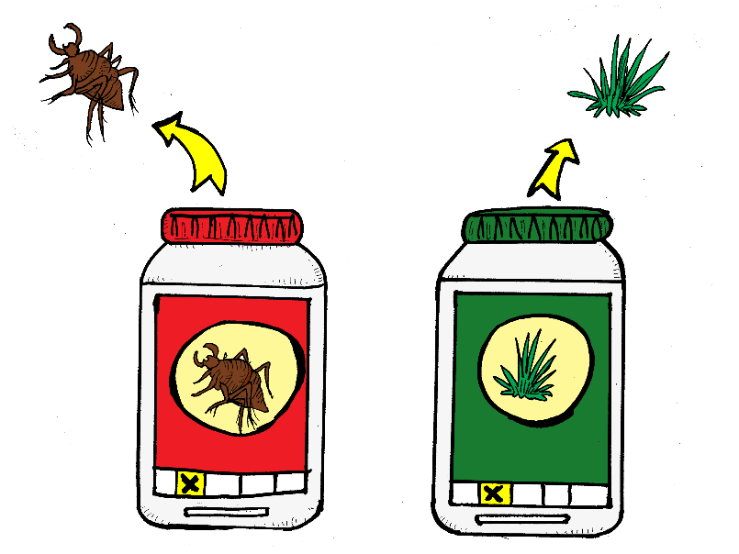
1.DEFINITION OF SPAM
  PAFA-4R funding :
  80% in year 1
  60% in year 2
  40% in year 3
QUALITY INPUTS
BURKINA PHOSPHATE
COMPOST/FO
NPK, UREE
CERTIFIED SEEDS
ORGANIC PESTICIDES

Slide 7
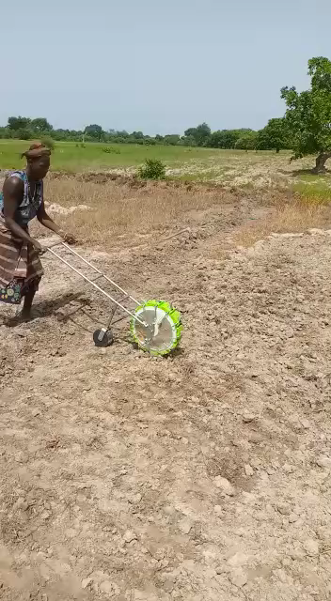
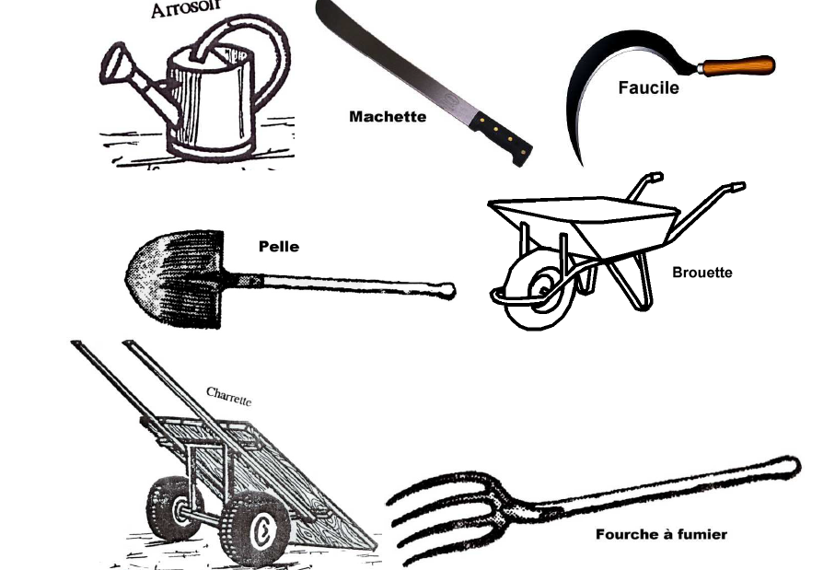
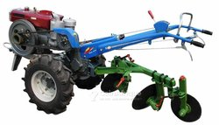
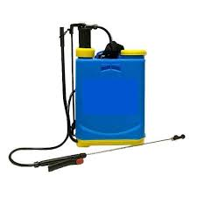
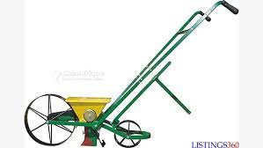
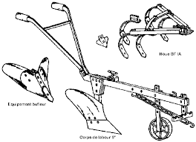
1.DEFINITION OF SPAM
Funded by PAFA-4R at 80% once in year 1
EQUIPMENT
AGRICULTURAL

Slide 8
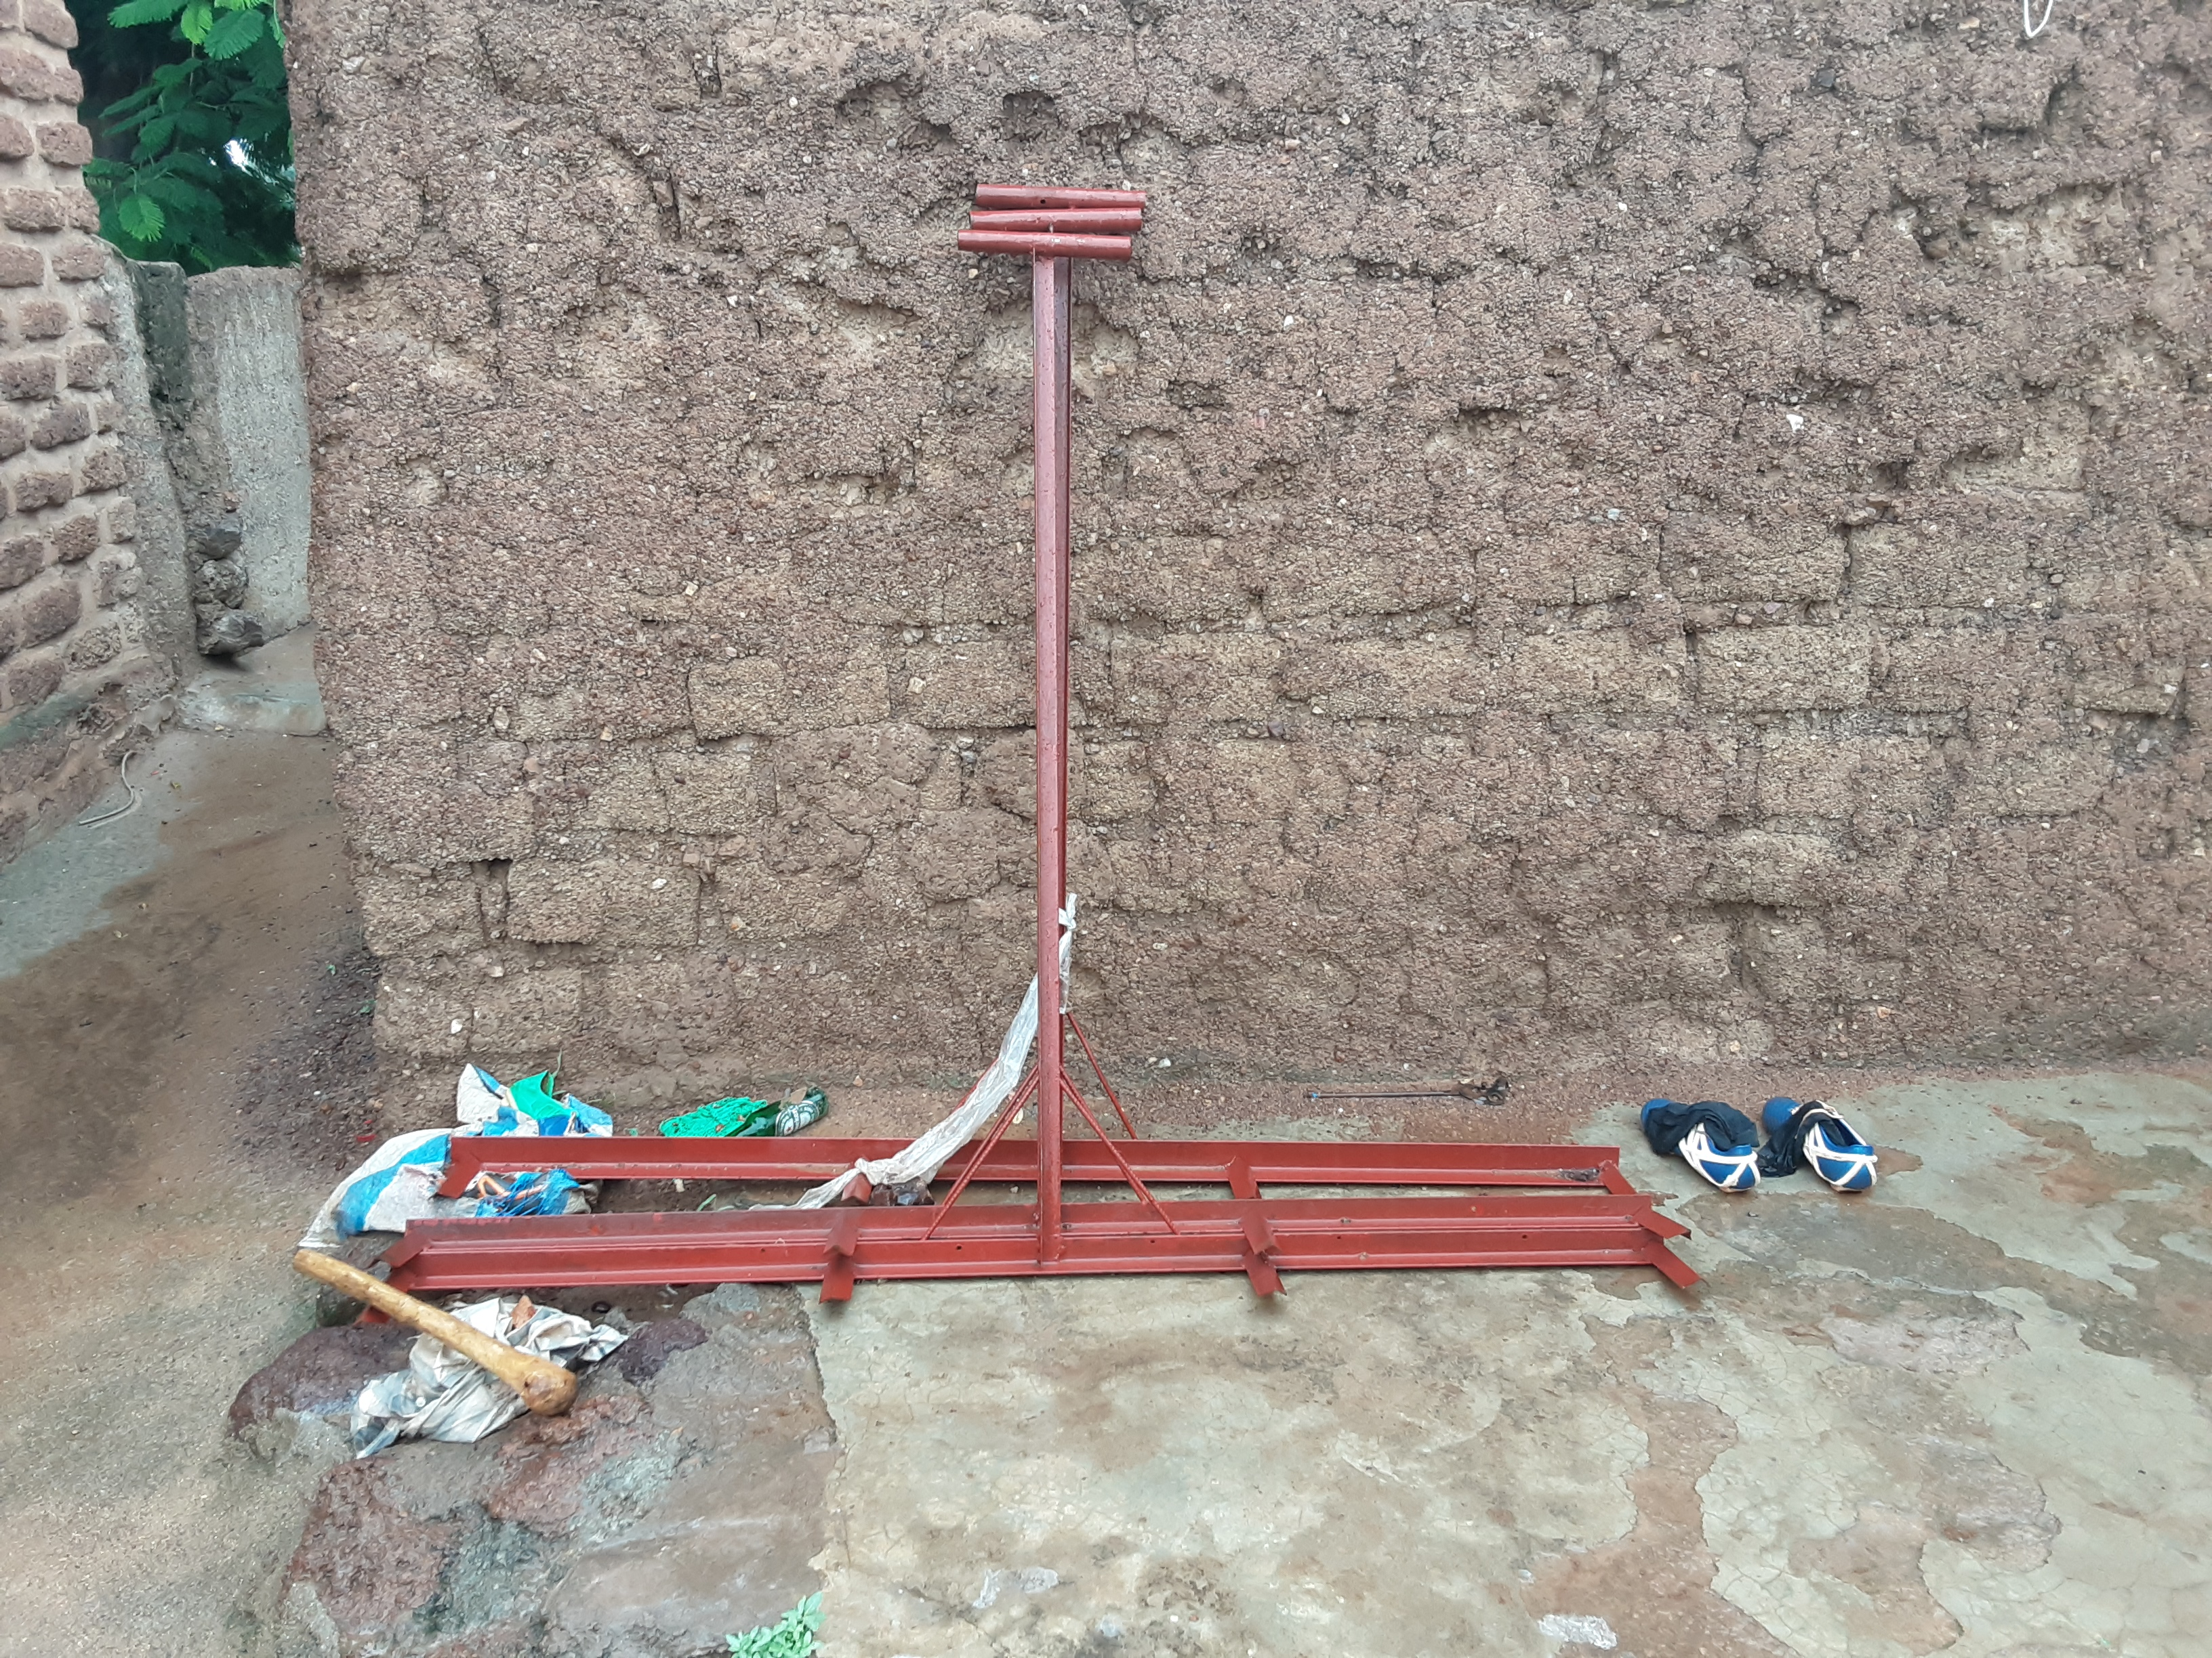
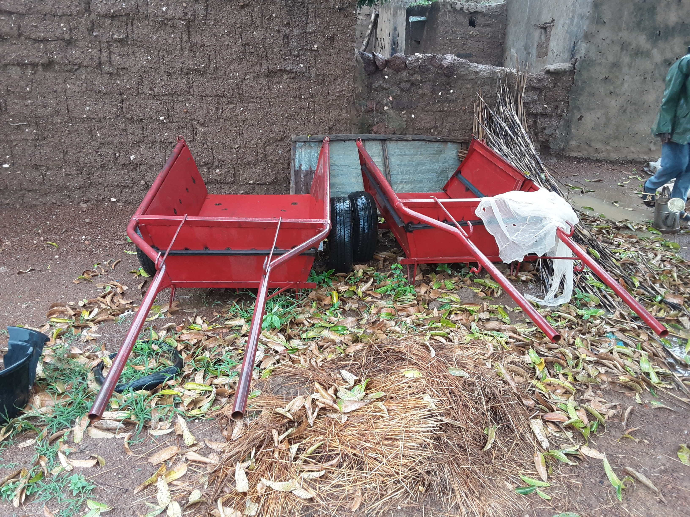

1.DEFINITION OF SPAM
EQUIPMENT
AGRICULTURAL
NB: OPBs should seize the opportunity to innovate in terms of equipment acquisition

Slide 9
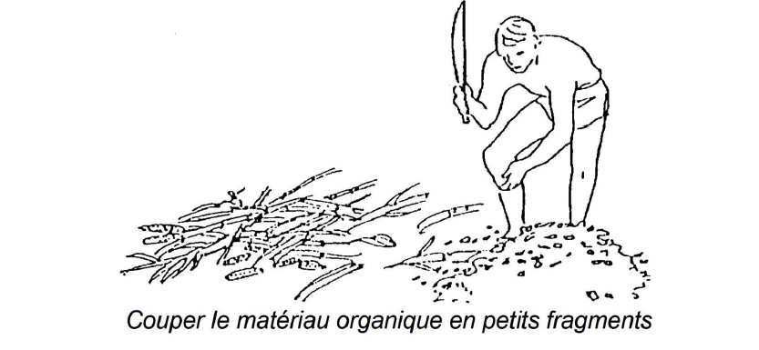
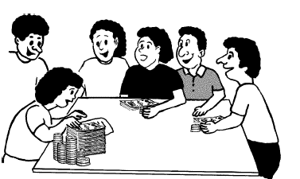
1.DEFINITION OF SPAM
100% funded by PAFA-4R
BOARD
AGRICULTURAL

Slide 10
2.PRINCIPLES AND CONDITIONS OF ACCESS (1/5)
Shared-cost financing
 | Project contribution | Contribution of the OPB beneficiaries
1st Growing Season | 80% | 20%
2nd Growing Season | 60% | 40%
3rd Growing Season | 40% | 60%
  OPB members' own contributions
  Campaign loans contracted with MFIs/SFDs,
  Advances obtained under contracts with market operators
  Prerequisite: deposit of the contribution in an OPB bank account (annually)

Slide 11
2.PRINCIPLES AND CONDITIONS OF ACCESS (1/5)
Be in a legally recognized OPB/ intervention zone (target sectors)
Accept the proposed input package (FO, Burkina phosphate, etc.)
Accept to mobilize your financial contribution and deposit it in a dedicated account
Strong representation of young people and women in the OPB is an asset
Etc.

Slide 12
2.PRINCIPLES AND CONDITIONS OF ACCESS (3/5)
Partnership: facilitate contractualization between SPAM beneficiary farmers' organizations and market operators (farmers' organizations and market operators). This will help to secure access to quality inputs and improve the marketing of produce.

Slide 13
3.IMPLEMENTATION PROCESS (1/1)
OPB, CRA, STD,
Display,
Information/awareness
SPAM editing
Selecting SPAM folders
Implementation
Evaluation
Beneficiaries Technicians
ZAT/UAT/CA
-Completed application form
-List of applicants/signatures
-Receipt
-List of equipment requested
- GNI
- Training actors
- Financing: purchase of inputs/beneficiaries)
- Follow-up/supervision

Slide 14
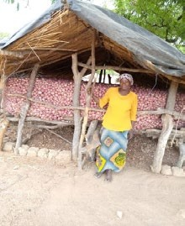
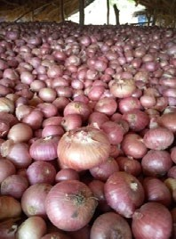
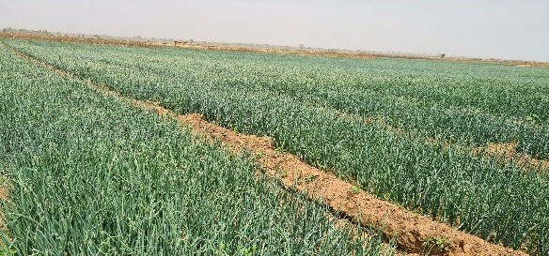
EUVRE
4. RESULTS
Support for 3 generations of OPBs in the PAPFA intervention zone (2019, 2020, 2021)
Support for 3 generations of OPBs in the PAFA-4R intervention zone (2021, 2022 and 2023)
547 SPAMs with a total surface area of 5,522 ha were supported in the PAPFA zone.
780 SPAM with a total area of 3821 ha in the PAFA-4R zone
Increase in sesame yields (from 0.625 to 0.8 t/ha); rice (from 1.9 to 4 t/ha); cowpeas (from 0.437 to 0.81 t/ha) and onions (from 20 to 21 t/ha).

Slide 15
5.LESSONS LEARNED
Increased empowerment of OPBs for sustainable land development ;
Strengthening governance within the OPBs through capacity building for members of the governing bodies;
Support for the structuring of umbrella organizations: several OPBs have been able to comply with the regulations in force and have joined umbrella organizations in the sectors targeted by PAPFA/PAFA-4R ;
Networking: strengthening partnerships and networking, with the side-effect of increasing the farmers' openness to the outside world and creating a climate of trust between players.

Slide 16
5.SUSTAINABILITY CHALLENGES
Close follow-up of SPAM beneficiaries by the network of agricultural advisors with the support of field agents/ MARAH (permanent advisory support structures).
Identification of 2 local animators within each SPAM beneficiary OPB to facilitate local support.
Identification/directory of resource persons (relay farmers, planners, phytosanitary brigadiers, etc.) in the intervention zone to provide their expertise in supporting SPAM beneficiary DPOs.
Links with input suppliers, FIs/MFIs and market operators (empowerment of OPBs and sustainability of actions).
Capacity-building actions for beneficiaries are factors in the sustainability of skills that are appropriated and applied.
Beneficiaries' contribution to financing is a guarantee of the sustainability of support.
SCOOP membership of an umbrella organization, such as the unions, is a factor of integration in the support system for the sector (search for financing, partnerships, markets, etc.).

Slide 17

THANK YOU FOR YOUR KIND ATTENTION

