Slide 1
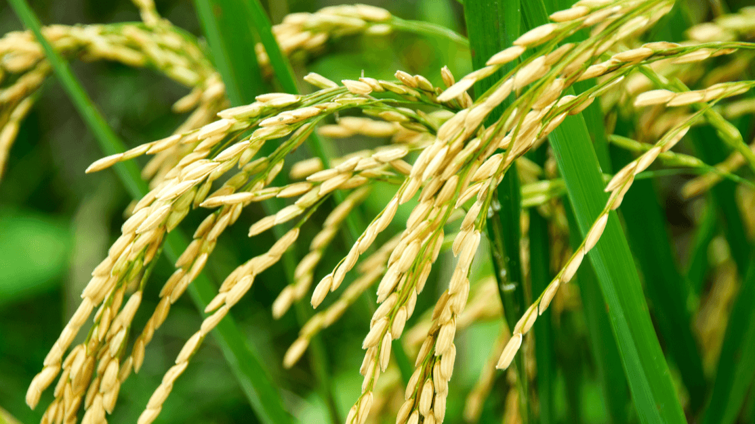
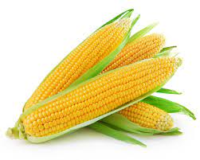
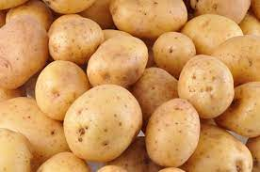
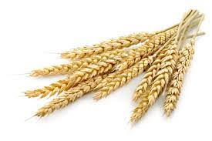
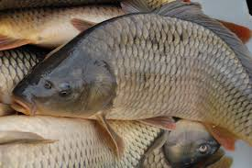
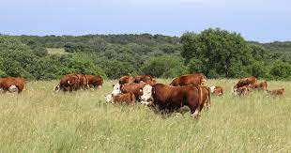
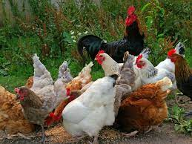
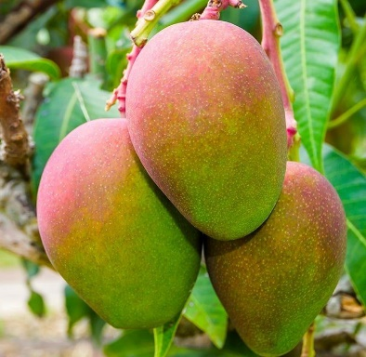
Operational plan for food sovereignty and the creation of decent jobs in the agropastoral sector
Agropastoral and fisheries initiative 2023-2025.
Dr PALE Remy, CDCPI/ST-OAPH

Slide 2
Plan
01
Background and rationale
02
Ambition and objectives
03
Global intervention logic
04
Cost and implementation mechanism
05
Necessary reforms
06
Impacts and implementation

Slide 3
I. Background
The shortcomings of our agricultural policies
Humanitarian situation continues to deteriorate
Existence of strong agro-pastoral potential...
What priority actions and reforms are needed to exploit the country's natural potential?
With what resources and how can they be mobilized to ensure effective intervention?
Ambition of high authorities to achieve food sovereignty in Burkina Faso.
Notes:
This ambition is in line with the vision for the structural transformation of Burkina Faso's agriculture set out in the PNIASP, taking into account recent developments in the national, sub-regional and international context................

Slide 4
II. Ambition and objectives
Adoption of the Operational Plan for Food Sovereignty and the Creation of Decent Jobs in the Agropastoral Sector (Plan Opérationnel pour la souveraineté alimentaire et la création d'emplois décents dans le secteur agropastoral) for 2025 on August 30, 2023
This plan, entitled "Offensive Agropastorale et Halieutique 2023-2025", represents a vision and a commitment to instill a dynamic of structural transformation in agriculture, while helping to rebuild the livelihoods of vulnerable households.
The primary ambition of the Offensive Agropastorale et Halieutique 2023-2025 (OAPH) is to achieve food sovereignty for the country by 2025, focusing on 8 strategic sectors: rice, corn, potatoes, wheat, fish, livestock/meat, poultry and mango.
Notes:
.....................huit strategic sectors in terms of (i) the importance of the product in national consumption, (ii) dependence on imports, (iii) the existence of potential in terms of production capacity, (iv) the opportunity to create decent jobs and income for the poorest and most vulnerable social strata, and (v) the need to preserve or reconstitute strategic production bases for the country.

Slide 5
II. Ambition and objectives
The OAPH plans to :
Annual production
  1,000,000 tonnes of paddy rice to cover 100% of consumption needs through the development of 10,000 ha of irrigated perimeters and 30,000 ha of lowlands;
  2,000,000 tonnes of corn to cover the consumption needs of people and poultry, but also to supply the agri-food industries
  600,000 tonnes of potatoes to cover all import requirements
  18,000,000 head of poultry ;
Produce one hundred thousand (100,000) tons of fish to meet 50% of consumption needs;
Notes:
To this end, the plan envisages a substantial increase in production in these strategic sectors in order to meet the population's consumption needs and reduce/raise our dependence on imports of staple food products.

Slide 6
II. Ambition and objectives
The OAPH plans to :
Rebuild the livestock stocks of 20,000 vulnerable farmers through the distribution of breeding nuclei of small ruminants and cattle feed;
Renew 15% of mango orchards, i.e. 5,000 hectares, with 2,000,000 more productive plants, supported by irrigation systems;
Create 2 modern reference pastoral zones in West Africa at Doubegué-Tchierbo in the Centre-Est region and Sondré-Est in the Centre-Sud region;
Boost national wheat production by developing 1,500 hectares of irrigated land.

Slide 7
III. Overall intervention logic
4
SEPB
- 10,000 young people & VDP
- 6 private developers
- 30,000 small producers
- 250 orchard owners
- 418 producers of P. T
Banks/IMFs
CUMA and BUMIGEB
6
12
CAIMA etc.
Guichet-FDA
10
7'
7
5
- 10,000 ha of perimeter
- 30,000 ha of lowlands
- 250 high-flow boreholes
- 5,000 ha of mangoes
- 1,500 ha of wheat
- 1,200 ha of potatoes
Rice: 1,000,000 T
2
8
Corn: 2,000,000 T
Potatoes: 58,000 T
Agro-Industrial
3
Condition:
- Projects and programs
- Budget
- APEC, FDI
2
Wheat: 6,200 Tons
9
Retailers
Institutional buyers
1
Mango: 5,000 ha
11
- 50,000 poultry kits
- 20,000 Small ruminant kits
- 21,000 floating fish cages
- 2 Modern pastoral zones
Fish: 100,000 Tons
- 50,000 poultry farmers
- 200 poultry farms
- 210 Fish farmers Mod
- 20,000 PR breeders
2
Chicken: 18,000,000 head
9
Agro-Industrial
8
Eggs: 85,000,000 units
3
144,000 small ruminants
26,000 ha of pastureland
10
Stock gross Coop
7
DGRH, CAMVET & CPAVI
5
12
Guichet-FODEL
6
Semi-finished stock
4
Banks/IMFs
Production
Transformation
Marketing

Slide 8
IV. Cost and implementation mechanism
Products | Total budget | Private investment | Public investment
Rice | 309 832 915 010 | 93 654 295 999 | 216 178 619 011
Corn | 69 761 139 853 | 51 931 879 523 | 17 829 260 330
Mango | 18 134 812 500 | 17 692 500 000 | 442 312 500
Potatoes | 3 009 795 097 | 1 504 897 549 | 1 504 897 549
Wheat | 24 354 290 502 | 23 532 966 666 | 821 323 837
Fish | 103 814 137 934 | 101 282 085 789 | 2 532 052 145
Poultry | 40 205 625 000 | 21 412 500 000 | 18 793 125 000
Meat cattle | 23 677 176 667 | 6 850 833 333 | 16 826 343 333
TOTAL | 592 789 892 564 | 317 861 958 859 | 274 927 933 705
Multi-annual programming gives 16% of the investment budget in 2023, compared with 47% and 37% in 2024 and 2025 respectively.

Slide 9
IV. Cost and implementation mechanism
The public funding to be mobilized represents 46% of the total amount.
Public resources will be mobilized by reallocating or restructuring the budgetary appropriations for the projects concerned.
    173 billion FCFA (public funding)
    317 billion, or 54% of the total amount to be raised from private players.
    This leaves a public financing requirement of CFA 101 billion.

Slide 10
V. Necessary reforms
The creation of a single fund, the Fonds de Développement Agropastoral (FDAP), with three branches: one for animal resources, one for fisheries resources and one for crop and fruit production;
the extension of the scope of agropastoral insurance to the eight products included in the initiative;
the introduction of a quota for the purchase of domestic rice and fish by importers;
facilitating agricultural cooperatives' access to institutional food purchases through a contract farming mechanism.
the adoption of specific derogation measures for PPPs and public procurement procedures
the adoption of an alternative mechanism for managing the land purge at the Samendeni and Bagré sites;
the adoption of innovative approaches to mobilizing financial resources and the reorganization of development projects and programs to close the public financing gap, estimated at 101 billion CFA francs.

Slide 11
VI. Impacts and implementation
10.85% increase in agricultural GDP and 4.85% increase in overall GDP.
Rural household incomes will therefore rise by 8.6%, compared with 4.5% for urban households.
the creation of at least 100,000 decent jobs in the agro-pastoral sector for young people, including IDPs and VDPs.
Additional annual production:
647,500 tonnes of rice,
270,000 tonnes of corn
33,400 tons of potatoes,
6,200 tonnes of wheat
77,350 tonnes of merchant fish,
18,000,000 head of poultry
85,000,000 egg units
140,000 head of small ruminants.
Notes:
Development and intensification actions will generate additional annual production

Slide 12
VI. Impacts and implementation
Implementation device:
  The offensive is implemented by MARAH's operational units, i.e. budget programs and decentralized technical departments.
  Coordination and monitoring/evaluation are under the leadership of a Technical Secretariat.
  A Steering Committee provides guidance and ensures that the necessary resources are mobilized.
Complementary processes
  a framework for facilitating budget execution procedures similar to that of the Sahel Emergency Program (SEP)
  a digital web platform set up

Slide 13
Thank you for your attention!

