Slide 1
Action contre la Faim
Burkina Faso
Resilience practices to improve the health and nutrition of vulnerable populations, especially mothers and children vulnerable to shocks and stresses
VimPlus presentation - December 12, 2023

Slide 2
ACF action in BF
2 types of intervention
  Emergency
  Development
Areas of operation
  Health /Nutrition
  SAME
  SMPS
  WASH
  Protection
Resilience activities
  RSS
  SURGE
  Community resilience ( Household BP, GASPA, Delegation of tasks to ASBC, PSP...)

Slide 3
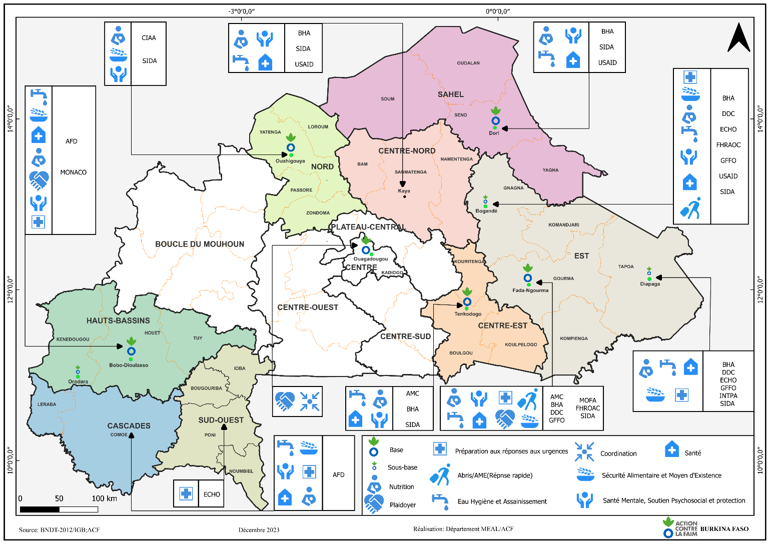
ACF intervention in BF

Slide 4
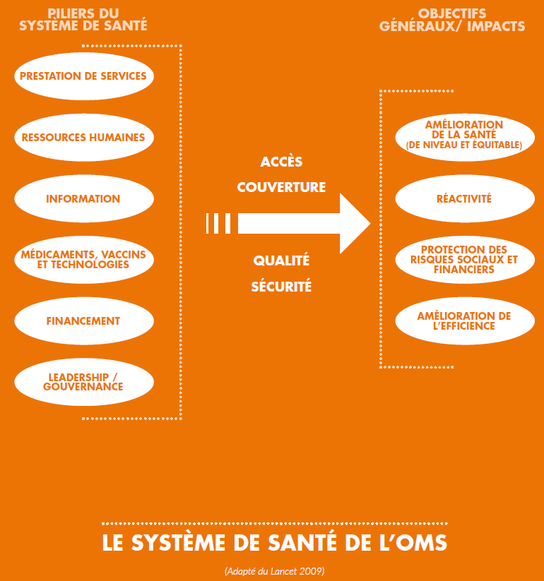
Strengthening health systems
From vertical to horizontal (lessons learned from global health initiatives developed in the 2000s)
Integrating MAS care into the healthcare system

Slide 5
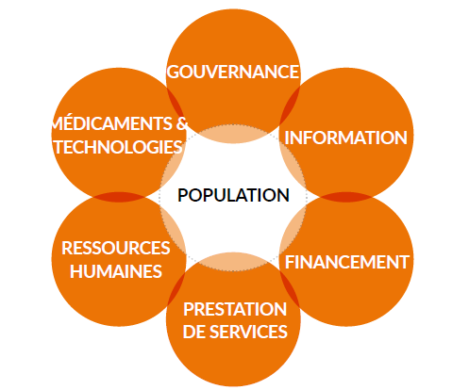
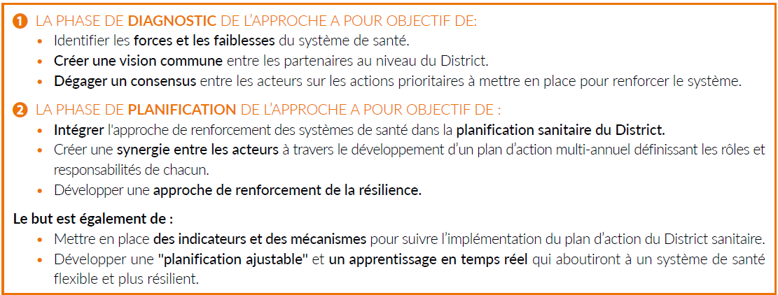
Strengthening health systems
Objectives and phases
Systemic approach based on the 6 pillars of SS

Slide 6
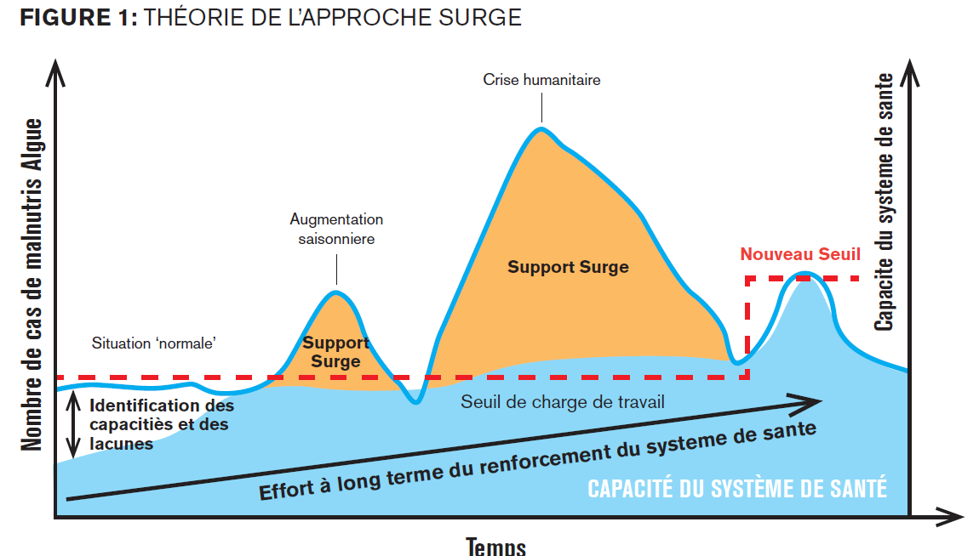
ONGE CMAM/PCIME
Objectives
The aim of this approach is to increase the resilience of the healthcare system so that it is able to provide quality services for the management of acute malnutrition at all times, particularly during periods of high demand when the capacity to save lives must be greatest, and without undermining the capacity and responsibility of government health actors.

Slide 7
Community resilience activities
Cleaning BP,
GASPA,
Access to water in CSPSs
Setting up SMCs
Delegation of tasks to ASBCs,
Awareness-raising and psycho-education on the signs of stress,
PSP training including basic concepts of GBV
Care practices (raising mothers' awareness of mother-child interaction)

Slide 8
Integrating the NEXUS approach: Triple NEXUS
ppTt
Peace
EMERGENCY
Post-emergency /
Deterioration
NORMAL
Replacement
Autonomy
Support for state systems and community networks

Slide 9
The peace dimension in our Nexus approach
Humanitarian access: We are taking the necessary measures to minimize the impact of insecurity on our operations, staff and infrastructure.
Conflict sensitivity: Our actions must not provoke or exacerbate conflict.
Social cohesion: Promoting social cohesion through our actions

Slide 10
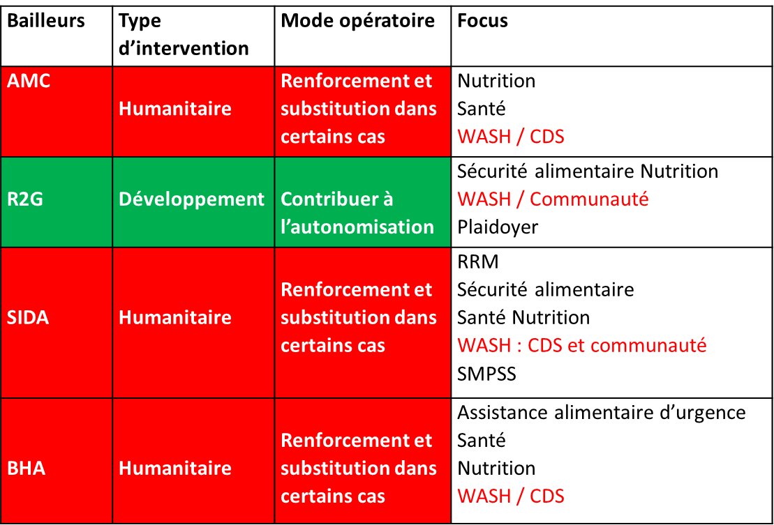
TRIPLE NEXUS HDP: The case of the Eastern region

Slide 11
THANK YOU FOR YOUR ATTENTION

