Slide 1
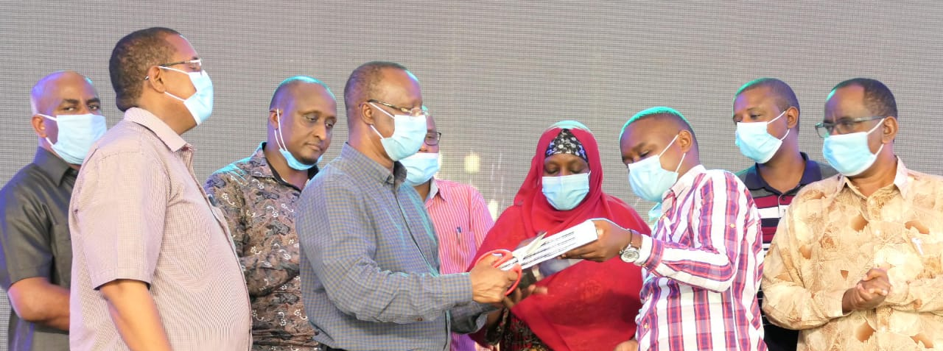
STRENGTHENING COUNTY GOVERNMENTS’ RESILIENCE CAPACITIES THROUGH KNOWLEDGE MANAGEMENT AND STRATEGIC COMMUNICATIONS PRACTICES

Slide 2
OPINION POLL: COUNTY GOVERNMENTS COMMUNICATIONS ENGAGEMENT SPECTRUM
1. Informing
Providing
2. Consulting
Inviting feedback from Counties on decisions related to your program
5. Empowering
Giving County Comms teams the sole decision-making
3. Involving
4. Collaborating
information
about new
programs
Working with
County communications team
to ensure that their
aspirations and
concerns are
considered at every
stage of planning and
decision-making.
Enabling County communications teams to participate in every aspect of planning and decision making to actively produce outcomes.
authority at the drivers’ seat to implement
solutions.
As professionals, you only serve in
consultative and
supportive roles
The County with balanced and
objective
As USAID Implementing Partners,
On a scale of 1-5 above, what is the level of your program’s engagement with the County Governments Communications teams? Where do you aspire to be?

Slide 3
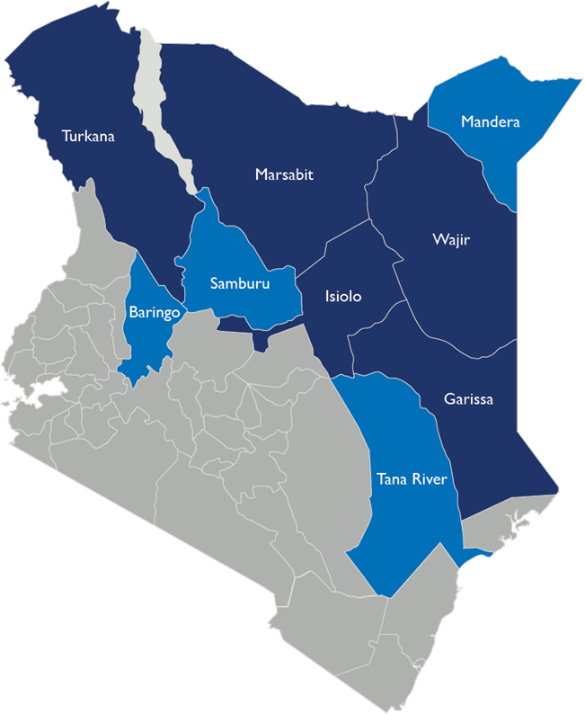
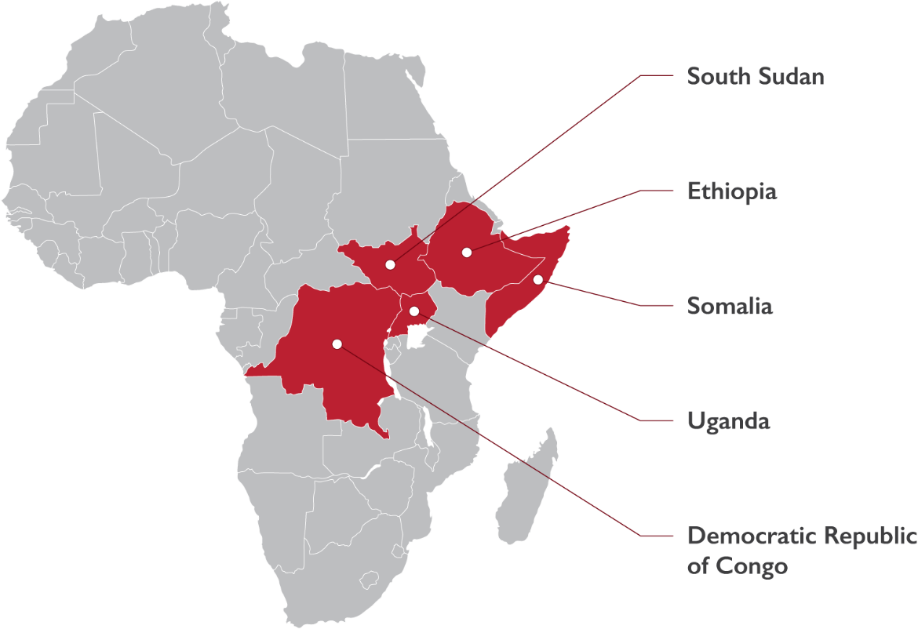
GEOGRAPHICAL AREAS OF INTERVENTION
RLA is a five-year initiative funded by the United States Agency for International Development (USAID) to support regional and country-level institutions to conduct resilience learning activities in Kenya and the Horn of Africa (HoA).

Slide 4
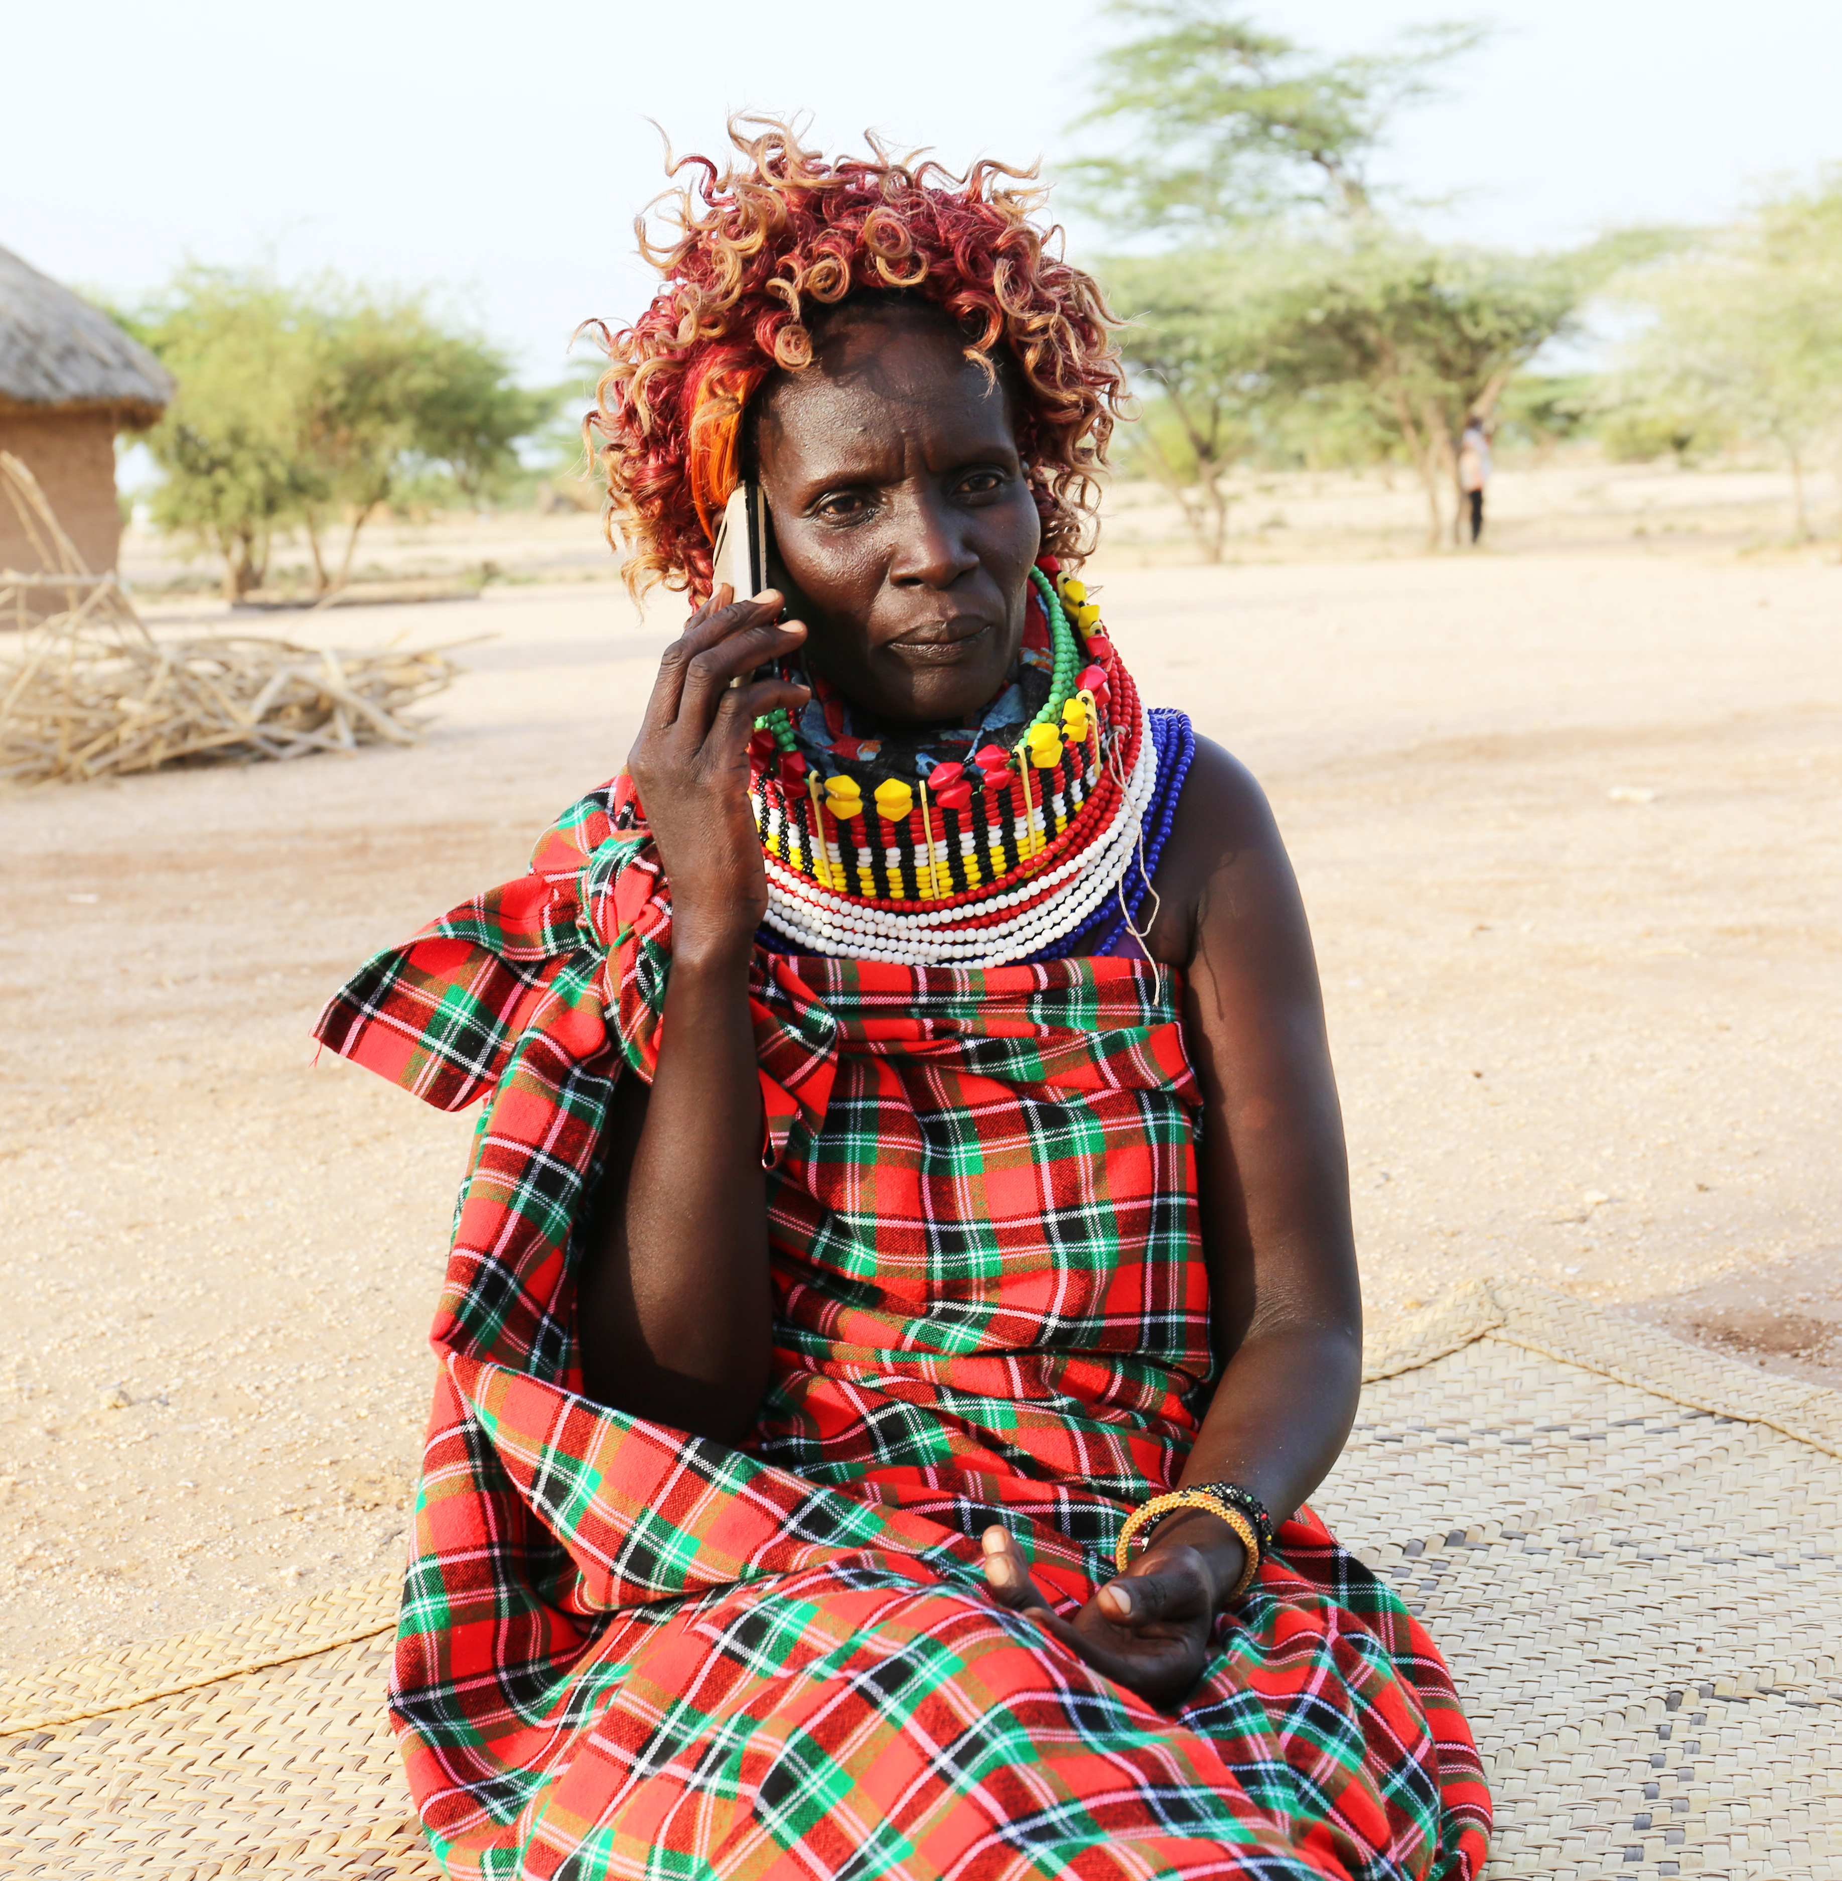
OBJECTIVE 3: KNOWLEDGE MANAGEMENT AND STRATEGIC COMMUNICATIONS
Local organizations need to package knowledge management analytics in accessible, practical, and applicable forms for decision-makers.
Strategic communications ensures that programs’ lessons are effectively shared and communicated with stakeholders.
This becomes the foundation for building networks for learning.

Slide 5
COMMUNICATIONS CHALLENGE AT THE COUNTY LEVEL
There are no/limited clear means of capturing knowledge, storing, managing, and harnessing it for decision-making at County level.
Information among stakeholders is in different pockets thus limited access for decision-making.
USAID-RLA is working with the County Government and local partners to create change-
by improving communications and the flow of information to build resilience in a region that suffers from shocks and stresses

Slide 6
WHO ARE WE WORKING WITH?
County Executives/top leadership
Communications and M&E reps from Ministries of
Agriculture, Livestock and Fisheries
Economic Planning
Health and Nutrition
Youth and Gender
Trade and Finance
Special Programs
Political Representation from County Secretary/Office of Governor
USAID Implementing partners and other development organizations
COUNTY GOVERNMENTS
National Government Representation at county level
through – Government agencies like NDMA & KNBS
CSO networks, Opinion leaders and influencers, women & youths, Religious leaders and local media outlets
Local Organizations, Business Community
70%
County Government Representatives

Slide 7
RLA- KNOWLEDGE MANAGEMENT AND COMMUNICATIONS INTERVENTIONS
Inter-County Departments
County-Community
County-County Learnings
Target Audience
Training on Knowledge Sharing methodologies
Development of Communications and KM products
Strengthening interdepartmental linkages for info sharing
Supporting county leaders to have sessions on local Radio to share information
Training County Executives including Governors
Development of County KM and Comms Strategies
Joint Community KM and Comms Community Needs Assessment study
Learning by Doing through WhatsApp mentorship groups
Joint Directors of Communications physical meetings to take stock of progress and learn from each County’s practices
Activities
Increased coordination and clarity of information flow across county departments
Strengthened county, and other actor's coordination mechanism and structures
Increased awareness among population on County Government and USAID joint interventions
Feedback loops and mechanisms established from community level to County level =Connecting County leaders to the people
Trained County leaders and community influencers
Strengthened monitoring, evaluation and research activities
Outputs

Slide 8
WHAT WE HAVE DONE: KM AND COMMS INTERVENTIONS
Activity | Description
KM and Communications Audit at County level | Conducted initial analysis and assessments to establish exiting KM and Communications culture, practices, structural, capacity and process gaps and opportunities at County level
Sensitization and buy-in from County Executives/leaders | Held sensitization forums with County executives, governors included, to create awareness on the importance of integrating KM and Communications in the daily business operations
Training/capacity building of County Communications teams | Trained County teams on skills-specific communications and KM areas Continuous information sharing and cross-county learning through WhatsApp group
Development of Communications Strategies and County Disaster Risk Communications Plans | Supported Isiolo County to develop its Crisis and Disaster Risk Communications plan launched in March Supported Turkana County in its County Communications Strategy process
Training/Capacity Building of local media outlets journalists | Trained local media journalists on working with the County Governments and local communities.
Collaboration with County Governments to carry out Community Communications Needs Assessment surveys. Joint Documentation of success stories with County Governments, Local media and USAID IPs | Collaborated with County Governments of Isiolo, Garissa, Turkana and Kitui to conduct Community KM and Communications needs Assessment surveys Held writeshops for training County Governments, local media outlets and USAID IPs together in Turkana County, after which journalists and County teams proceeded to document the success stories from USAID IPs while integrating the elements of collaboration and County Government interventions

Slide 9
WHAT HAS WORKED WELL
Great support and buy-in from County executives and communications teams. Influencing perceptions: Political goodwill from leaders.
Development and launch of the Isiolo County Disaster Risk and Crisis Communications plan
Supporting the development and finalization of Turkana County Communications Strategy
Improved relationship between County leaders and local journalists

Slide 10
WHAT HAS WORKED WELL
Kitui County budgetary allocation of Ksh. 35million to Comms and KM activities 2021/2021 FY following RLA’s engagement and sensitization forum
Isiolo County purchasing Comms equipment for its County staff after RLA’s engagement
USAID IPs and County Government teams conducting Joint success story documentation processes in Turkana
Great support received from USAID IP communications managers led by Nawiri’s CRS and MercyCorps. Continuous commitment by County Government Comms directors to learn and share information in the WhatsApp group promotes learning

Slide 11
WHAT WE HAVE LEARNED FROM THE COUNTY ENGAGEMENTS
Most Counties have both the Office of the Governor’s press and that of Public Service. Engage both offices.
Communications officeholders at the county level are from dynamic career backgrounds, so train and build capacity.
Support the institutionalization of data systems and knowledge management culture.
Build on existing traditional systems of communication already in place than re-inventing the wheel.
Budgetary allocations and resource mobilization: IPs to set aside some budgets to support counties communications activities.
Support and invest in local/Community media capacity.
Collective action, collective impact and collaboration should be prioritized by all stakeholders.
Simplicity is key-use methods that are interactive, citizen-based and focus on peer-to-peer learning in building communications

Slide 12
CHALLENGES & OPPORTUNITIES FOR IMPROVEMENT
Limited/lack of budgetary allocations/resources to communications teams at county level.
Need to strengthen the Communications departments and capacity of office holders
Most USAID Implementing partners do not involve us-the County Communications teams in joint visits and success stories coverage. We just read in the media about USAID’s work in our counties
It is a political campaign period season thus counties have divided attention

Slide 13
OPPORTUNITIES FOR USAID IPS TO COLLABORATE
Joint information sharing forums for feedback loops on research work done by implementing partners.
Build the capacity of the County communications teams.
Development and roll-out of County communications strategies and risk/crisis plans.
Joint site visits and documentation of success stories and best practices for media coverage
Joint community media programming to provide thematic content
Support Counties to set up their information and knowledge resource centers
Strengthening the County websites into effective and efficient KM tools.
Plugin on the County social media platforms to publicize IP’s interventions in the counties.
Support with communications equipment like---cameras, laptops

Slide 14
LEARNING QUESTIONS
What can counties best do by themselves?
What do they need some help from organizations to do, and
What can we offer to County Governments to support their actions?
What is the story you tell about your work in the counties and what roles do County Government representatives play in your story?
How can you support more leadership, engagement, and connection of County Communications teams as partners in producing your impact/result?

Slide 15
ASANTE

