Slide 1
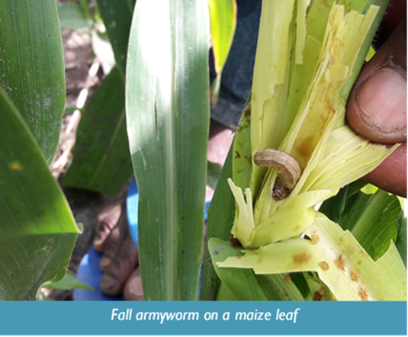
Fall Armyworm:
Lessons from the Field
Emmanuel Dormon
Chief of Party, USAID/Ghana ADVANCE II Activity
Patricia Gichinga
Head of Productions, the Mediae Company
Silvanus Mruma
Component Lead, Access to Inputs, USAID/Tanzania NAFAKA II Activity
July 24, 2019
Facilitated by Daniel White
Senior Technical Advisor, ACDI/VOCA

Slide 2
Fall Armyworm (FAW) Overview
FAW OUTBREAK IN AFRICA: February- April 2017 (CABI, 2017)
8—21 million
metric tons of lost maize per year
$2.5—6.2Bn
Lost value

Slide 3
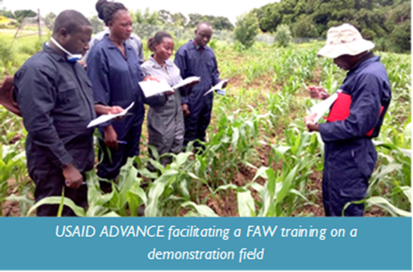
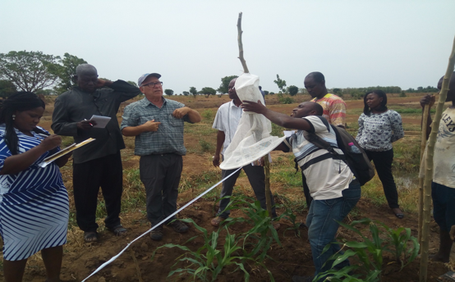
Ghana ADVANCE II
FAW was identified in Ghana in 2016
  Distinguished from the African armyworm
ADVANCE brought in Expert from USA to help identification
Ghana government set up national Task Force in 2017 (USAID ADVANCE is member)
Extensive training of field staff

Slide 4
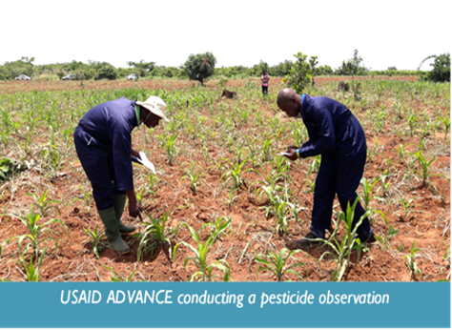
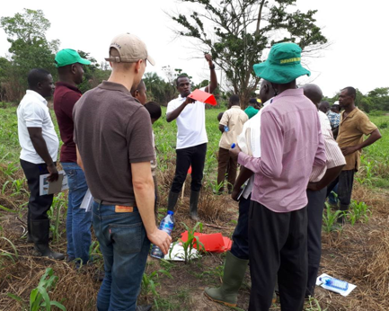
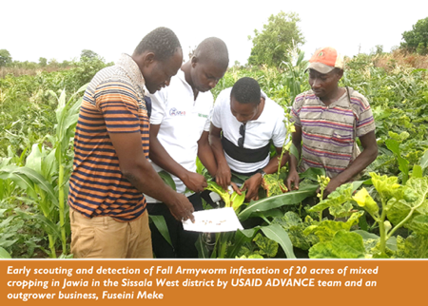
Ghana ADVANCE II
Together with national Taskforce
Trained project and MoFA Staff on pheromone trap set up and scouting
Monitored and collected data from pheromone traps
Developed a national framework on effective FAW response
Recommended pesticide for FAW control
  Recommended time for pesticide application
  Recommended dosage and plant stage
  But pesticide handling may not be done professionally (unless SSPs are used)

Slide 5
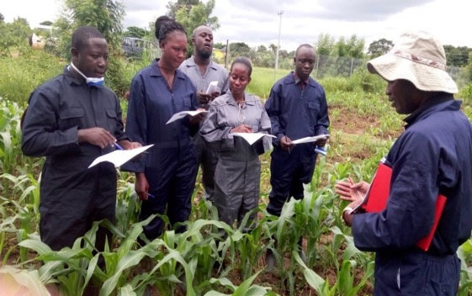
Training, Education and Awareness
Ghana ADVANCE II
Trainings
Agric. Extension Professionals
Media Personnel
Out grower Businesses
Smallholder farmers
Project staff
Spray Service Providers
Training materials
FAW Management Protocol
Training manual for smallholder farmer
Recommendation guide
Awareness through radio and Adverts
Radio jingles in 10 languages
Posters and leaflet
Call Center Awareness
Three hotlines to provide direct support to farmers

Slide 6
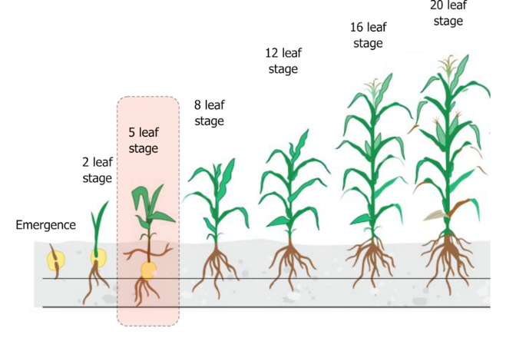
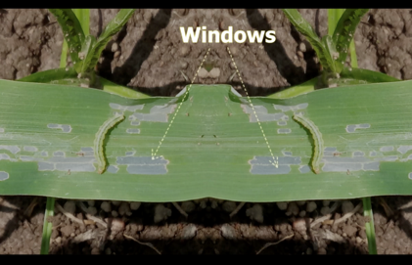
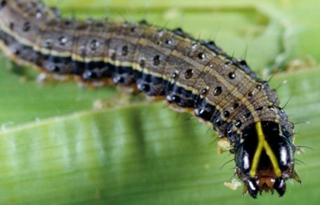
The Mediae Company
Partner Organization: DAI
Assignment Topic: Raise awareness on identification, control of Fall Army Worm
May 2018- May 2019
Aim: Helping farmers identify FAW and how to mitigate it before the five leaf stage
Short animation
Look out for clear patches on the leaves called windows
They have three yellow stripes all along the back and an upside down Y shape on its head.
There are also 4 black spots by its tail.
Animated clip: https://www.youtube.com/watch?v=ERXRiaiVPq0

Slide 7
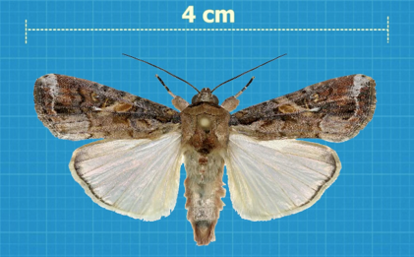

The Mediae Company
Building Farmer Awareness through Shamba Shape Up
Make over programme on smallholder farms
Broadcast in Kenya ,Tanzania (Swa, Eng)
8 Million audience
Focus: FAW identification, control using animations

Slide 8
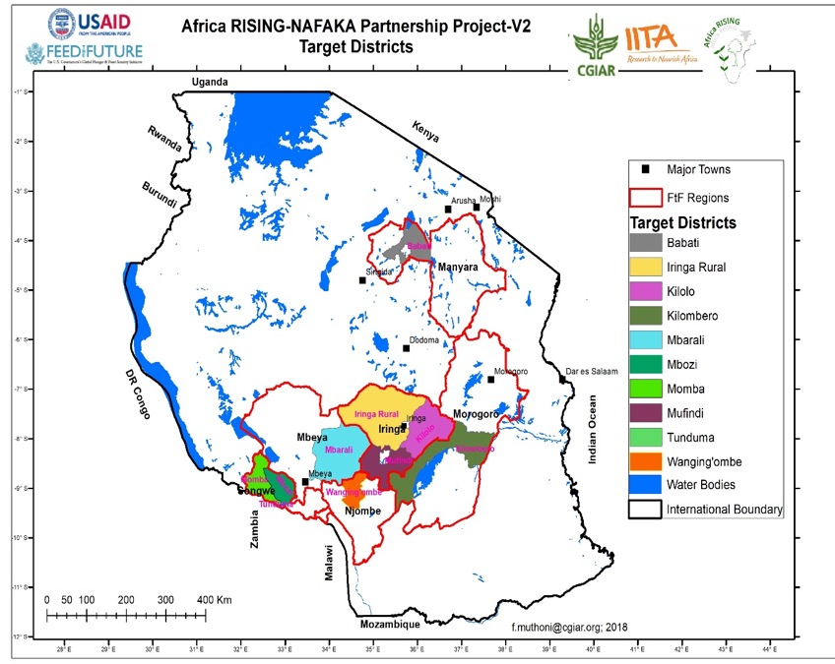
Tanzania NAFAKA II
First reported case N.E, Central and South West Tanzania in March, 2017
Farmers reported an unusual larvae feeding on both mature & immature maize plants
NAFAKA liaised with GoT, IITA and identified the mysterious larvae to be Fall Army Worm

Slide 9
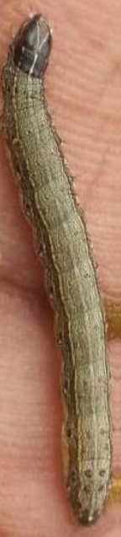
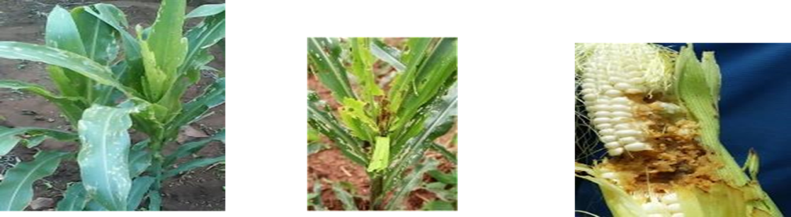
Tanzania NAFAKA II
NAFAKA Seed and Input Specialist attended a regional training for agronomists, entomologists, decision makers from Governments, NGOs, and multilateral development organization in Addis Ababa Ethiopia
Worked in collaboration with IITA, Departments of Agriculture in District Councils to design a training program for GoT Extension staff, lead Farmers and Village Based Agricultural Advisors

Slide 10
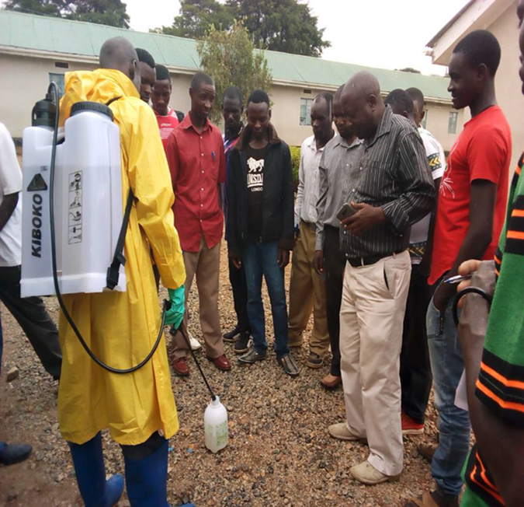
Tanzania NAFAKA II
Building Farmer Awareness- Approaches used by NAFAKA
Training of Trainers(TOT)
Cascade Training by VAEOS, VBAAs, SSPs and Lead Farmers
Public Information Campaigns: Radio Interviews, Flyers, Posters

Slide 11
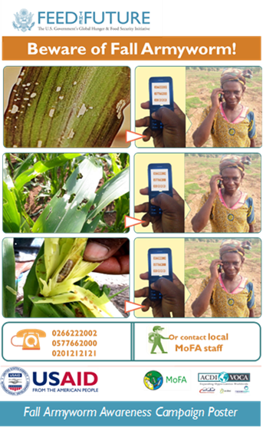
Ghana ADVANCE II
Awareness campaign on the pest through:
  Radio broadcasts,
  Posters, and
  Call center to provide direct technical support to farmers
Lessons from using call center
  Calls were mainly made by men; only 4% women
  Most callers (66%) called the center at least twice.
  Main information sought from was how to control the FAW
  All the farmers said that the information was useful
  Over 80% (83.3%) applied the information
  Main challenge is mobile phone penetration in rural areas, especially for women

Slide 12
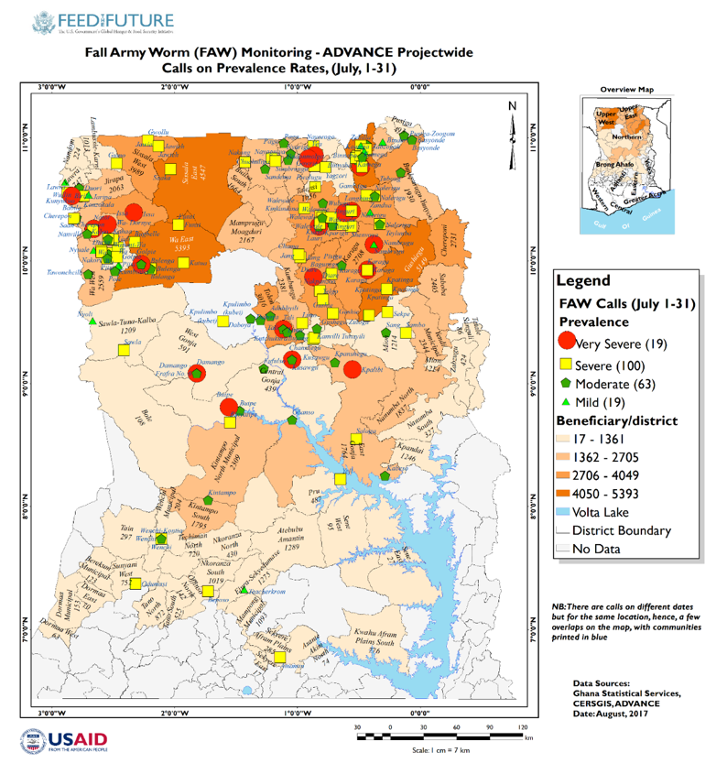
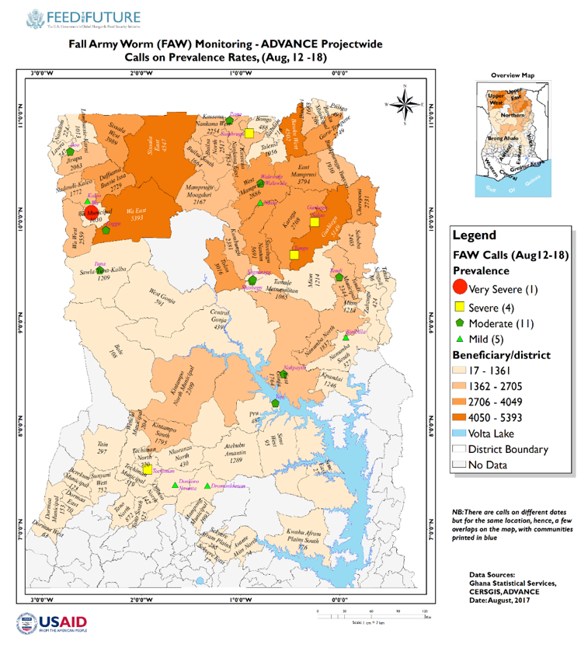
Map of areas from which calls were received on FAW incidence

Slide 13

iShamba Call Center Advisory
The Mediae Company
iShamba
iShamba is a mobile back up call center – it is promoted on Shamba Shape Up
275,000 signed up farmers
Viewers encouraged to sign up to iShamba to receive more information on FAW
Do's
Listen carefully to the farmer when raising a problem on FAW.
Take down the notes related to the description of the symptoms of the plant and description of the insect
Find out when the problem started the levels of spread
For farmers who send in an SMS, confirm the description fits that of FAW.
For the Premium farmers, diagnosis is easier as our call centre experts ask for images of the plant and the insect
Making the correct diagnosis is key to determining the correct way to treat
We give alerts to farmers living in areas prone to attacks
Don't
Our experts would not conclude an attack of FAW before listening carefully to the symptoms and making further inquiries
We do not give rates of mixing until we are sure after checking on the labels of different brands of insecticides used to control FAW

Slide 14
Tanzania NAFAKA II
Cultural Practices Pros & Cons
Push/Pull method developed by ICIPE
Perimeter attractor crop to ‘pull’ the FAW out of the field
Field hygiene (weeding)
Push/Pull
Pros:
Safety
Sustainability (FAW does not develop resistance)
Cons:
Intensive method
Requires supporting nurseries, community development approach
Repellent intercrop (legumes) to ‘push’ the FAW out of the field

Slide 15
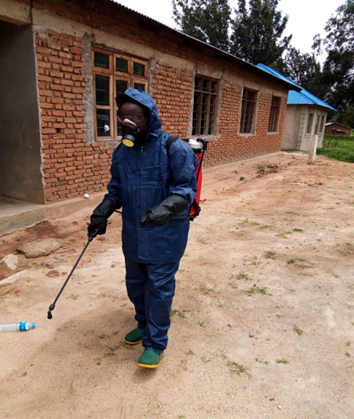
Tanzania NAFAKA II
Pesticides: Pros & Cons
Effectively curtailed the FAW disaster in NAFAKA project area when the right chemical used with proper application method
Massive income generation for VBAAs: 250 VBAAs linked with hub agro dealers and sold about 45,000liters of insecticides in 2 seasons 2017 and 2018
Cons
Risk of environmental hazards and intoxication to farmers with limited knowledge on safer use and handling
A very narrow range of insecticides are effective against FAW

Slide 16
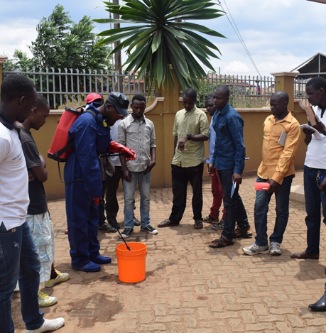
Tanzania NAFAKA II
Pesticides: Pros & Cons
Youth Sprayer Service Providers
Pros
Limits exposure to toxic chemical among farmers with limited knowledge about handling and safer use
Income generation: 153 VBAAs, 105 Youth trained as professional Sprayer Service Providers
Cons
Very Expensive to train a professional Sprayer Service Providers: full set of PPE Kits, travels, logistics, accommodation, monitoring and follow up.
Need to be accompanied with a heavy behavior change and communication campaign to guarantee effectiveness

Slide 17
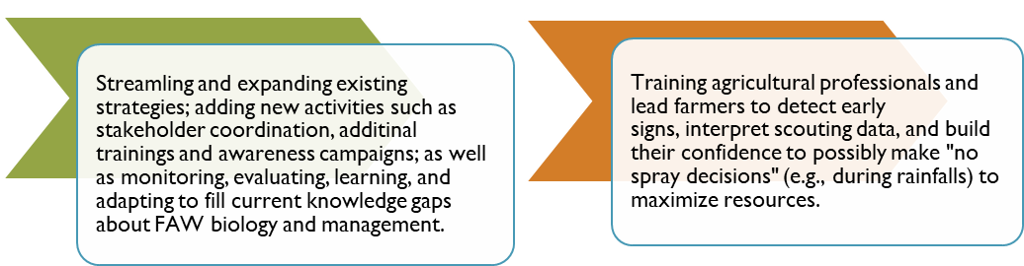
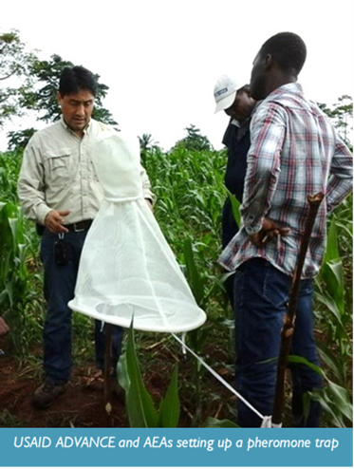
Ghana ADVANCE II: Next Steps
FAW is an invasive pest;
  its introduction, as well as biological and ecological adaptation are still speculative
  More research, expertise, and time are necessary to establish best practices to manage the pest.

Slide 18
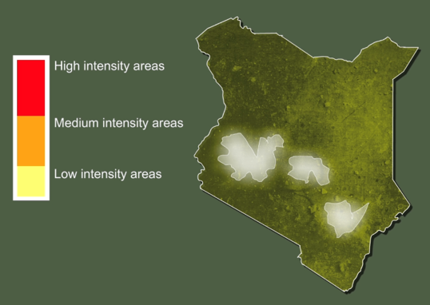

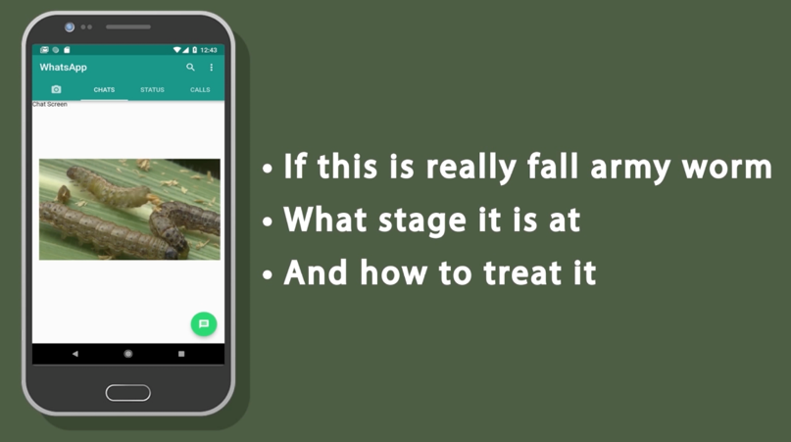
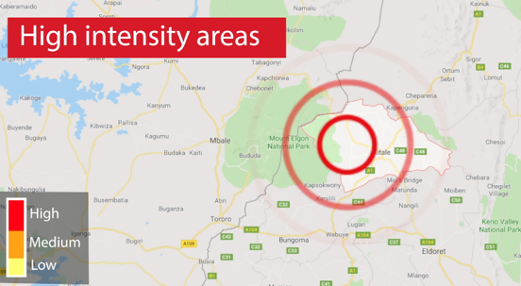
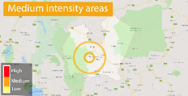
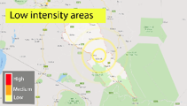
Future
The Mediae Company: Next Steps
On Shamba Shape Up
On iShamba

Slide 19
Tanzania NAFAKA II: Next Steps
Strengthening existing commercial linkages between suppliers of FAW control pesticides, VBAAs and Producer organization focusing on fostering last mile distribution networks.
Monitoring and follow up Pest outbreak in collaboration with District councils using pheromone trap installed by Ministry of Agriculture
Training and technical assistance to of SSP s and VBAAs
CLA: Research on farmers willingness to pay (FY19) for these services, rolled out in FY20 (and beyond)

Slide 20
Thank you for listening!
For further information feel free to contact:
Emmanuel Dormon (USAID/Ghana ADVANCE II):
edormon@acdivoca.onmicrosoft.com
Patricia Gichinga (The Mediae Company):
patricia@mediae.org
Silvanus Mruma (USAID/Tanzania NAFAKA II):
smruma@nafaka-tz.org

